Slide 1
2023 EITI Standard: Key changes
Social and environmental issues

Slide 2

Why is transparency on social and environmental aspects important?
REFLECTION
Notes:
Ask the audience to respond to this questions and summarise their replies.

Slide 3

Why is transparency on social and environmental aspects important?
REFLECTION
Provide complete picture of mandatory & voluntary payments
Ensure effective social & environmental expenditures that reach intended beneficiaries
Demonstrate company contributions
Notes:
1. Communities do not always know how much companies are obliged to contribute according to their contracts and relevant legislation. Misunderstanding about what constitutes a mandatory and voluntary social and environmental expenditure and lack of access to the contractual terms can make public oversight challenging. It is thus important to be transparent about the expectations and the actual contributions made to provide a more complete picture for all stakeholders involved.
2. Government stakeholders and citizens have a particular interest in ensuring that the social and environmental expenditures are effective and reach the intended beneficiaries.
3. Companies also have an interest in demonstrating their positive contribution beyond fiscal payments, managing community expectations and ensuring that the expenditures they make and the projects they are directed towards are well managed and executed.

Slide 4
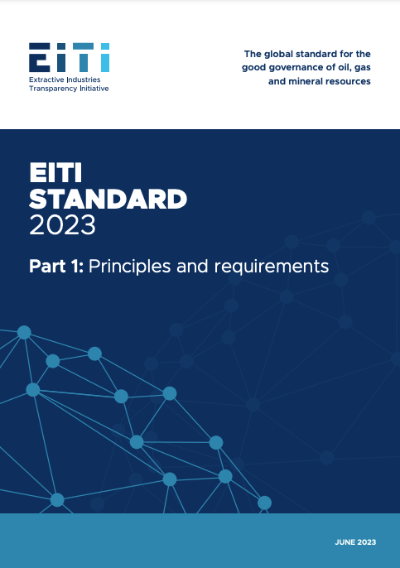
Social and environmental
REFLECTION
Strengthened provisions to promote:
Greater diversity in decision-making
Disclosures on social & environmental issues
Requirements: 2.1, 2.2, 5.2, 6.1, 6.4
Notes:
To help ensure that natural resources are managed in the interest of all citizens, there are strengthened provisions on promoting greater diversity in decision-making and disclosures that consider gender, social and environmental issues.
Note: There is a separate slide deck on gender. This presentation mostly addresses social/environmental issues.

Slide 5
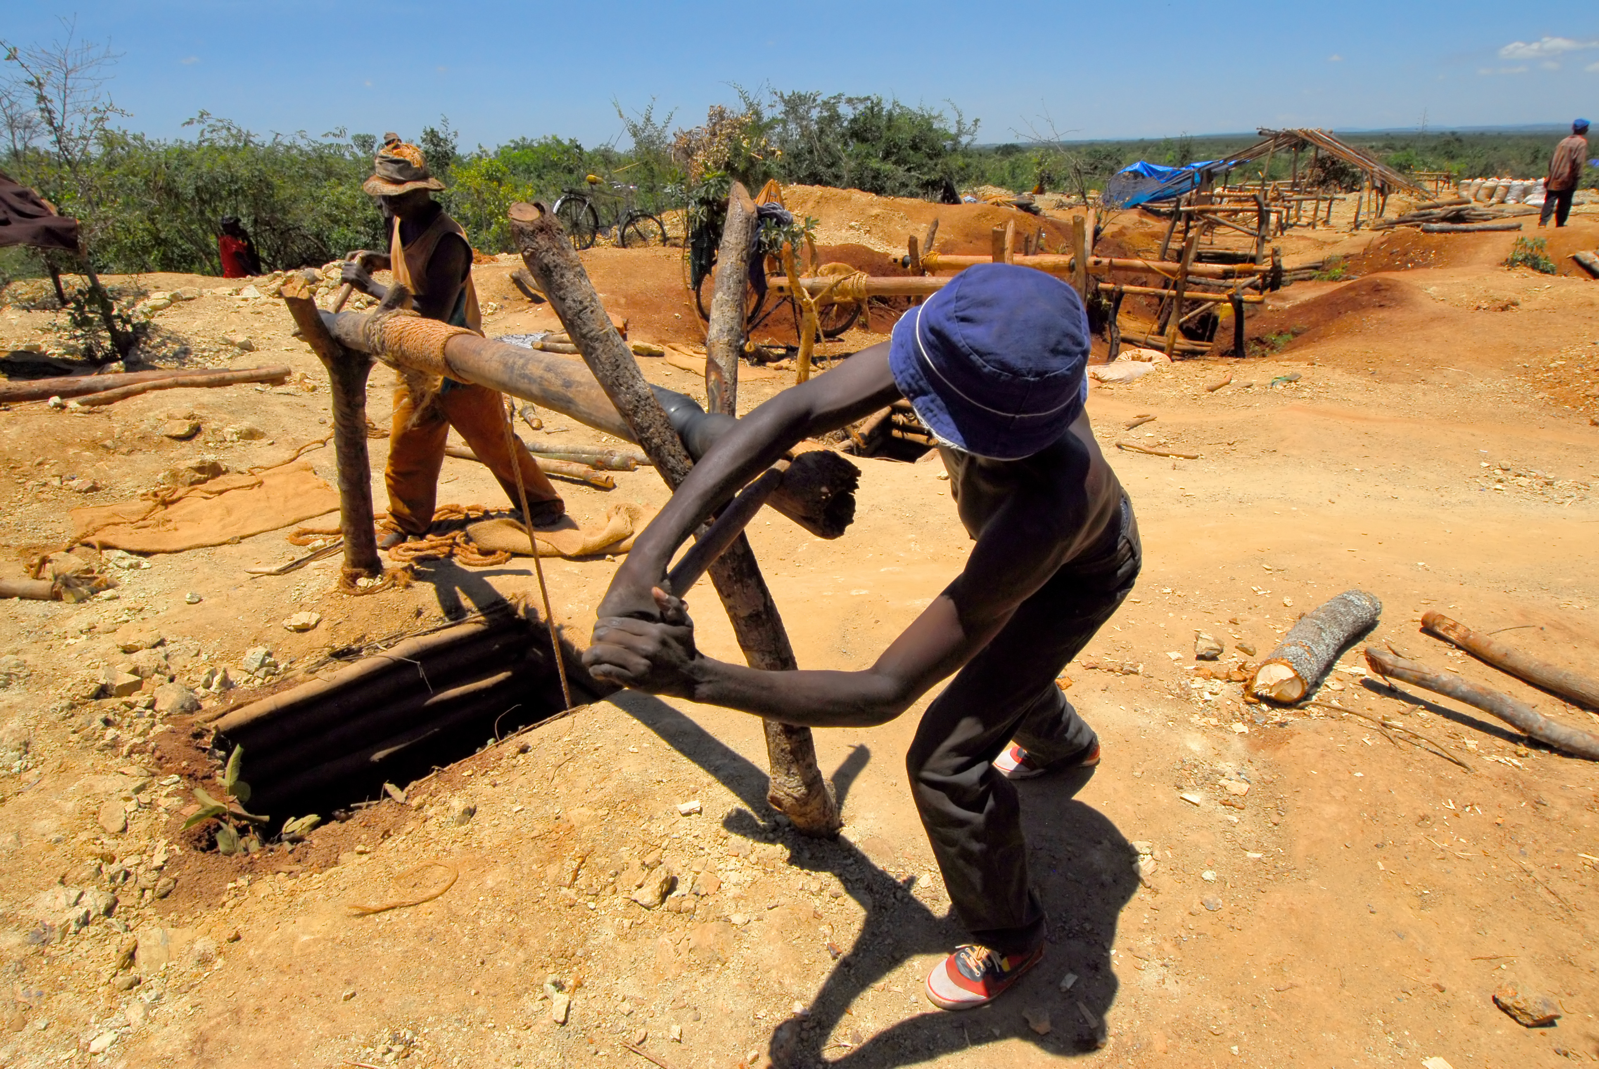
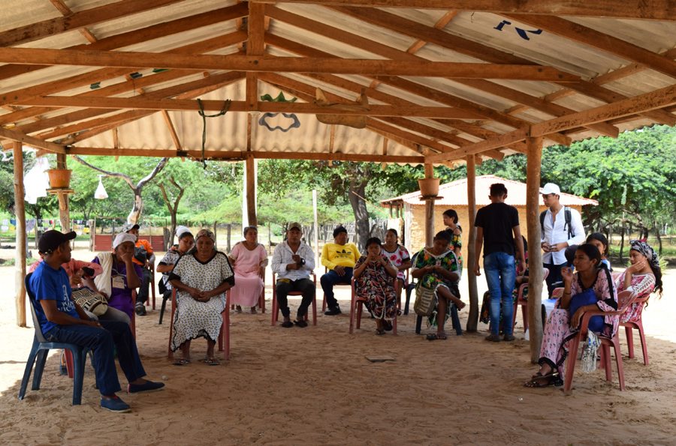
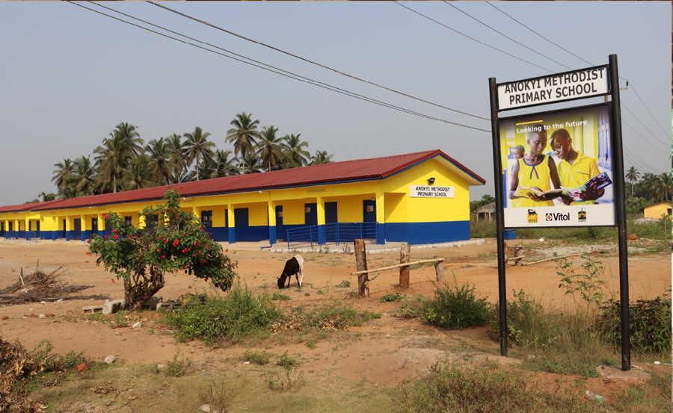
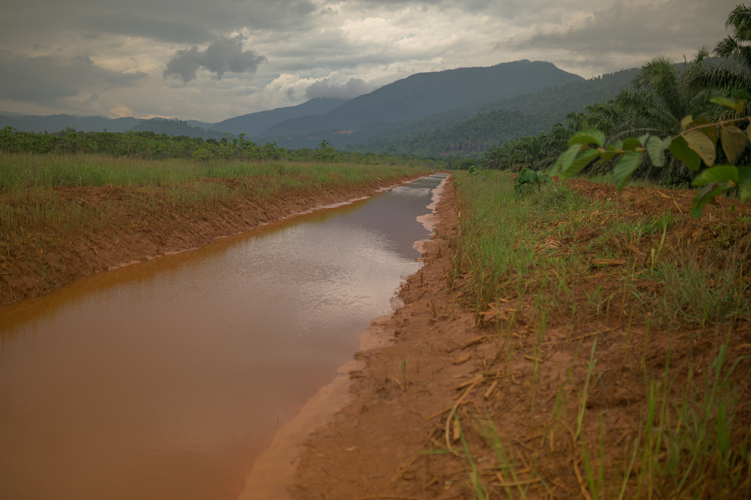
Key aspects
ARTISANAL &
SMALL-SCALE MINING
COMMUNITY CONSULTATION & CONSENT
BENEFITS TO COMMUNITIES
IMPACT
ASSESSMENTS
Notes:
When it comes to key changes to the EITI Standard that pertain to reporting on social & environmental issues, these can be broadly grouped into four categories:
ASM
Community consultation & consent
Benefits to communities
Impact assessments

Slide 6
KEY ASPECTS
Artisanal and small-scale mining

Slide 7
Summary
ARTISANAL AND SMALL-SCALE MINING
Primarily an informal sector, despite economic significance
True value of sector is overlooked
Demand for critical minerals heightens corruptions risks
Notes:
In many resource-rich developing countries, the extraction of minerals by artisanal and small-scale miners plays a significant role in national mineral production and economic activity. Despite its scale, ASM remains predominantly an informal sector. As such, the sector does not directly contribute to official government revenues and its true value is largely overlooked.
Obtaining detailed information about ASM’s scale, dynamics and economics can be challenging even in countries where ASM is regulated and where research has been undertaken.
Heightened demand for critical minerals has already resulted in a significant growth of ASM and exacerbated risks of corruption and revenue loss in the sector. Rising commodity prices may trigger more unregulated or illegal artisanal and small-scale mining (ASM).

Slide 8
Rationale
ARTISANAL AND SMALL-SCALE MINING
Provide understanding of ASM’s economic contribution
Clarify regulatory framework
Support anti-corruption efforts
Support reforms and formalisation plans
Notes:
Information and dialogue on ASM can help to address risks associated with informal mining. EITI reporting and multi-stakeholder dialogue can be used to:
Improve the governance of the sector by providing a better understanding of the extent to which ASM contributes to mineral production, government revenues, subnational revenues, employment and local livelihoods;
Provide clarity on the regulatory framework,
Support anti-corruption efforts and reduce the potential for conflict
Provide recommendations for reforms that could contribute to formalisation

Slide 9
ARTISANAL AND SMALL-SCALE MINING
Requirement 2.1(f)
Where applicable, implementing countries are encouraged to disclose policies related to the artisanal and small-scale mining sector, as well as information on planned or ongoing reforms.
Notes:
Objective of Req 2.1: to ensure public understanding of all aspects of the regulatory framework for the extractive industries, including the legal framework; fiscal regime; roles of government entities and reforms; as well as laws and regulations related to addressing corruption risks in the extractive sector.

Slide 10

Democratic Republic of the Congo
ARTISANAL AND SMALL-SCALE MINING
CASE STUDY
Scoping study on ASM used secondary data
and field visits
Mapping of stakeholders and revenue streams
Recommendations to MSG and reporting templates for entities
Source: PwC (2015), Rapport de l’Auditeur Independent sur l’Etude de Cadrage de la Couverture de l’Exploitation Minière Artisanale a l’est de la République Démocratique du Congo.
Notes:
CASE STUDIES CAN BE SUBSTITUTE TO MEET REGIONAL NEEDS.
A scoping study on ASM in the Democratic Republic of the Congo used a combination of secondary data and field visits to provide a roadmap on integrating ASM data in EITI reporting.
The study included a stakeholder mapping of various actors operating in the informal and semi-formal ASM sector, an overview of revenue streams stemming from ASM at the national and local levels (drawing on the ITSCI framework), recommendations to the MSG, and reporting templates for entities and individuals (merchants or traders, purchasing houses, processing entities, local and central authorities) that would be required to report.
Source: PricewaterhouseCoopers (2015), Rapport de l’Auditeur Independent sur l’Etude de Cadrage de la Couverture de l’Exploitation Minière Artisanale a l’est de la République Démocratique du Congo.

Slide 11
KEY ASPECTS
Community consultation and consent

Slide 12
Summary
COMMUNITY CONSULTATION AND CONSENT
Some countries require companies to consult affected communities or obtain free, prior and informed consent (FPIC)
The energy transition creates tensions between need for rapid development and time needed for meaningful community consultation
Notes:
In many countries, extractive companies are legally required to consult affected communities before an oil, gas or mining license is awarded.
In some cases, the free, prior and informed consent (FPIC) of Indigenous people is required for a project to move ahead.
Acceleration of the energy transition creates tensions between the pace required to attract investment and the implementation of projects on the one hand and the substantial timeframes needed for meaningful consultation and consent processes on the other. This situation is exacerbating risks across multiple governance dimensions.
In the race to secure minerals can increase governance risks related to the social and environmental impacts of mining. In their haste to obtain approval for mineral exploration and production, companies and governments may try to rush consultation processes. The consequences of these risks will be felt most strongly at the subnational level with the risk of approvals being granted without giving due consideration to the needs and priorities of communities and the environment.

Slide 13
Rationale
COMMUNITY CONSULTATION AND CONSENT
Impacted communities are informed about projects, can share views, and have their concerns addressed
Identify and address weaknesses in license allocation process
Notes:
Genuine and meaningful community consultation is critical for ensuring that impacted communities living near the extractive projects are fully informed about a proposed projects; have the opportunity to form and share their views; and have their concerns addressed.
In many countries, companies are legally required to consult affected communities before an oil, gas and mining license is awarded. In some cases, the free, prior and informed consent (FPIC) of indigenous people is required for a project to move ahead. This aims to ensure communities are part of the decision-making processes and that procedures for license awards are followed in practice.
This can allow stakeholders to identify and address possible weaknesses in the license allocation process, including those that make these processes vulnerable to corruption.

Slide 14
COMMUNITY CONSULTATION AND CONSENT
Requirement 2.2(a)(ii)
Where the process for awarding or transferring a license mandates consultations with impacted communities, countries and companies are expected to include a description of how the consultation process was conducted.
This could include the number of people consulted, disaggregated by gender, and a summary of how views on the project’s impacts were collected and considered.
Notes:
Objective of Req 2.2: to provide a public overview of awards and transfers of oil, gas and mining licenses; the statutory procedures for license awards and transfers; and whether these procedures are followed in practice. This can allow stakeholders to identify and address possible weaknesses in the license allocation process, including those that make these processes vulnerable to corruption.

Slide 15

Regulations and legislation
COMMUNITY CONSULTATION AND CONSENT
CASE STUDY
Convention 169 of the International Labor Organization (ILO) protects right of Indigenous peoples to be consulted
Colombia issued a presidential directive on procedure for developing a consultative process
Notes:
CASE STUDIES CAN BE SUBSTITUTE TO MEET REGIONAL NEEDS.
Countries signatories to Convention 169 of the International Labor Organization (ILO) have a specific obligation to protect the right of indigenous peoples to be consulted on measures which may affect them directly, including prior to exploration or explotation of subsurfaces resources.
EITI implementing countries signatories to the convention: Argentina, Colombia, Dominican Republic, Ecuador, Germany, Guatemala, Mexico, Netherlands, Norway, Peru.
Colombia in order to implement ILO Convention 169, issued the Presidential Directive 10 of 26 March 2013, which outlines the procedure for developing the consultative process, in accordance with the traditions and beliefs of the ethnic communities.

Slide 16
COMMUNITY CONSULTATION AND CONSENT
COMPANY POLICIES ON FPIC
Ecopetrol publishes information on its consultations processes
Shell’s statements on Indigenous Peoples and working with communities
BHP’s Indigenous Peoples Policy Statement
Anglo American’s Task 7 – Obtain and retain agreement free, prior and informed consent
Repsol’s Human Rights and Community Relations Policy
Notes:
Countries signatories to Convention 169 of the International Labor Organization (ILO) have a specific obligation to protect the right of indigenous peoples to be consulted on measures which may affect them directly, including prior to exploration or explotation of subsurfaces resources.
EITI implementing countries signatories to the convention: Argentina, Colombia, Dominican Republic, Ecuador, Germany, Guatemala, Mexico, Netherlands, Norway, Peru.
Colombia in order to implement ILO Convention 169, issued the Presidential Directive 10 of 26 March 2013, which outlines the procedure for developing the consultative process, in accordance with the traditions and beliefs of the ethnic communities.

Slide 17
KEY ASPECTS
Benefits to communities

Slide 18
Summary
BENEFITS TO COMMUNITIES
Benefits from the extractive sector are often not equally distributed between different social groups
Negative impacts of extraction have been known to adversely affect women and marginalised groups living near extractive activities

Slide 19
Rationale
BENEFITS TO COMMUNITIES
Disaggregated data (e.g. gender)
can help:
Analyse the efficiency of revenue allocation policies and regulations
Build credibility with local communities by addressing emerging priorities
Support data-driven advocacy efforts
Notes:
All constituencies can benefit from reporting not only revenue allocation, but also revenue management at the local level.
More detailed disaggregation (for example, by gender) can help:
Analyse the efficiency of revenue allocation policies and regulations;
Build credibility with local communities by addressing emerging priorities;
Support data-driven advocacy efforts.

Slide 20
BENEFITS TO COMMUNITIES
Requirement 5.2(c)
Countries are encouraged to report on […] how extractive revenues earmarked for specific programmes or investments at the subnational level are managed, as well as how those programmes address women and other marginalised groups.
Notes:
Objective of Req 5.2: to enable stakeholders at the local level to assess whether the transfer and management of subnational transfers of extractive revenues are in line with statutory entitlements.

Slide 21
BENEFITS TO COMMUNITIES
Requirement 6.1(d)
Countries are encouraged to […] provide gender disaggregated data on the beneficiaries of social and environmental expenditures and transfers.

Slide 22

Tracing mining revenues in Mali
BENEFITS TO COMMUNITIES
CASE STUDY
A study by ITIE Mali examines revenue allocations by region, emphasising those allocated to youth, infrastructure services for women and women’s organisations (Requirement 5.2).
Notes:
CASE STUDIES CAN BE SUBSTITUTE TO MEET REGIONAL NEEDS.
Countries signatories to Convention 169 of the International Labor Organization (ILO) have a specific obligation to protect the right of indigenous peoples to be consulted on measures which may affect them directly, including prior to exploration or explotation of subsurfaces resources.
EITI implementing countries signatories to the convention: Argentina, Colombia, Dominican Republic, Ecuador, Germany, Guatemala, Mexico, Netherlands, Norway, Peru.
Colombia in order to implement ILO Convention 169, issued the Presidential Directive 10 of 26 March 2013, which outlines the procedure for developing the consultative process, in accordance with the traditions and beliefs of the ethnic communities.

Slide 23
KEY ASPECTS
Environmental, social and impact assessments

Slide 24
Summary
ENVIRONMENTAL, SOCIAL AND IMPACT ASSESSMENTS
Impact assessments of oil, gas and mining projects are often public documents, they can be challenging to access, especially for communities affected by extractive activities.
Notes:
While environmental, social and gender impact assessments of oil, gas and mining projects are often public documents, they can be challenging to access, especially for communities affected by extractive activities. Countries and companies are now required to ensure that these documents are accessible to the public.

Slide 25
Rationale
ENVIRONMENTAL, SOCIAL AND IMPACT ASSESSMENTS
Data can help:
Analyse the implementation of environmental, social and gender regulations;
Build credibility with local communities by addressing emerging priorities
Support data-driven advocacy efforts
Notes:
Objective of the EITI disclosure provisions is to provide a basis for stakeholders to assess the adequacy of the regulatory framework and monitoring efforts to manage the environmental and social impact of extractive industries, and to assess extractive companies’ adherence to environmental and social obligations.
This data can help:
Provide access to environmental, social and gender impact assessments for further analysis and monitoring;
Analyse implementation of environmental, social and gender impact assessments;
Build credibility with local communities by addressing emerging priorities;
Support data-driven advocacy efforts.

Slide 26
ENVIRONMENTAL, SOCIAL AND IMPACT ASSESSMENTS
Requirement 6.4(a)
Countries and companies are required to disclose an overview of […] information on rules regarding environmental permits and licenses, including social, gender and environmental impact assessments.

Slide 27
ENVIRONMENTAL, SOCIAL AND IMPACT ASSESSMENTS
Requirement 6.4(b)
Countries and companies are required to ensure that environmental, social and gender impact assessments and monitoring reports […] are accessible to the public.

Slide 28
ENVIRONMENTAL, SOCIAL AND IMPACT ASSESSMENTS
Requirement 6.4(c)
Companies are encouraged to disclose further information about their social, gender and environmental management and impact.

Slide 29

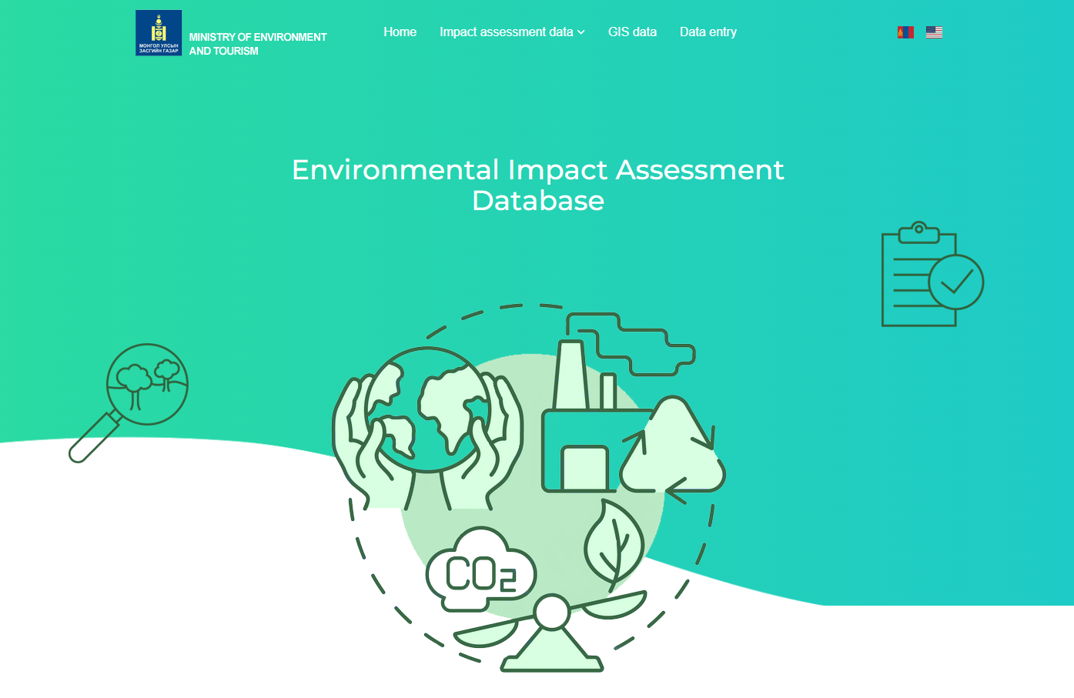
ENVIRONMENTAL, SOCIAL AND IMPACT ASSESSMENTS
CASE STUDY
Mongolia
Environmental Information Centre website:
database of approved environmental
impact assessments and environmental audit reports
Mongolia’s EITI reporting: Overviews of EIAs and environmental remediation plans and contributions to environmental rehabilitation funds.
Notes:
CASE STUDIES CAN BE SUBSTITUTE TO MEET REGIONAL NEEDS.

Slide 30
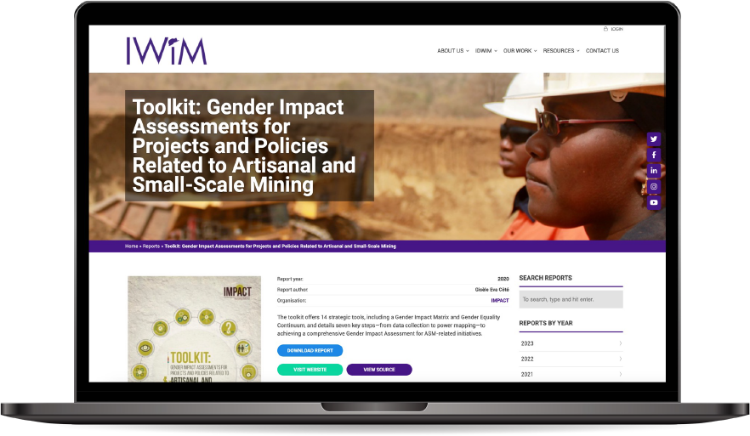
ENVIRONMENTAL, SOCIAL AND IMPACT ASSESSMENTS
TOOLKIT
Gender impact assessments
A toolkit by IMPACT offers strategic tools and steps to support gender impact assessments on ASM
Notes:
CASE STUDIES CAN BE SUBSTITUTE TO MEET REGIONAL NEEDS.

Slide 31
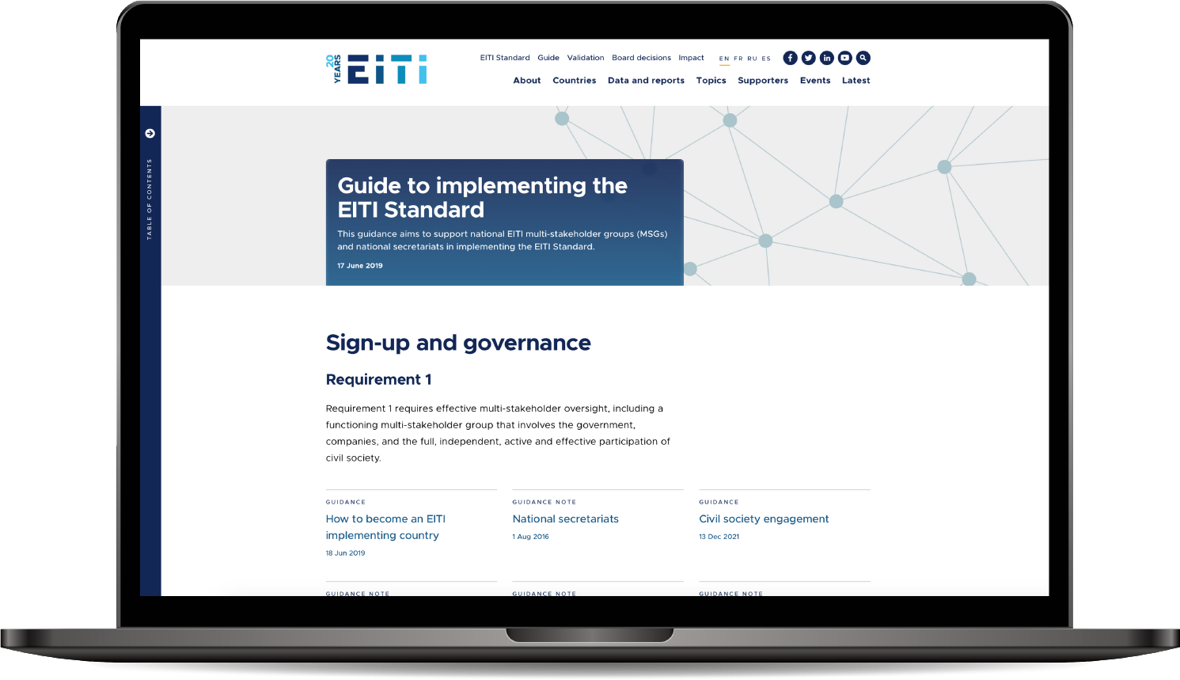

Consult our guidance at eiti.org/guide

Slide 32
Questions?

Slide 33
E-MAIL secretariat@eiti.org PHONE +47 22 20 08 00
ADDRESS EITI International Secretariat, Rådhusgata 26, 0151 Oslo, Norway

