Slide 1
Norme ITIE 2023 : Principaux changements
Lutte contre la corruption

Slide 2
Prévalence de la corruption dans les industries extractives
Secteur à haut risque
Importants flux de recettes
Secteur complexe et technique
Affaires retenant l’attention du public
Certain flou entre l’intérêt des actionnaires, et les intérêts purement privés et ceux du secteur public ; participation des PPE dans les projets extractifs
20 % des actions engagées dans le cadre de la loi américaine (Foreign Corrupt Practices Act, ou FCPA)
Négociations de haut niveau et mécanismes décisionnels discrétionnaires
Nombre insuffisant d’experts, ou de freins et de contrepoids
Notes:
Scene setting...
Corruption is a pressing challenge for many resource-rich countries. The lack of transparency and accountability has created opportunities for corrupt individuals, officials, companies and entities to exploit natural resources revenues for their own benefit. The statistics are alarming: Africa loses approximately $88.6 billion annually in illicit financial flows, equivalent to 3.7 percent of Africa’s GDP, as per the UN (United Nations) Conference on Trade and Development.
The prevalence of extractive sector corruption has led the EITI to face some tough questions: Why hasn’t the EITI prevented extractive sector corruption from cropping up in its member countries? Why didn’t its reports expose these scandals? What role can the EITI realistically play in fighting corruption?

Slide 3
Quels sont les maillons de la chaîne de valeur de l’industrie extractive les plus exposés aux problèmes de corruption ?
RÉFLEXION
Notes:
Ask the audience to respond to this questions and summarise their replies. Potential replies that you could highlight:
Transparency enables detection/identification of risks or vulnerabilities to risks
Transparency empowers citizens to monitor corrupt practices
Transparency increases understanding of types of corruption risks, how they occur
Transparency deters corrupt behavior
Transparency stimulates debates /policies that are essential to fight corruption

Slide 4
Les risques de corruption dans le secteur extractif
LICENCES
CONTRATS
PROPRIÉTÉ EFFECTIVE
ENTREPRISES D’ÉTAT
Pots-de-vin
Collusion
Ingérence politique
Influence indue
Absence de procédures concurrentielles
Ingérence politique
Non-respect de la législation fiscale
Conflits d’intérêts
Conflits d’intérêts
Flux financiers illicites
Sociétés écrans
Blanchiment d’argent
Abus d’autorité
Conflits d’intérêts
Flux financiers opaques
Détournement de fonds
Notes:
LICENSES & LICENSE ALLOCATION: Exploration and production licenses are the industry’s most valuable prizes, and competition for them creates all kinds of corruption risks.
CONTRACTS: contractual terms sit at the heart of some extractive sector corruption cases, with questions arising about whether the parties to the deal received an overly lucrative deal. With the contract in hand, anti-corruption actors can ask well-informed questions about whether the company received terms that deviate from industry or market norms.
BENEFICIAL OWNERSHIP: Assuming the information is verified and reliable, regulators, law enforcement and oversight actors can use BO data to assess to holds the license. BO data can also inform public debate about conflict of interest policies and other important anti-corruption measures. Past corruption cases reveal how PEPs have used front companies to receive lucrative extractive sector licenses, and BO disclosure could be useful in detecting and deterring this kind of behavior.
SOEs: SOEs receive huge amounts of funds, often operate apart from standard government oversight systems, and some have proven susceptible to both bribery and rent-seeking activities. In some cases, the misappropriation of SOE revenues impedes the company’s performance and its ability to meet its contractual obligations. For these reasons, SOEs sit at the center of many prominent corruption cases. Brazil’s Petrobras is perhaps the most famous case, but it’s far from alone.

Slide 5
Les risques de corruption dans le secteur extractif
PREMIÈRES VENTES
RECOUVREMENT ET FLUX DE RECETTES
PAIEMENTS INFRANATIONAUX
TRANSITION ÉNERGÉTIQUE
Avantages injustes
Secteur informel
Négociations et procédures d’octroi de licences rapides
Raccourcis réglementaires
Devoir de diligence mal exercé
Spéculations frauduleuses sur les réserves
Appels d’offres opaques
Critères de référence inappropriés
Conditions contractuelles déséquilibrées
Acquéreurs non qualifiés
Manipulation des prix
Malversations
Blanchiment d’argent
Fausses factures
Fausses déclarations et évasion fiscales
Exonérations fiscales défavorables
Malversations
Détournement de fonds
Mécanismes de transfert opaques
Notes:
IEA 2020 - their share of total demand rises significantly over the next two decades to over 40% for copper and rare earth elements, 60-70% for nickel and cobalt, and almost 90% for lithium. EVs and battery storage have already displaced consumer electronics to become the largest consumer of lithium and are set to take over from stainless steel as the largest end-user of nickel by 2040. https://www.iea.org/reports/the-role-of-critical-minerals-in-clean-energy-transitions/executive-summary
Transition minerals are in countries with huge informal sectors (e.g. Cobalt. Total demand is expected to rise by 60-70% by 2040. 10 per cent of the global supply of cobalt, and 20 percent of the DRC’s total cobalt exports, comes from ASM operations.
The Democratic Republic of Congo (DRC) is the world’s leading source of mined cobalt, supplying approximately 70% of Global cobalt mine production (Source: United States Geological Survey). https://www.cobaltinstitute.org/cobalt-mining-in-the-democratic-republic-of-congo/
10 per cent of the global supply of cobalt, and 20 per cent of the DRC’s total cobalt exports, comes from ASM operations https://www.iisd.org/story/green-conflict-minerals/
(e.g. children have been found to be present at about 30% of cobalt ASM sites in the DRC) IEA, 2021.
Corruption risks were taken from OECD Report on Supply Chains https://mneguidelines.oecd.org/Interconnected-supply-chains-a-comprehensive-look-at-due-diligence-challenges-and-opportunities-sourcing-cobalt-and-copper-from-the-DRC.pdf

Slide 6
Une approche axée sur les données pour lutter contre la corruption
La Norme ITIE couvre
Ressources naturelles
Contrats et licences
Recouvrement des recettes
Allocation des recettes
Dépenses économiques et sociales
Utilité publique
Production
Contrats
Propriété effective
Données relatives aux licences
Activités de prospection
Chiffres de production
Chiffres d’exportation
Recettes fiscales
Ventes effectuées par le gouvernement et les entreprises d’État
Accords d’infrastructure et de partenariat
Gestion des recettes
Répartition des recettes
Transferts infranationaux
Contributions liées à la RSE
Dépenses quasi budgétaires
Contribution à l’économie nationale
Emploi par sexe
Impact sur l’environnement
Notes:
The EITI Standard requires countries and companies to disclose information on the key steps in the governance of oil, gas and mining revenues, which we call the EITI value chain.
Here is a short overview what the value chain steps cover:
Legal framework, distribution of licenses and contracts This section sets the stage of how the sector is governed, particularly in relation to the rights to extract.
Exploration and production This covers information on what exploration activities are under way and how much the country produces and exports.
Revenue collection The major companies disclose what they pay to the government in tax, royalties, signature bonuses, etc. The government discloses what it receives. The figures are broken down by company, project and revenue stream.
Revenue allocation Once revenues are collected from companies, they need to be recorded in government accounts. Usually, most of the revenue goes to the central government. Sometimes it goes straight to or is transferred to the subnational government or to special funds or projects.
Social and economic spending This covers some of the ways the extractive sector is contributing to social and economic development. Companies disclose where funds have been mandated to be spent on social projects. The government is asked to publish information about the role of the extractive sector in the economy. How many people are employed in the sector? How important is the contribution of the sector to the economy? This allows citizens to understand the importance of oil, gas and mining in their country.
Common questions asked when detecting corruption:
Licensing and contracting:
What are the rules for licensing/contracting and are these rules followed? IF not, what were the motivations for not following them? E.g. undue favor given to high-level/influential individuals
What are the terms of the extractive contracts? Are these terms fair or do they unduly favor certain parties? How?
Who ultimately benefits from these contracts?
Revenue collection
Are the right payments made to the government?
Do these payments reach the national budget?
How are they spent? Who benefits from these payments?
State participation
How much does the state /SOEs get in extractive sector revenues?
How do revenues flow from the state to SOEs?
Social and environmental obligations
What are these obligations and how were they negotiated?
Who benefits from these social and environmental obligations?
How are they enforced? What are the motivations for enforcing them?
Production, exports, commodity trading
How is production valued and is it accurate?
Who are we trading with and on what terms?

Slide 7
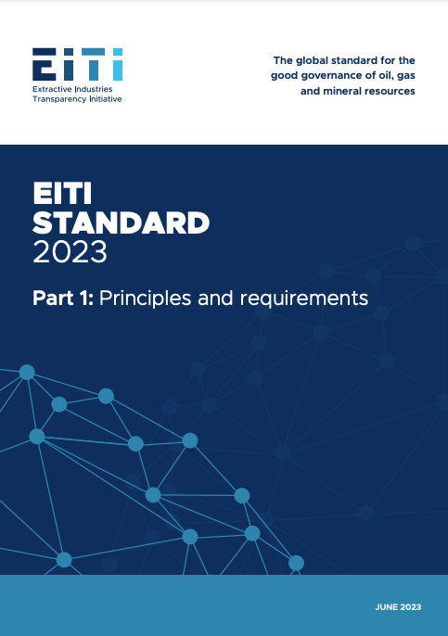
Lutte contre la corruption
La Norme ITIE 2023 offre aux pays et aux entreprises la possibilité d’utiliser la plateforme ITIE pour identifier et contrôler les risques de corruption dans le secteur des ressources naturelles.
Notes:
Since 2020, the EITI has been strengthening its work on anti-corruption, recognising the unique opportunity for EITI implementation to address corruption and governance risks in the natural resource sector.
For the first time, the 2023 EITI Standard explicitly reflects anti-corruption in the objectives and text of several EITI Requirements.
It includes provisions to help EITI implementing countries identify areas across the extractive sector value chain that are vulnerable to corruption, without imposing burdensome reporting requirements.
In addition, all companies participating in EITI reporting are now expected to disclose their anti-corruption policies.

Slide 8
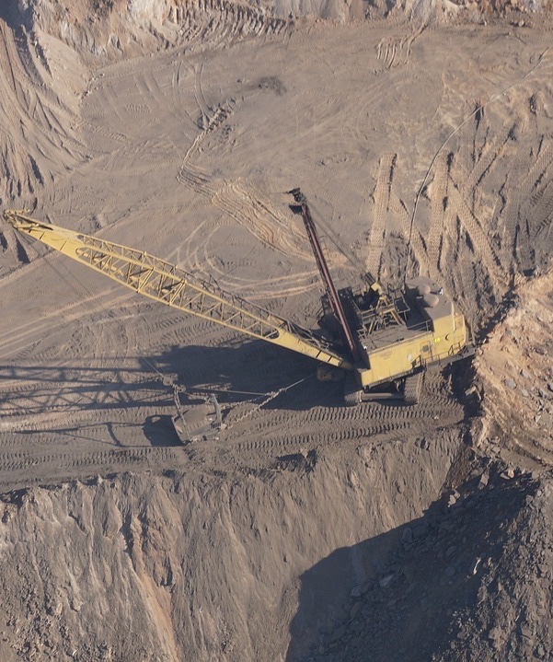
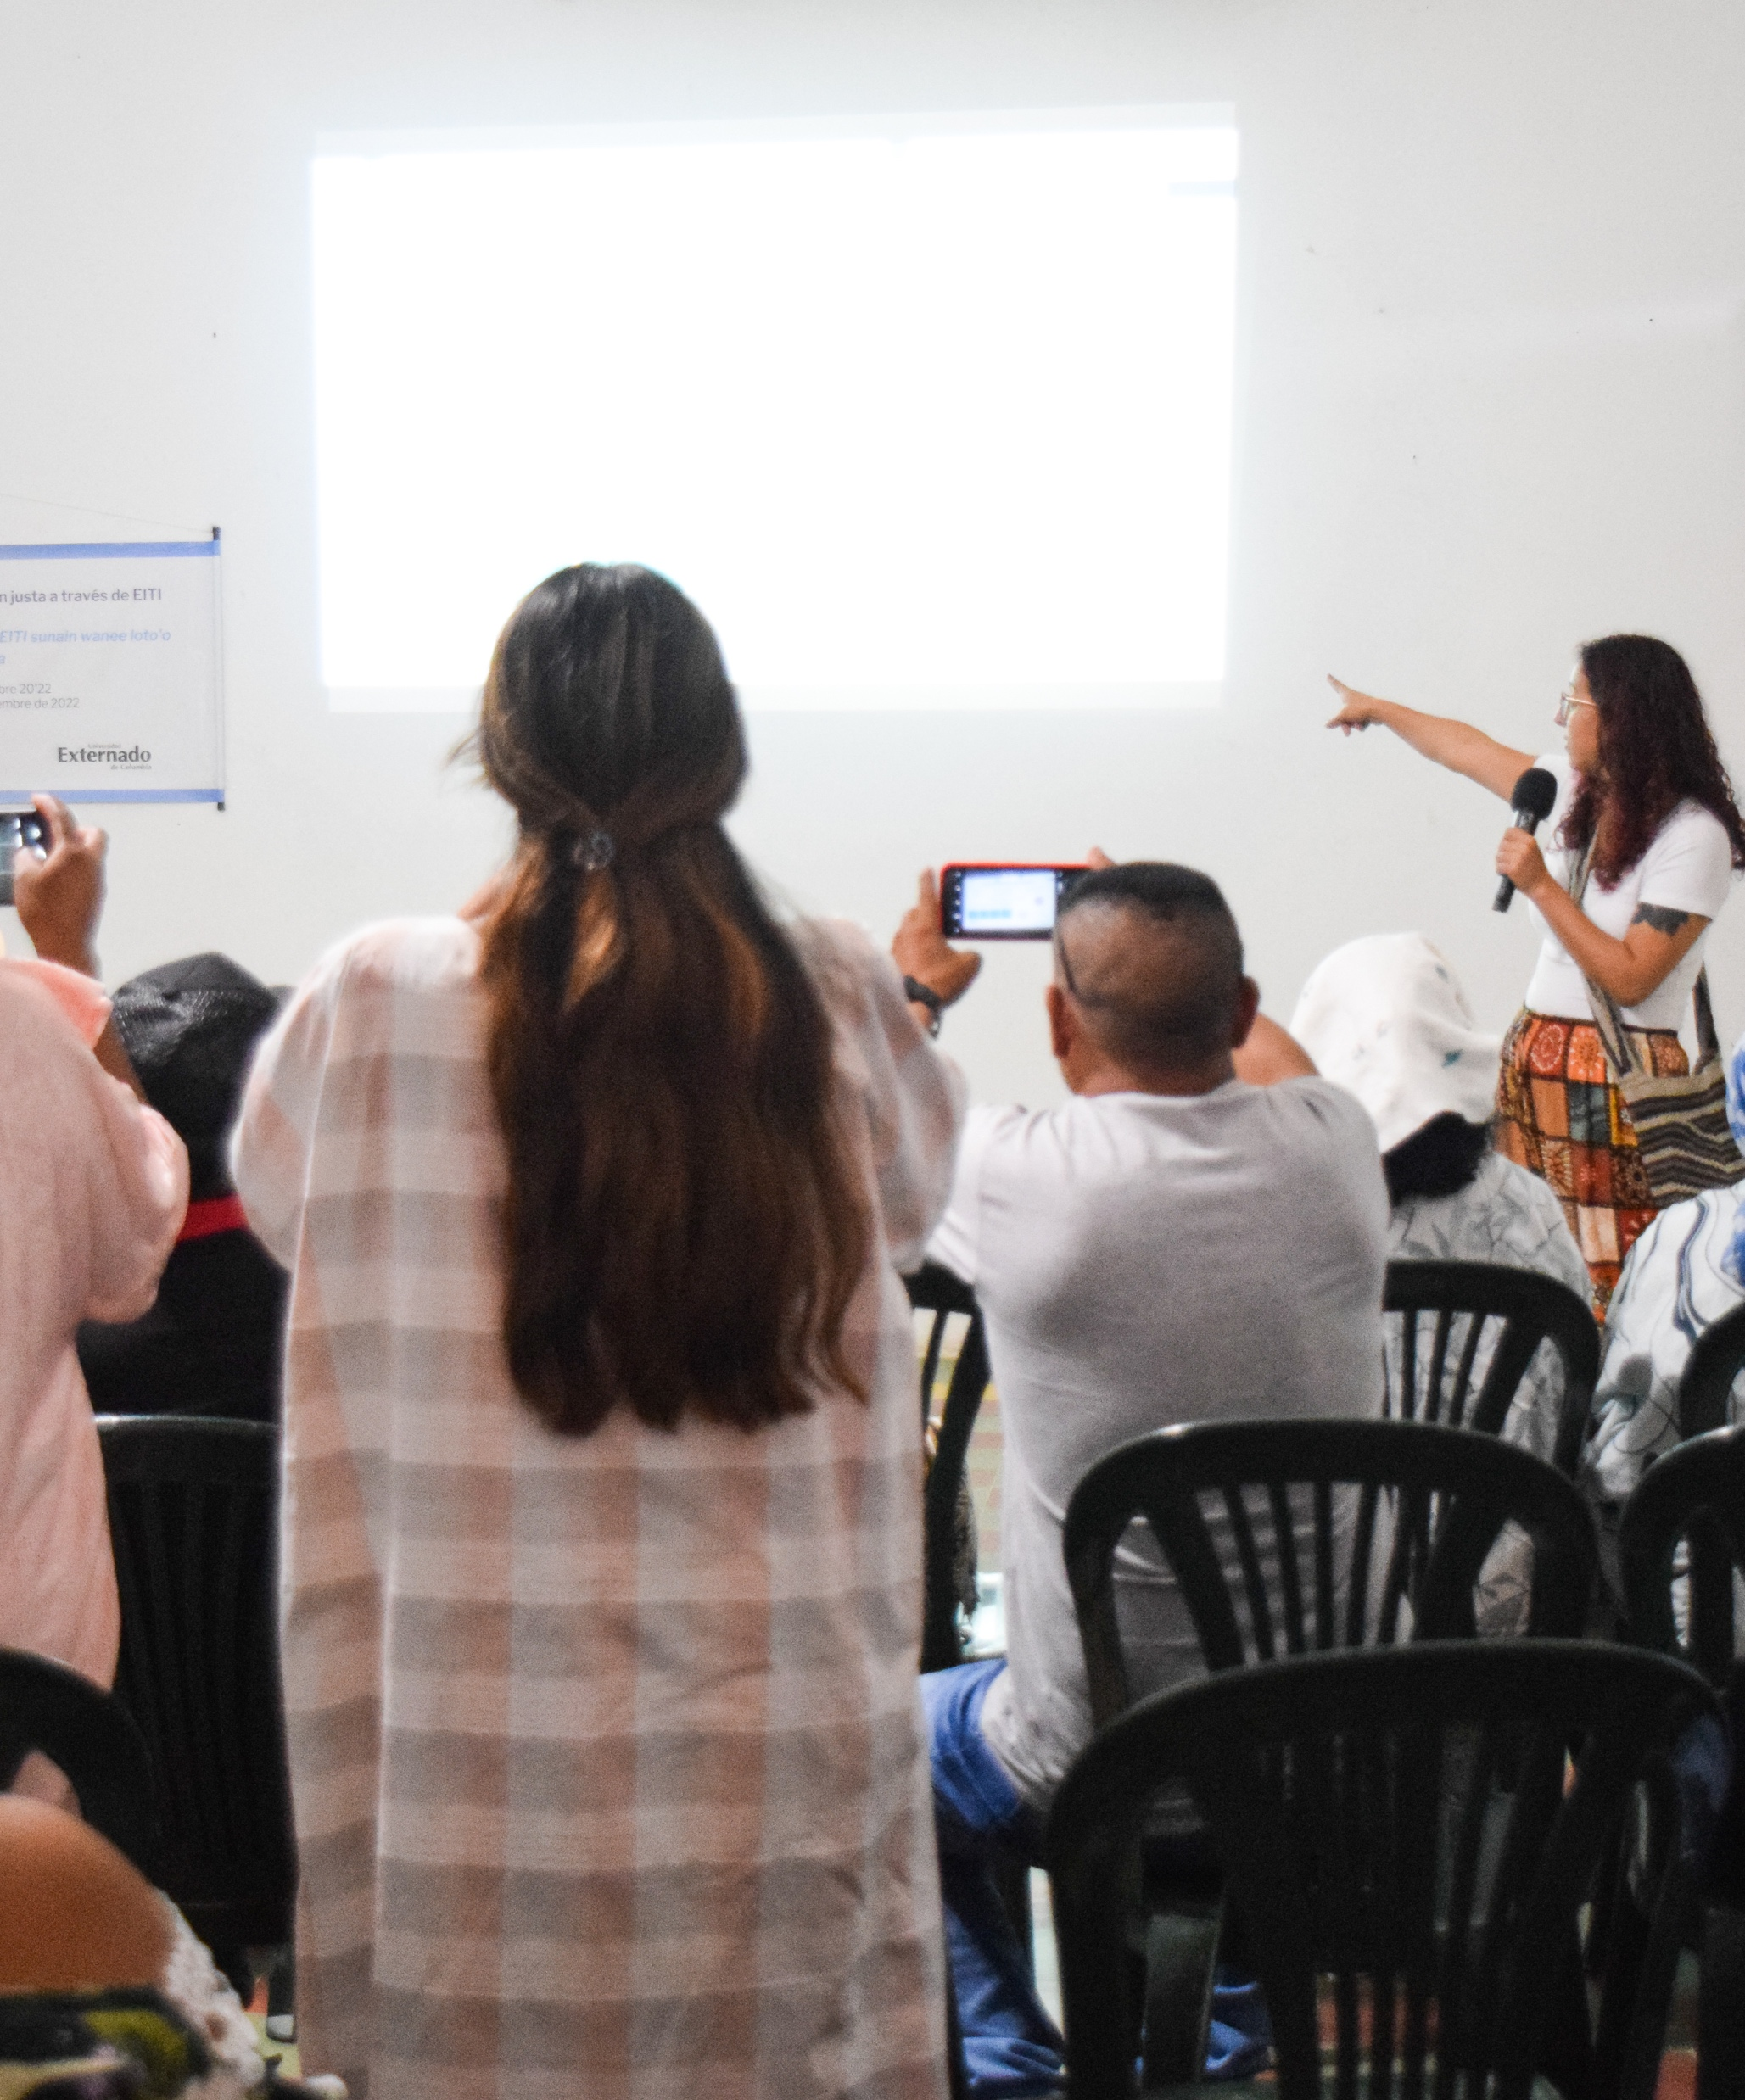
Domaines clés
CADRE JURIDIQUE, LICENCES
CONTRATS
PROPRIÉTÉ EFFECTIVE
EXPLORATION, PRODUCTION ET RECETTES
SUPERVISION DU GROUPE MULTIPARTITE

Slide 9
DOMAINE CLÉ
Cadre juridique et octroi des licences

Slide 10
Justification
CADRE JURIDIQUE ET OCTROI DES LICENCES
Comprendre le cadre juridique et institutionnel de lutte contre la corruption
Identifier les points faibles et les vulnérabilités dans l’octroi des licences et la gouvernance des entreprises d’État
Améliorer l’accès du public aux données pour limiter le risque de corruption
Notes:
Summary
Disclosure of related anti-corruption laws
Explanation of deviations from laws
Rationale for adopting certain methods for awarding licenses (e.g. for fast-tracked approvals)
Linking license information with beneficial ownership data
Understand the legal and institutional framework to fight corruption
EITI reports can provide comprehensive data on laws, regulations and institutional mandate to address corruption in the extractive industry. By analysing this information, stakeholders can assess the effectiveness of existing legal and institutional frameworks in curbing corruption.
Promoting accountable license and contract awards
License and contract awards are often susceptible to corruption. This challenge is particularly apparent in the transition minerals sector where growing demand can drive an uptick in investments. EITI disclosures play a role in mitigating these risks by strengthening transparency on license and contract awards.
EITI reports include information on license allocations, detailing who holds the rights to exploit natural resources. Stakeholders can scrutinise this data to identify any lack of transparency or fairness in the license allocation process.
The information disclosed by the EITI helps in detecting vulnerabilities, such as non-competitive bidding or favouritism, that could lead to corruption in the allocation of resource licenses.
Disclosures related to award criteria and processes can enable stakeholders to understand whether decision-making is transparent and competitive.
Strengthening SOE governance
A significant proportion of recent corruption cases in the oil, gas and mining sectors have involved SOEs. As SOEs pursue new business opportunities in the context of the energy transition, corruption risk may surface in areas such as the use of agents and intermediaries, supplier and contractor selection, and commodity trading.
EITI disclosures can help to strengthen SOE governance.

Slide 11
CADRE JURIDIQUE ET OCTROI DES LICENCES
Exigence 2.1 (a)
Il est exigé des pays qu’ils divulguent une description du cadre juridique, incluant les lois relatives à la prévention de la corruption dans le secteur extractif.
Notes:
The 2023 EITI Standard requires the disclosure of national energy transition commitments, policies and plans relevant to the extractive industries. This could include, for example, relevant nationally determined contributions, policies to phase down or phase out fossil fuels, transition mineral strategies, or just transition plans.
This information can shed light on the relationship between government policy on climate, energy and extractives and support better alignment and coordination.

Slide 12
CADRE JURIDIQUE ET OCTROI DES LICENCES
Exigence 2.2 (a.iv)
Les pays sont tenus de divulguer les informations relatives aux écarts importants par rapport au cadre légal et réglementaire applicable, régissant les attributions et transferts de licences.
Notes:
Implementing countries are required to disclose information related to all contract and license awards and transfers taking place during the accounting period covered by the most recent EITI disclosures, including for companies whose payments fall below the agreed materiality threshold. This must include:
iv. Any material deviations from the applicable legal and regulatory framework governing license transfers and awards, including an explanation of the methodology adopted for the assessment.

Slide 13
CADRE JURIDIQUE ET OCTROI DES LICENCES
Exigence 2.2 (a)
Dans les cas où les gouvernements peuvent sélectionner différentes méthodes d’attribution des contrats ou licences (p. ex. appels d’offres ou négociations directes), le groupe multipartite est encouragé à fournir une explication des règles déterminant la procédure à suivre et des raisons pour lesquelles une procédure particulière a été retenue.
Notes:
2.2 a: This includes instances where governments use expedited or “fast-tracked” awards or transfer processes. The multi-stakeholder group must clearly document the rationale for this choice; the award or transfer processes to which these processes applied; the procedures and criteria used; the institutions involved; and the outcomes of the award and transfer processes. countries are required to disclose information related to… any material deviations from the applicable legal and regulatory framework governing license transfers and awards

Slide 14
CADRE JURIDIQUE ET OCTROI DES LICENCES
Exigence 2.2 (a)
Lorsque les gouvernements ont recours à des procédures rapides ou « accélérées » d’attribution ou de transfert (de licences), le groupe multipartite doit documenter :
Les raisons de ce choix
Les conditions d’attribution ou de transfert auxquelles ces procédures s’appliquent
Les procédures et les critères utilisés
Les institutions y prenant part
Les résultats des procédures d’attribution et de transfert
Notes:
Implementing countries are required to disclose information related to all contract and license awards and transfers taking place during the accounting period covered by the most recent EITI disclosures, including for companies whose payments fall below the agreed materiality threshold. This must include:
2.2 a: This includes instances where governments use expedited or “fast-tracked” awards or transfer processes. The multi-stakeholder group must clearly document the rationale for this choice; the award or transfer processes to which these processes applied; the procedures and criteria used; the institutions involved; and the outcomes of the award and transfer processes. countries are required to disclose information related to… any material deviations from the applicable legal and regulatory framework governing license transfers and awards

Slide 15
CADRE JURIDIQUE ET OCTROI DES LICENCES
Exigence 2.3 (d)
Les pays sont encouragés à relier les registres de licences accessibles au public à d’autres plateformes gouvernementales en ligne, conformément à l’Exigence 2.5 sur la divulgation des bénéficiaires juridiques et effectifs des entreprises extractives.
Notes:
2.3 d) Implementing countries are encouraged to link publicly available license registers to other government platforms that disclose or hold information in accordance with Requirement 2.5 on the legal and beneficial owners of oil, gas and mining companies.

Slide 16
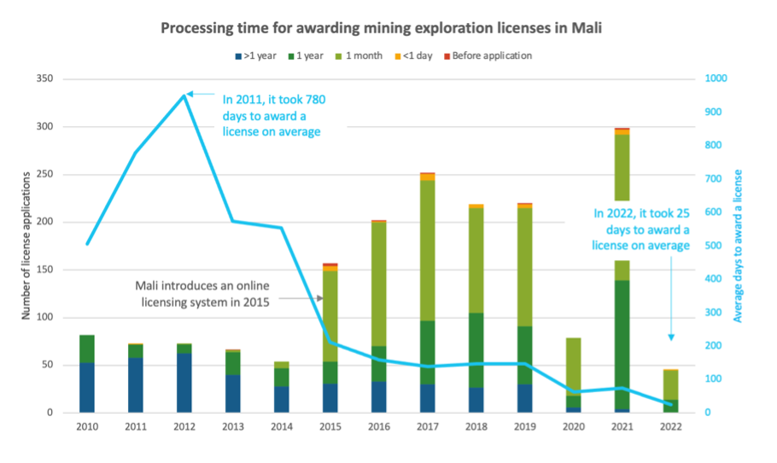
CADRE JURIDIQUE ET OCTROI DES LICENCES
ÉTUDE DE CAS
Mali
Une analyse des informations relatives aux licences, provenant des divulgations ITIE, montre que le délai d’octroi des licences a diminué au fil du temps.
Notes:
Mali is Africa's third-largest gold producer, experienced a 23% increase in industrial gold production in 2018 due to new discoveries.
From 2010 to 2022, around 1,700 exploration licenses were granted in the country.
The EITI International Secretariat conducted an analysis of license data systematically disclosed by Mali's Ministry of Mines, Energy and Water
The analysis Illustrates how the period for awarding licensing (from the moment of application) has improved over time.
This may suggest improvements in the efficiency of licensing processes. However, it also raises concerns about vulnerabilities in the process, particularly in instances where licenses were apparently awarded before their applications.
Investigations of outliers can help understand
Potential risks associated with the owners
Whether the practice of license awards is consistent with the analysis of the rule
Compliance risks
These insights can be used to enhance oversight of licensing processes and ensure they adhere to established protocols, promoting transparency and accountability in Mali's extractive sector.
--
Key findings
The (monthly) average time taken to award prospection and exploration licenses (calculated as the difference between the dates of applications and of award) has declined over the 2010-2022 period, with a sharp decline from 2015 onwards.
· The time for awarding prospection and exploration licenses has become more consistent for all such licenses over time, particularly since 2020 onwards.
· The time for awarding prospection and exploration licenses does not appear to correlate to the type of prospection and exploration license awarded.
· The average time for awarding prospection and exploration licenses continues to exceed the 45 day limit set in the 2019 Mining Code, including for licenses awarded since the implementation of the 2019 Mining Code in November 2020.
· There are several (older) prospection and exploration licenses whose date of award is recorded as pre-dating the date of application.

Slide 17
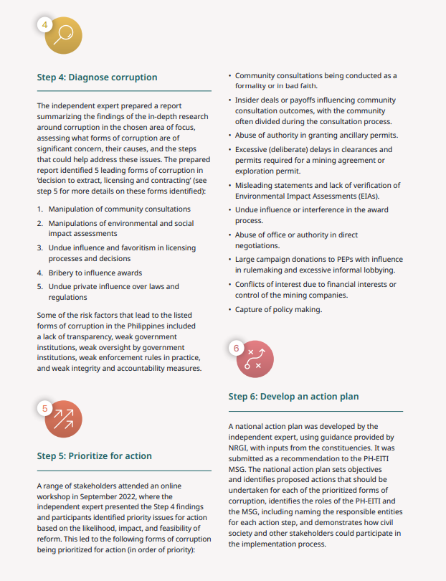
CADRE JURIDIQUE ET OCTROI DES LICENCES
ÉTUDE DE CAS
Philippines
Pays grand producteur de nickel, minéral de transition clé
Étude approfondie sur les risques ou le manque d’intégrité dans l’octroi de licences pour l’exploitation du nickel
Élaboration d’un plan d’action par le Groupe multipartite pour atténuer les risques
Notes:
The Philippines is one of the world’s top producers of nickel, an important transition mineral that is expected to see growing demand due to its use in a range of low-carbon technologies.
To better understand potential corruption risks related to nickel extraction, the Philippines EITI commissioned an integrity study with support from USAID in 2023.
The study used a corruption diagnostic tool, developed by NRGI, to conduct an in-depth investigation of integrity risks, including in the licensing and contracting procedures for large-scale nickel mines.
It provided recommendations for mitigating governance and corruption risks, as well as an action plan for the Philippines EITI to address priority risks and strengthen its anti-corruption work.

Slide 18
DOMAINE CLÉ
Contrats

Slide 19
Justification
CONTRATS
Améliorer la capacité des parties prenantes à surveiller le respect des obligations contractuelles
Permettre aux citoyens d’évaluer si le pays dans son ensemble retire « un profit » de ses ressources
Faciliter l’analyse permettant de vérifier la cohérence entre les contrats et les engagements nationaux en matière de transition énergétique
Notes:
Summary
Encouraged disclosures:
Material exploration contracts
Terms of sale of state’s share of production or other in-kind revenues
Infrastructure and barter provisions in contracts (including resource-backed loans)
Expected disclosures:
Agreements mandating social and environmental payments
Understand the legal and institutional framework to fight corruption
EITI reports can provide comprehensive data on laws, regulations and institutional mandate to address corruption in the extractive industry. By analysing this information, stakeholders can assess the effectiveness of existing legal and institutional frameworks in curbing corruption.
Promoting accountable license and contract awards
License and contract awards are often susceptible to corruption. This challenge is particularly apparent in the transition minerals sector where growing demand can drive an uptick in investments. EITI disclosures play a role in mitigating these risks by strengthening transparency on license and contract awards.
EITI reports include information on license allocations, detailing who holds the rights to exploit natural resources. Stakeholders can scrutinise this data to identify any lack of transparency or fairness in the license allocation process.
The information disclosed by the EITI helps in detecting vulnerabilities, such as non-competitive bidding or favouritism, that could lead to corruption in the allocation of resource licenses.
Disclosures related to award criteria and processes can enable stakeholders to understand whether decision-making is transparent and competitive.
Strengthening SOE governance
A significant proportion of recent corruption cases in the oil, gas and mining sectors have involved SOEs. As SOEs pursue new business opportunities in the context of the energy transition, corruption risk may surface in areas such as the use of agents and intermediaries, supplier and contractor selection, and commodity trading.
EITI disclosures can help to strengthen SOE governance.

Slide 20
CONTRATS
Exigence 2.4 (a)
Les pays sont encouragés à rendre publics tous les contrats d’exploration significatifs.
Notes:
Implementing countries are encouraged to publicly disclose any contracts and licenses that provide the terms attached to the exploitation of oil, gas and minerals, as well as material exploration contracts.

Slide 21
CONTRATS
Exigence 4.2 (c)
Les pays sont encouragés à divulguer les contrats de vente connexes conclus avec les entreprises acheteuses.

Slide 22
CONTRATS
Exigence 4.3 (b)
Les pays sont encouragés à publier les accords de troc ou d’infrastructure sous-jacents, et aussi les accords de prêts adossés à des ressources.

Slide 23
CONTRATS
Exigence 6.1 (a-b)
Il est attendu des pays qu’ils divulguent :
Les contrats, et tout autre document exigé par la loi, décrivant les dépenses sociales obligatoires significatives
Les contrats imposant des paiements environnementaux, le cas échéant

Slide 24
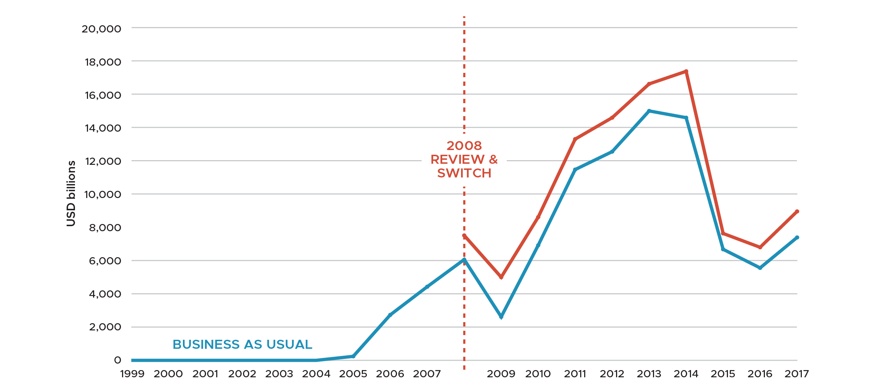
CONTRATS
ÉTUDE DE CAS
Analyser les contrats pour estimer la perte de recettes ​et traiter le problème
SOURCE : ITIE NIGERIA et OPENOIL
Notes:
*Estimated gains in revenue had the government switched the 1993 PSCs to the terms of the 2005 fiscal regime. USD 16 - 28 bn
Key message: Natural resource income, in the form of taxes, royalties, production shares and bonuses, makes up a significant portion of revenue in some countries. Making revenue information public can help to inform fiscal policies and strengthen tax administration to support development.
Nigeria:
When Nigeria ventured into offshore oil extraction in the 1990s, the government incentivised exploration and production activities by awarding licenses through Production Sharing Contracts (PSCs). These contracts featured low tax and royalty rates. While they represented a small portion of Nigeria’s oil industry at the time, they make up a 45% share of total production today.
Nigeria’s 1993 law governing these PSCs stipulates that the contracts ought to have been reviewed when oil prices exceeded USD 20 per barrel (which occurred in 2004), as well as 15 years after the law came into force. Yet, these reviews were not enforced.
Nigeria EITI undertook financial modelling to estimate the oil revenue loss that resulted from not triggering the 15-year review of the 1993 PSCs. The startling conclusion of the study – that the loss of revenue was in the order of USD 16 billion to 28 billion – contributed to an amendment of the PSC Act in November 2019, introducing increased royalty rates, periodic reviews and stringent penalties for non-compliance.

Slide 25
DOMAINE CLÉ
Propriété effective

Slide 26
Justification
PROPRIÉTÉ EFFECTIVE
Limiter la règle de l’anonymat au niveau des entreprises et contribuer à la lutte contre le blanchiment d’argent et la corruption
Identifier les PPE, ce qui est important pour détecter les conflits d’intérêts
Faciliter une vue d’ensemble et une compréhension complète des chaînes de propriété
Notes:
Summary
Encourages threshold of 10% or lower for ownership disclosure
Requires zero threshold for politically exposed persons
Encourages disclosure of company structures
Encourages SOEs to disclose beneficial owners of their agents or intermediaries
To avoid loopholes in BO disclosure which could be taken advantage of by non-legitimate companies, the new Requirement 2.5 encourages a threshold of 10% or lower for ownership disclosure, zero threshold for politically exposed persons and disclosure of company structures. There are also new requirements for SOEs specifically on how ownership or control is exerted. Recognising that many of the corruption cases involving SOEs are done through the use of third parties, Requirement 2.6 now encourages SOEs to disclose the beneficial owners of their agents or intermediaries.

Slide 27
PROPRIÉTÉ EFFECTIVE
Exigence 2.5 (a)
Les pays sont :
Encouragés à adopter un seuil de propriété de 10 % ou moins
Tenus d’exiger la divulgation complète des personnes ; politiquement exposées, et de leur niveau de propriété effective, quel que soit ce niveau.
Notes:
In extractives, a high-risk sector for corruption, it has long been acknowledged that low thresholds are important for understanding ownership, for example of a small percentage stake in a very large extractives company.
Lower thresholds for reporting the beneficial owners of oil, gas and mining companies enable the public to have a more comprehensive view of who benefits from natural resources.
To avoid loopholes in BO disclosure which could be taken advantage of by non-legitimate companies, the new Requirement 2.5 encourages a threshold of 10% or lower for ownership disclosure, zero threshold for politically exposed persons and disclosure of company structures.

Slide 28
PROPRIÉTÉ EFFECTIVE
Exigence 2.5 (g)
Les entreprises sont encouragées à divulguer leur structure de propriété, notamment la chaîne complète de personnes morales menant jusqu’au bénéficiaire effectif.

Slide 29
PROPRIÉTÉ EFFECTIVE
Exigence 2.6 (e)
Dans la mesure du possible, les entreprises d’État sont encouragées à divulguer l’identité et la propriété effective de leurs agents ou intermédiaires, fournisseurs ou sous-traitants relativement aux transactions significatives.

Slide 30
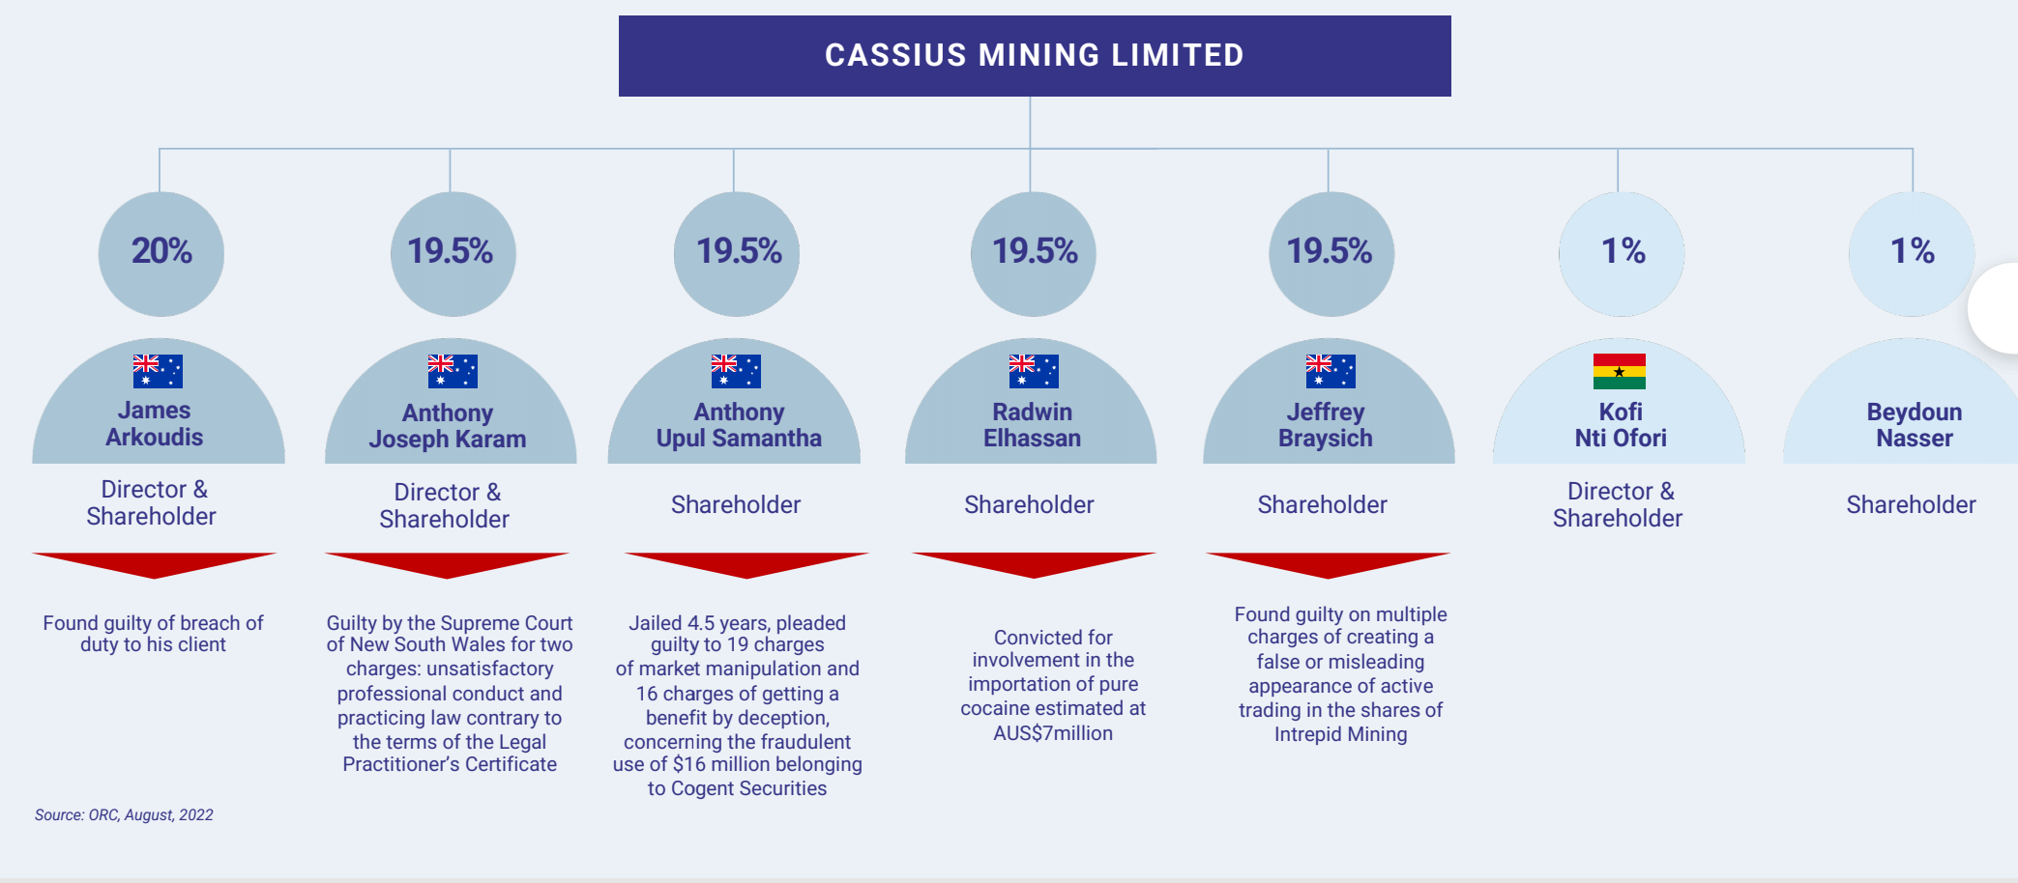
PROPRIÉTÉ EFFECTIVE
ÉTUDE DE CAS
Ghana
Étudier les données concernant la propriété pour améliorer l’intégrité du processus d’octroi des licences minières
Notes:
Ghanaian CSO spotted wrongdoings by a mining company operating under restructured ownership in Ghana and incorporated in Australia.
Used Ghana’s BO register to identify beneficial owners of the company
Used Australia judicial records to establish evidence of criminal history of some beneficial owners
CSO informed the relevant government entities, which later revoked the company’s mining license.
Using BO data to identify deviations from legal provisions
In 2022, the Ghanaian CSO NOPRA spotted wrongdoings by a mining company operating under restructured ownership in Ghana and incorporated in Australia. Using Ghana’s BO register, NOPRA (supported by the Opening Extractives program) could link the companies to Australia and provide evidence that some of the directors of the Ghanaian structure had a criminal past that should have prevented them owning a mining license in Ghana. The CSO informed the relevant government entities, which later revoked the company’s mining license.

Slide 31
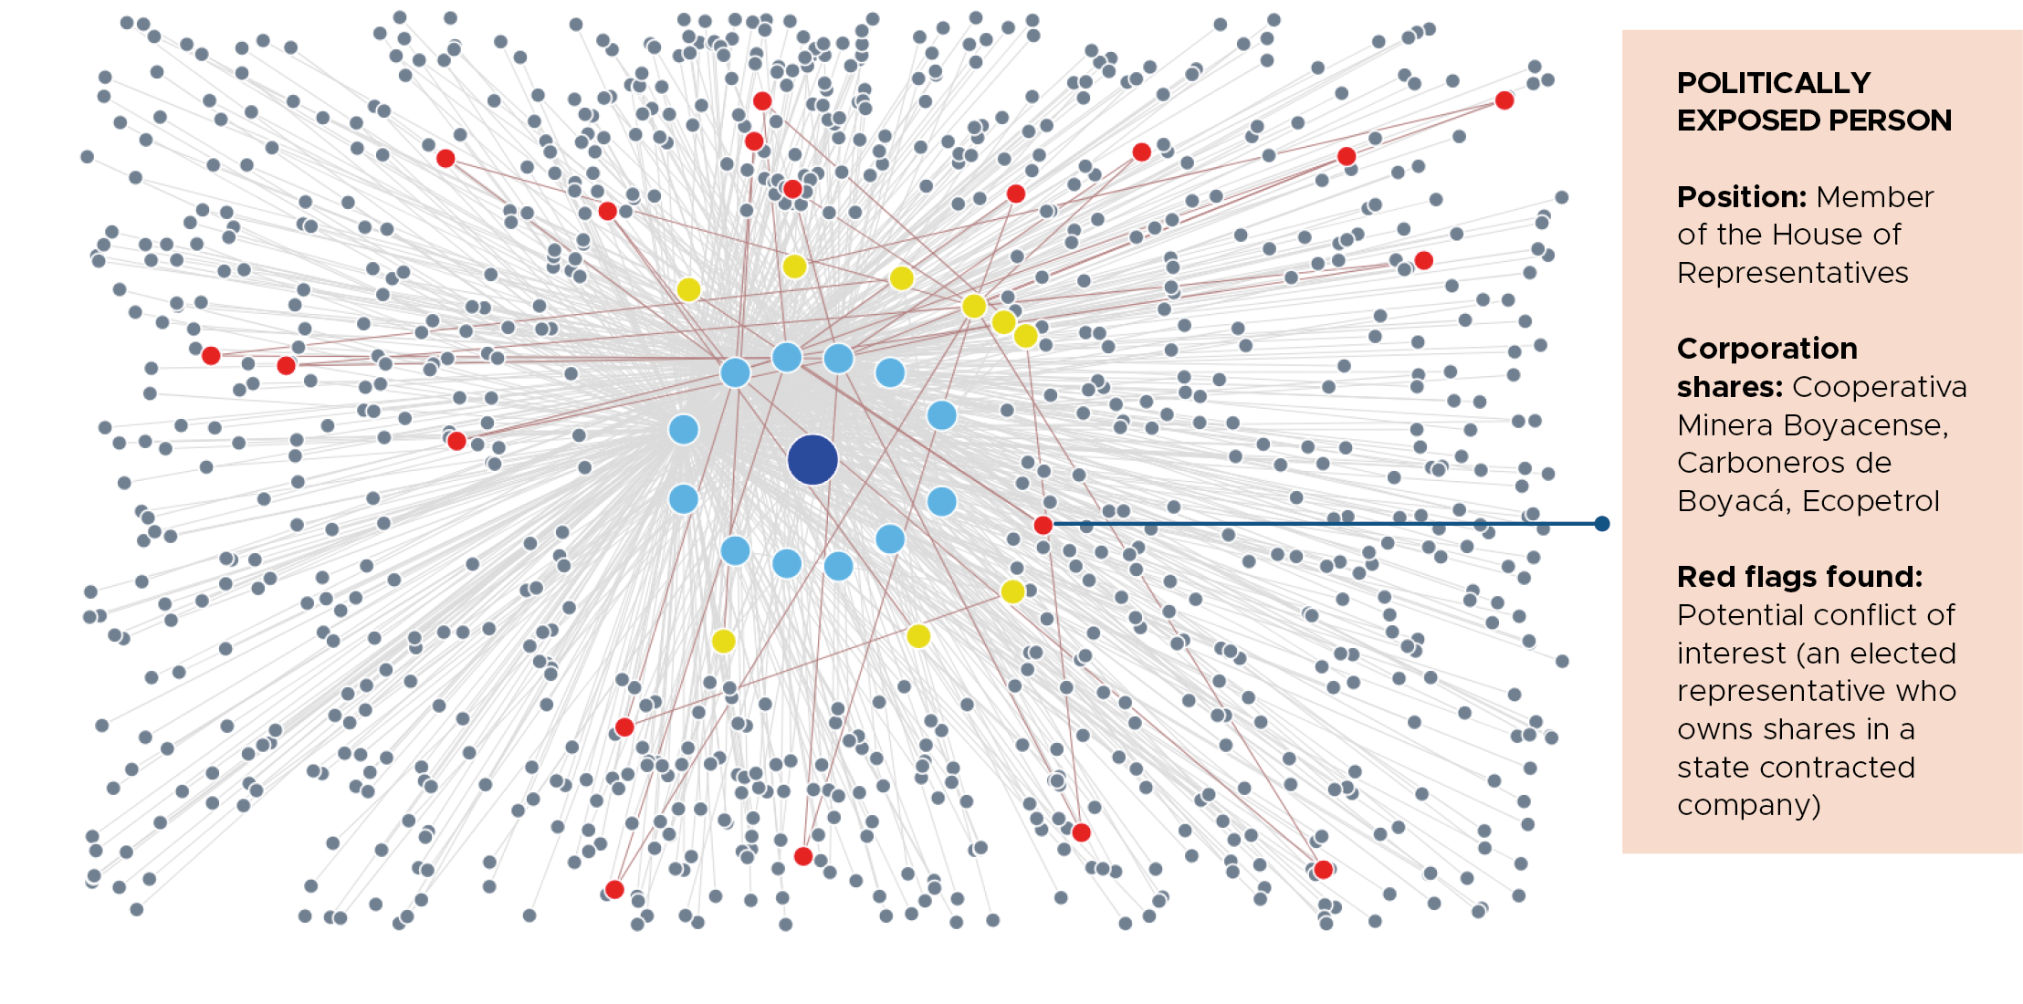
PROPRIÉTÉ EFFECTIVE
ÉTUDE DE CAS
Colombie et Nigeria
Relier les points de données concernant la propriété effective
Gouvernement
Entreprises
PPE
Alerte rouge

Slide 32
DOMAINE CLÉ
Exploration, production et recettes

Slide 33
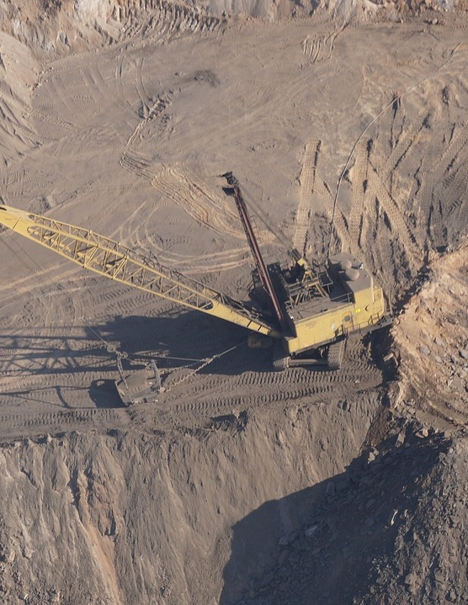
Justification
EXPLORATION, PRODUCTION ET RECETTES
Favoriser la compréhension du potentiel de réserve, afin de réduire les risques de corruption liés à la dissymétrie des informations
Aider à estimer les recettes publiques attendues
Détecter la possible évasion de recettes liée à la non déclaration des quantités produites ou au gonflement des coûts de production
Notes:
Summary
To mitigate risks of corrupt speculation of reserves and potential revenue leakages, the 2023 EITI Standard encourages disclosure of proven economic oil, gas or mineral reserves and methods for verifying accuracy of production data as well as an estimate of production and export from artisanal mining (Requirement 3.1, 3.2, 3.3) Project costs are also expected to be disclosed to understand how governments are managing revenue loss risks (Requirement 4.10)
Requires disclosure of sources and methods for calculating production volumes and values
Requires disclosure of mechanisms for verifying accuracy of production data
Encourages disclosure of proven economic oil, gas or mineral reserves
Encourages disclosure of estimated production and export from artisanal mining
Expects disclosure of project costs
Production volumes and values data enhance financial transparency in the extractive sector, reducing opportunities for corruption by ensuring accurate reporting of revenues, taxes, and payments to governments.
Accessible data empowers the public, civil society, and local communities to monitor extractive activities, fostering accountability and identifying potential irregularities or corrupt practices.
Governments and companies can utilise production data for risk assessments, enabling targeted anti-corruption measures and contributing to effective resource governance within the extractive sector.

Slide 34
EXPLORATION, PRODUCTION ET RECETTES
Exigence 3.1 (b)
Les pays et les entreprises sont encouragés à divulguer des données sur les réserves économiques prouvées de pétrole, de gaz ou de minéraux, lorsqu’elles sont disponibles.
Notes:
b) Implementing countries and companies are encouraged to disclose data on proven economic oil, gas or mineral reserves, where available.

Slide 35
EXPLORATION, PRODUCTION ET RECETTES
Exigence 3.2
Les pays doivent divulguer :
Une estimation de la production résultant des activités minières artisanales et à petite échelle ;
Les sources et les méthodes de calcul des volumes et des valeurs de production ;
Les mécanismes existants de surveillance et de contrôle de l’exactitude des données de production.
Notes:
a) Implementing countries are required to disclose timely production data, including production volumes and values by commodity. Data must be further disaggregated by project, where available. An estimate of production resulting from artisanal and small-scale activities must be disclosed where applicable and available
b) The sources of and the methods for calculating production volumes and values must be disclosed. Implementing countries are required to disclose existing mechanisms to monitor and verify the accuracy of production data and document findings, including any weaknesses related to the comprehensiveness and reliability of publicly available production data.

Slide 36
EXPLORATION, PRODUCTION ET RECETTES
Exigence 3.3
Les pays doivent divulguer :
Une estimation des exportations résultant des activités minières artisanales et à petite échelle ;
Les sources et les méthodes de calcul des volumes et des valeurs de production ;
Les mécanismes existants de surveillance et de contrôle de l’exactitude de données de production.
Notes:
a) Implementing countries are required to disclose timely export data, including export volumes and the value by commodity and by exporting company. Implementing countries are expected to disaggregate export data by transaction. An estimate of exports resulting from artisanal and small-scale activities must be disclosed where applicable and available.
b) The sources of and the methods for calculating export volumes and values must be disclosed. Implementing countries must disclose existing mechanisms to monitor and verify the accuracy of export data and document findings, including any weaknesses related to the comprehensiveness and reliability of publicly available export data. This could involve analysing possible deviations between export values and market prices and/or import values reported by the destination country.

Slide 37
EXPLORATION, PRODUCTION ET REVENUS
Exigence 4.10 (a)
Il est exigé des pays qu’ils divulguent les politiques et pratiques gouvernementales en matière de suivi des coûts des projets pétroliers, gaziers et miniers et de gestion des risques de perte de recettes.
Notes:
a) Implementing countries are required to disclose government policies and practices for monitoring oil, gas and mining project costs and managing revenue loss risks. This must include the disclosure of relevant laws, regulations and policies, as well as actions undertaken to monitor costs.

Slide 38
EXPLORATION, PRODUCTION ET RECETTES
Exigence 4.10 (b)
Il est attendu des pays qu’ils divulguent des sonnées sur les coûts finaux et des rapports sur les contrôles fiscaux, ou des résumés de ces rapports, incluant les coûts considérés comme non recouvrables / non déductibles, ainsi que les recettes supplémentaires à percevoir en conséquence.

Slide 39
EXPLORATION, PRODUCTION ET RECETTES
Exigence 4.10 (c-d)
Les entreprises et les pays sont encouragés à divulguer :
Les coûts déclarés, ventilés par projet et par coûts liés aux dépenses d’exploitation et d’investissement ;
Les coûts engagés depuis le commencement d’un projet.
Notes:
c) Companies and implementing countries are encouraged to disclose declared costs disaggregated by project, and by costs related to operating and capital expenditures. Operating expenditures declared in the reporting year may include amortisation or depreciation of costs incurred in prior years. Companies and implementing countries are encouraged to disclose costs incurred since the commencement of the project.

Slide 40
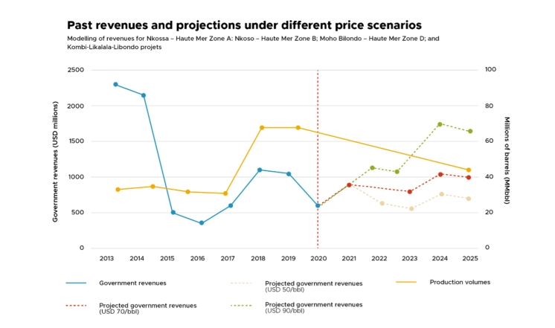
EXPLORATION, PRODUCTION ET RECETTES
ÉTUDE DE CAS
République du Congo
Utiliser les données de production et les recettes actuelles pour prévoir et modéliser les futures recettes.
Notes:
The analysis showed that even with high oil prices, revenues were not expected to return to the level seen in 2013-2014 due to changes in the fiscal regime.
The energy transition will impact government revenues that are generated from both fossil fuel and minerals, particularly those needed for renewable energy technologies.
Governments will be expected to disclose their revenue forecasts or scenarios, as well as the assumptions that underlie these forecasts.
Companies are expected to disclose information about future production plans, when requested by the multi-stakeholder group.
These disclosures help citizens understand how prepared their country is to manage the energy transition and enable public debate about the sustainability of public revenues.

Slide 41
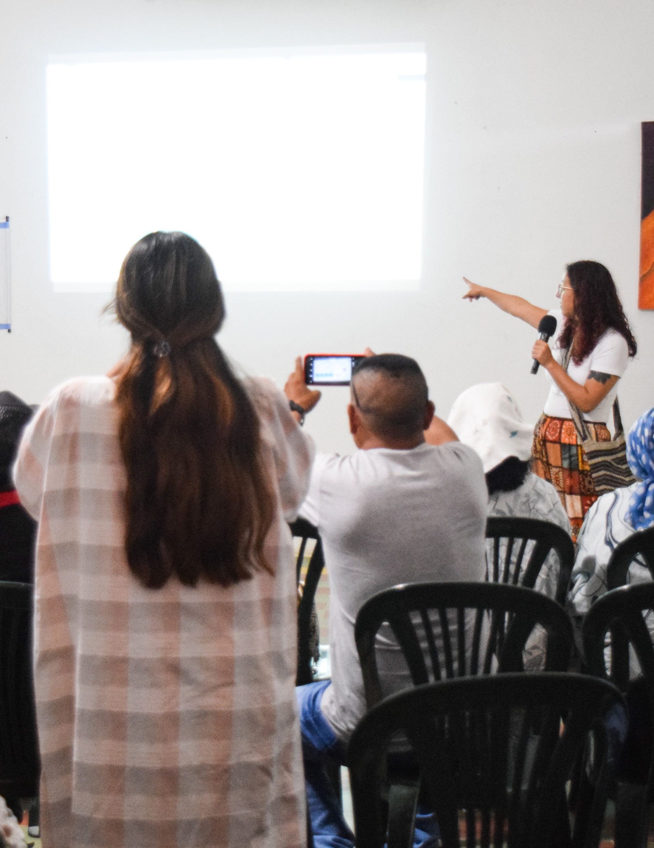
DOMAINE CLÉ
Supervision par le groupe multipartite (GMP)

Slide 42
Justification
SUPERVISION DU GMP
S’attaquer aux problèmes de corruption par le biais du débat public
Donner aux GMP le mandat de discuter des questions de corruption
Inciter les entreprises privées et les entreprises d’État à s’associer aux efforts de prévention de la corruption
Notes:
Summary
The 2023 Standard strengthens the multi-stakeholder’s mandate to use the EITI process in engaging in anti-corruption issues in their country. MSGs are now required to include in their work plans objectives that reflect national priorities including issues related to corruption (Requirement 1.5) and to conduct related activities (Requirement 1.4.vii). Requirement 7.1. further states that tackling corruption issues through public debate is a key objective of the requirement. Companies and SOEs are now expected to publish their anti-corruption policies, how they manage corruption risks and how they use BO data. They are further encouraged to engage in rigorous due diligence processes (Requirement 1.2 and 2.6). . All of these new provisions are expected to address perceived limitations on the MSGs mandate in engaging with corruption issues and to directly involve companies and SOEs in the efforts to prevent corruption through the EITI process.
Country work plans must reflect national priorities (e.g. anti-corruption) and conduct related activities
Companies and SOEs expected to publish anti-corruption policies, how they manage corruption risks and use beneficial ownership data
Companies and SOEs encouraged to engage in rigorous due diligence processes
Understand the legal and institutional framework to fight corruption
EITI reports can provide comprehensive data on laws, regulations and institutional mandate to address corruption in the extractive industry. By analysing this information, stakeholders can assess the effectiveness of existing legal and institutional frameworks in curbing corruption.
Promoting accountable license and contract awards
License and contract awards are often susceptible to corruption. This challenge is particularly apparent in the transition minerals sector where growing demand can drive an uptick in investments. EITI disclosures play a role in mitigating these risks by strengthening transparency on license and contract awards.
EITI reports include information on license allocations, detailing who holds the rights to exploit natural resources. Stakeholders can scrutinise this data to identify any lack of transparency or fairness in the license allocation process.
The information disclosed by the EITI helps in detecting vulnerabilities, such as non-competitive bidding or favouritism, that could lead to corruption in the allocation of resource licenses.
Disclosures related to award criteria and processes can enable stakeholders to understand whether decision-making is transparent and competitive.
Strengthening SOE governance
A significant proportion of recent corruption cases in the oil, gas and mining sectors have involved SOEs. As SOEs pursue new business opportunities in the context of the energy transition, corruption risk may surface in areas such as the use of agents and intermediaries, supplier and contractor selection, and commodity trading.
EITI disclosures can help to strengthen SOE governance.

Slide 43
SUPERVISION DU GROUPE MULTIPARTITE
Exigence 1.2
Il est attendu des entreprises déclarantes qu’elles publient une politique de lutte contre la corruption établissant la manière dont elles gèrent le risque de corruption, y compris l’utilisation qu’elles font des données sur la propriété effective.
Les entreprises siégeant au GMP sont également encouragées à engager des processus rigoureux de vérification préalable.
Les autres entreprises déclarantes sont également encouragées à suivre des processus rigoureux de vérification préalable.
Notes:
b) Reporting companies are expected to publish an anti-corruption policy setting out how the company manages corruption risk, including their use of beneficial ownership data. In addition, companies on the multi-stakeholder group are expected to engage in rigorous due diligence processes. Other reporting companies are also encouraged to engage in rigorous due diligence processes.

Slide 44
SUPERVISION DU GROUPE MULTIPARTITE
Exigence 1.4 (b vii)
Il est exigé des GMP qu’ils traitent des questions portant sur la gouvernance des industries extractives, en couvrant les activités complémentaires liées à la lutte contre la corruption, le cas échéant.
Notes:
vii. The multi-stakeholder group is required to consider issues linked to the governance of the extractive industries, including complementary activities related to anti-corruption; energy transition reforms; gender equity; and artisanal and small-scale mining (where applicable).
Creating an MSG anticorruption working group or subcommittee In countries where corruption is a sensitive topic which may create controversy, it may be strategic to frame anticorruption efforts as promotion of “integrity” or “good governance.” • It may also be more strategic to task existing thematic working groups or subcommittees with responsibility for mainstreaming anticorruption in other EITI thematic engagements, rather than to form a new grouping explicitly dedicated to working on corruption issues. • Either way, a working group’s mission should include engaging with external anticorruption actors such as government commissions, law enforcement agencies, auditors, anticorruption NGOs, investigative journalists and the compliance staff of reporting companies.
Creating a focus group on governance risks in supply chains: In Indonesia, the EITI established a focus group to analyze governance risks in the critical minerals supply chain for the battery industry, and commissioned a study describing each of these risks. The MSG is linking these efforts to the country’s national anticorruption plan and conducted a study to identify how the EITI could provide support to existing anticorruption initiatives.

Slide 45
SUPERVISION DU GROUPE MULTIPARTITE
Exigence 1.5 (a i)
Le plan de travail du GMP doit inclure des objectifs de mise en œuvre de l’ITIE qui tiennent compte des priorités nationales, et en particulier des questions liées à la corruption dans les cas applicables.
Notes:
a) The multi-stakeholder group is required to maintain a work plan for implementation. The work plan must address the most relevant themes for natural resource governance in line with national priorities. The work plan must include: i. EITI implementation objectives that reflect national priorities, including issues related to corruption; gender equity; energy transition; revenue collection; artisanal and small-scale mining (where applicable); and other key extractive sector governance issues, as well as consultations with key stakeholders.

Slide 46
SUPERVISION DU GROUPE MULTIPARTITE
Exigence 2.6 (c)
Conformément à l’attente 7 à l’égard des entreprises soutenant l’ITIE, il est attendu des entreprises d’État qu’elles publient leurs politiques de lutte contre la corruption ; elles sont en outre encouragées à engager des processus rigoureux de vérification préalable.
Notes:
In line with Expectation 7 for EITI supporting companies, SOEs are expected to publish their anti-corruption policies and are encouraged to engage in rigorous due diligence processes.

Slide 47
SUPERVISION DU GROUPE MULTIPARTITE
Exigence 7.1 (c iii)
Les GMP sont encouragés à divulguer des données allant au-delà des exigences de l’ITIE et permettant d’améliorer le débat public sur la gouvernance du secteur extractif, et aussi sur les risques de corruption.
Notes:
iii. Use EITI implementation to disclose data beyond the EITI Requirements that would enhance public debate on extractive sector governance, including on corruption risks, gender equity, revenue collection, the impact of the energy transition, and artisanal and small-scale mining, as determined by the multi-stakeholder group.

Slide 48
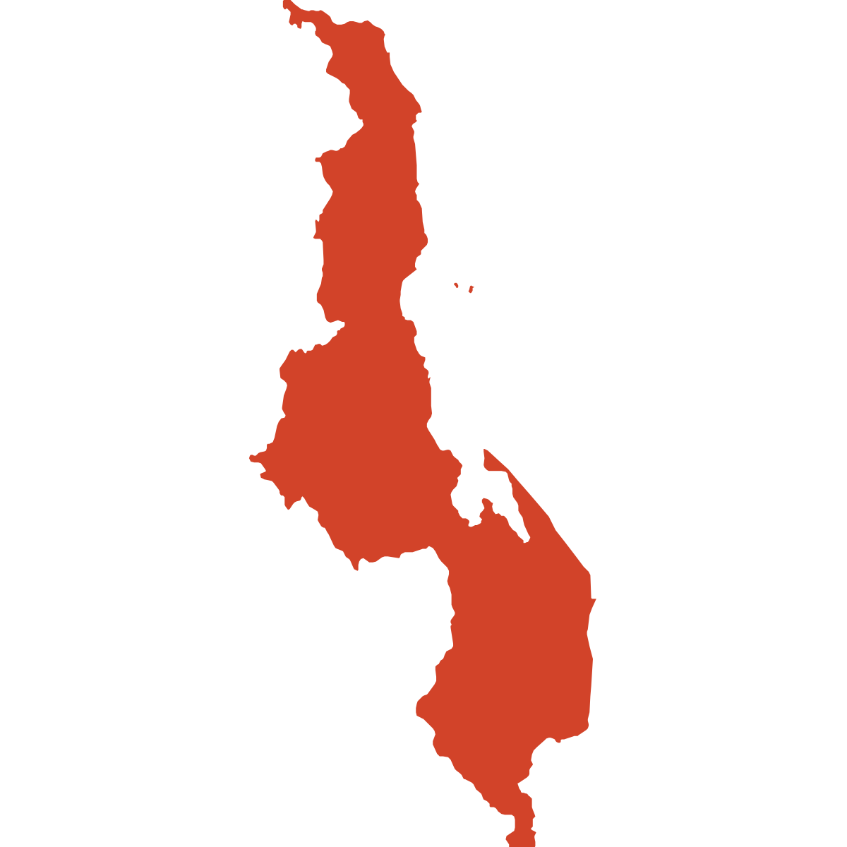
SUPERVISION DU GROUPE MULTIPARTITE
ÉTUDE DE CAS - MALAWI
Profiter de la plateforme offerte par le GMP pour traiter d’une affaire de corruption
2020 :
Les médias révèlent une affaire de corruption à la suite d’une fuite.
Une OSC membre du GMP a soulevé le cas lors d’une réunion, exigeant une déclaration officielle de la part du gouvernement
Le gouvernement a ordonné au Bureau anticorruption d’enquêter sur l’affaire.
Après conclusion de l’enquête par ce Bureau, un des supposés auteurs a été arrêté.
2023 :
L’ITIE Malawi met au point une stratégie de lutte contre la corruption.
Notes:
In November 2020, CSOs in the Malawi EITI MSG brought to the group’s attention a corruption case involving senior officers at the Ministry of Mining, pertaining to the renewal of a mining license, after several media outlets had covered the story.4 The CSOs leveraged the Malawi EITI reporting process and the multi-stakeholder platform to demand a public statement from the government and call for robust government action to address the allegations. The case was later reported to the AntiCorruption Bureau, which subsequently conducted an investigation. These events prompted the Malawi EITI to develop an anticorruption policy and strategy, including measures to identify future deviations from laws and regulations.

Slide 49
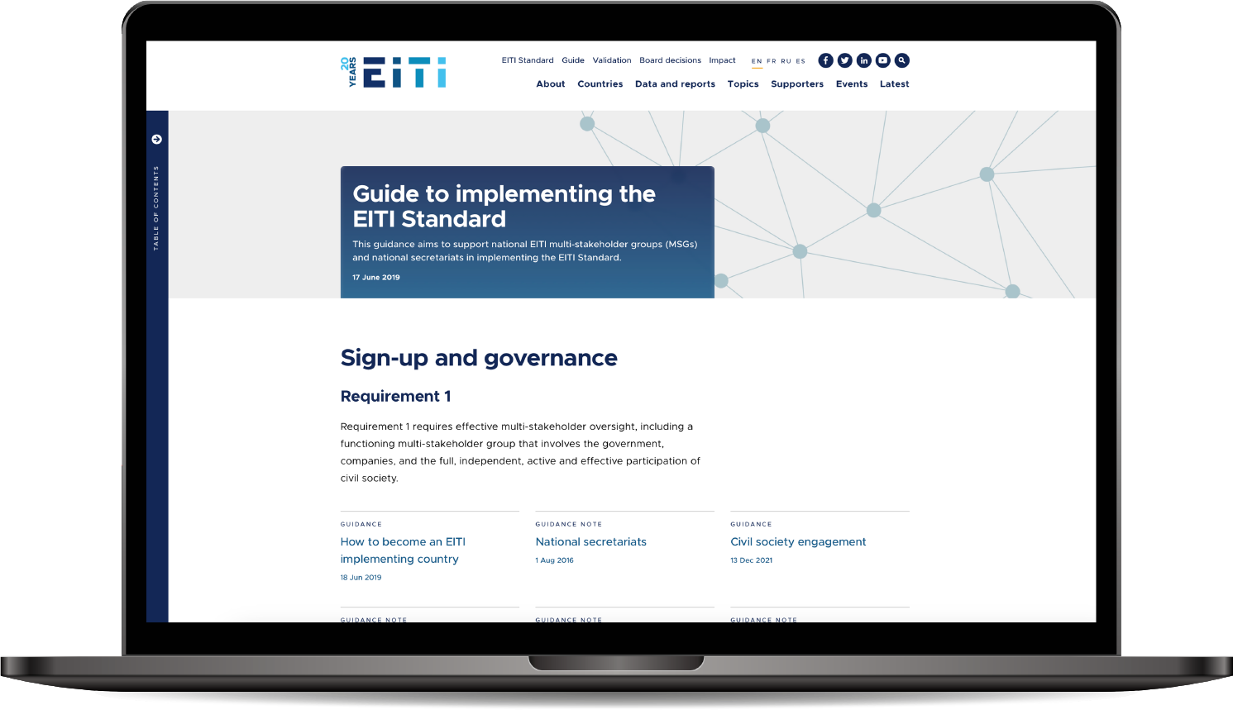
Le guide de mise en œuvre de la Norme ITIE est mis à jour ! Consultez le guide : eiti.org/guide

Slide 50
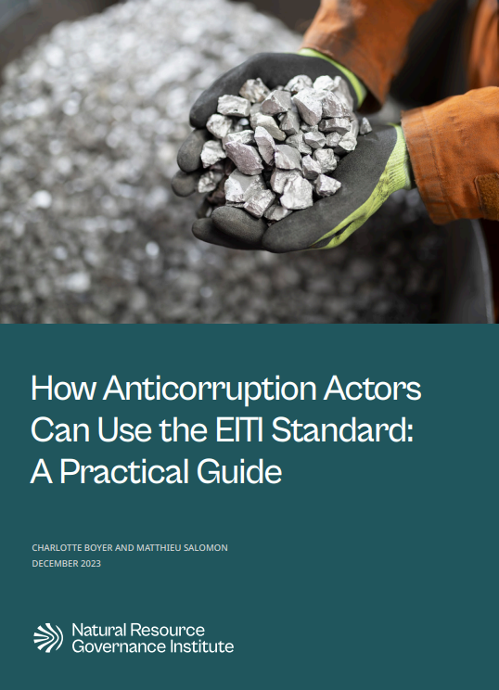
Outils et ressources
Note d’orientation de l’ITIE sur la lutte contre la corruption
Orientations publiées par NRGI sur la façon dont les acteurs de la lutte contre la corruption peuvent utiliser la Norme ITIE
Le rôle de l’ITIE dans la prévention de la corruption
Qui en profite ? Comment utiliser les données sur la propriété des entreprises pour prévenir et détecter les cas de corruption

Slide 51
Merci
E-MAIL secretariat@eiti.org TÉL. +47 22 20 08 00
ADRESSE EITI International Secretariat, Rådhusgata 26, 0151 Oslo, Norvège

