Slide 1
Стандарт ИПДО 2023: основные изменения
Раскрытие информации о бенефициарных владельцах

Slide 2

Почему прозрачность бенефициарного владения важна?
ДЛЯ РАЗМЫШЛЕНИЯ
Notes:
Ask the audience to respond to this questions and summarise their replies.

Slide 3

Почему прозрачность бенефициарного владения важна?
ДЛЯ РАЗМЫШЛЕНИЯ
Анонимные компании могут содействовать отмыванию денег и коррупции
Информация о конечных владельцах
и лицах, контролирующих добывающие компании, играет ключевую роль
в устранении коррупционных рисков
и конфликта интересов
Notes:
The abuse of anonymous companies remains the getaway vehicle for the corrupt. They enable wrongdoers to hide behind a chain of companies registered in multiple jurisdictions. Protecting anonymity can deter investment and make it harder to curb corruption. It is estimated that developing countries have lost USD 1 trillion a year since 2011 as a result of corrupt or illegal deals, many of which involve anonymous companies.
Knowing who has the rights to extract oil, gas and minerals is key to addressing risks of corruption or conflict of interest.
Multi-stakeholder groups are required to consider issues related to extractive sector governance – including issues related to corruption – to place more focus on ensuring that EITI implementation strengthens anti-corruption efforts and addresses other nationally relevant governance issues.

Slide 4

Для правительств и граждан
ДЛЯ РАЗМЫШЛЕНИЯ
Эффективный возврат украденных активов
Поддержание надежности системы выдачи лицензий
в горнодобывающем секторе путем предотвращения коррупции, обусловленной политическими связями
Обеспечение благонадежности государственных закупок за счет выявления случаев конфликта интересов
Мониторинг участия местного бизнеса в поставках полезных ископаемых
Улучшение инвестиционного климата
Notes:
Provides an additional tool for the recovery of stolen assets.
Restores the integrity of the mining licensing system and ensures the absence of political connections that promote corruption.
Increases integrity of public procurement by detecting conflicts of interest.
Enables effective monitor progress towards increased participation of local businesses in the supply of goods and services to the mining sector and participation of citizens in mining activities.
Improves countries’ standing as an attractive investment destination.

Slide 5

Для компаний
ДЛЯ РАЗМЫШЛЕНИЯ
Создание честного и справедливого операционного
и инвестиционного климата
Укрепление социальной лицензии компаний на ведение деятельности
Содействие комплексной проверке благонадежности поставщиков и деловых партнеров (должная осмотрительность)
Укрепление и защита репутации за счет соблюдения принципов прозрачности ведения бизнеса

Slide 6


Стандарт ИПДО 2023
Новые положения:
Расширение возможностей стран и компаний по выявлению и устранению коррупционных рисков
Более строгие положения
о раскрытии информации
о бенефициарных владельцах
Notes:
The EITI Standard has evolved to respond to stakeholder needs and a changing global context.
Now in its fourth edition, the 2023 EITI Standard now includes several new and refined provisions that enable countries to respond to the most pressing challenges that concern natural resource governance today.
Since 2020, the EITI has been strengthening its work on anti-corruption, recognising the unique opportunity for EITI implementation to address corruption and governance risks in the natural resource sector.
For the first time, the 2023 EITI Standard explicitly reflects anti-corruption in the objectives and text of several EITI Requirements.
It includes provisions to help EITI implementing countries identify areas across the extractive sector value chain that are vulnerable to corruption, without imposing burdensome reporting requirements.
As part of strengthening aspects of the standard related to anti-corruption, there are some key changes on beneficial ownership

Slide 7
Прозрачность БВ в цепочке создания стоимости
Охват Стандарта ИПДО
Природные ресурсы
Контракты и лицензии
Добыча
Сбор доходов
Распреде-ление доходов
Затраты на социально-экономические нужды
Выгоды для обществен-ности
Описание антикоррупционных механизмов
в процессах предоставления
и переуступки лицензий/контрактов
Усиление государственного надзора за операторами/проектами
Снижение коррупционных рисков на этапе закупок
в цепочке поставок
Содействие разоблачению фиктивных компаний и схем, используемых для уклонения от уплаты налогов/отмывания денег
Устранение конфликта интересов при управлении доходами
Выявление утечки доходов через фиктивные компании
Выявление конфликта интересов в процессах закупки
Повышение репутации и доверия инвесторов к общественным проектам
Notes:
Contracts and licenses: Prevents conflict of interest /Ensures compliance with anti-corruption provisions/ Detects anomalies and license transfers/ Reveals track record and past conduct of license applicants
Production: Supports government oversight of operators and project participants / Improves due diligence / Reduces corruption in procurement /
Revenue collection: Exposes shell companies and schemes used for tax evasion / Curbs money laundering by revealing ultimate beneficiaries / Attracts investment by providing necessary data for investors and analysts
Revenue allocation: Prevents conflict of interest in management of resource funds / Reveals attempts to divert revenues through shell companies / Increases oversight of joint venture partnerships with state owned enterprises
Social and economic spending: Detects conflict of interest in government procurement processes / Increases competition and attracts responsible investors in public projects /Enables law enforcement to identify and pursue criminal activity /Improves revenue collection and increases domestic resources available to citizen services

Slide 8
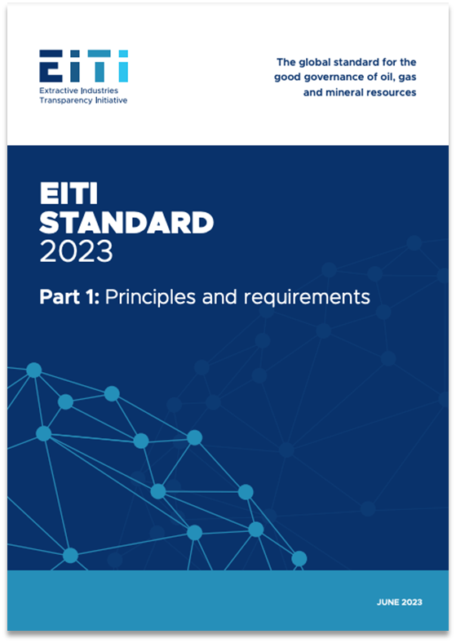
СТАНДАРТ ИПДО 2023
Основные поправки
к положениям
о прозрачности бенефициарного владения

Slide 9




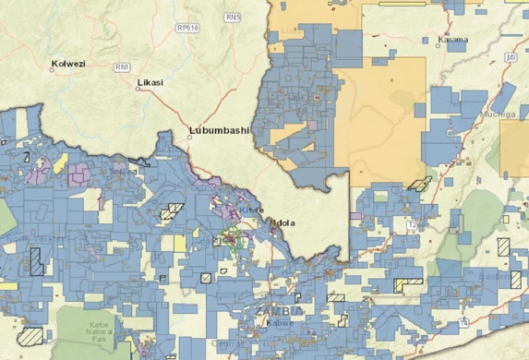


Ключевые аспекты
ПОРОГОВЫЕ ЗНАЧЕНИЯ ОТЧЕТНОСТИ
ПУБЛИЧНЫЕ ДОЛЖНОСТНЫЕ ЛИЦА
ГОСУДАРСТВЕННЫЕ ПРЕДПРИЯТИЯ
ЮРИДИЧЕСКОЕ ВЛАДЕНИЕИ КОРПОРАТИВНАЯ СТРУКТУРА
ВЫДАЧА ЛИЦЕНЗИЙ
ПОЛИТИКА
И ПРАКТИКА КОМПАНИЙ
ПОЛНОТА
И НАДЕЖНОСТЬ
Notes:
There are seven key changes in the 2023 Standard that relate to beneficial ownership
Reporting thresholds
PEPs
SOEs
Legal ownership and structures
Licensing
Company policies and practices
And comprehensiveness and reliability of stock exchange filings

Slide 10

КЛЮЧЕВОЙ АСПЕКТ
Порог доли участия для отчетности
о бенефициарных владельцах
Notes:
First aspect – ownership thresholds.
For the most common forms of ownership and control – namely, direct or indirect possession of ownership shares, voting rights, and right to income – most jurisdictions establish a threshold for disclosure requirements, expressed as a percentage of total ownership or control.
When establishing the definition of beneficial ownership, jurisdictions specify the minimum stake an individual needs to own or control in a company, such as possession of ownership shares or voting rights. The lower the threshold, the easier it is to identify hidden interests.
However, there is no one-size-fits-all level for thresholds since different percentages will be appropriate in line with the different policy aims that governments pursue via BOT. Similarly, certain economies or industry sectors that are associated with higher risks of financial crime should apply more stringent thresholds.
Whilst thresholds can always be exploited by individuals seeking to avoid disclosure requirements by limiting their ownership stakes to just below the level stipulated in law, having low thresholds makes this more difficult. Lower thresholds for reporting the beneficial owners of oil, gas and mining companies enable the public to have a more comprehensive view of who benefits from natural resources.

Slide 11
ПОРОГ ДОЛИ УЧАСТИЯ ДЛЯ ОТЧЕТНОСТИ
Требование 2.5(f)(i)
Внедряющие ИПДО страны поощряются к тому, чтобы согласовать для отчетности
о бенефициарных владельцах пороговое значение доли участия в размере не ниже 10%.
Notes:
The EITI Standard now encourages countries to adopt an ownership threshold of 10% or lower.
This means that any individual who directly or indirectly holds this or a higher percentage of shares of a company will be disclosed as a beneficial owner. This ensures that most or all ownership interests are disclosed, leaving no room for hidden interests.
This makes the EITI the only Standard clearly recommending a threshold. FATF does not recommend a specific threshold level, but mentions a maximum 25% figure as recommended, in the context of examples to illustrate how thresholds would work.
While early adopters like the UK and Ukraine established a 25% threshold in 2015, and the European Union’s AMLD4 did the same that year, more recent legislation across jurisdictions has set lower thresholds.
Now, more than 20 EITI countries have embraced a threshold of 10% or less, including Argentina (1 share or above), Colombia (5%), Nigeria (5%) and Senegal (2%).
Several countries have also adopted lower thresholds specifically for high-risk sectors such as the extractives, including Armenia (10% for mining sector, versus 20% for other sectors), Ghana (5% for locally registered extractive sector companies, versus 20% for low-risk sectors) and Liberia (5% for mining, oil, gas and agriculture, versus 10% for the forestry sector).
Still, many countries have yet to follow suit.

Slide 12
Обоснование
ПОРОГ ДОЛИ УЧАСТИЯ ДЛЯ ОТЧЕТНОСТИ
Добывающий сектор характеризуется высокими коррупционными рисками
Более низкие пороговые значения отчетности (небольшая доля в крупной компании) помогают понять структуру владения
Возможность общественного контроля за теми, кто получает выгоду от природных ресурсов
Notes:
When setting threshold levels, governments should start by examining the policy goals behind their drive to create BO registers. These can include tackling corruption, money laundering, terrorism financing, and tax evasion, or supporting economic activity by lowering the chance of fraud and the cost of due diligence. A low threshold is necessary to capture data on the relevant beneficial owners that enable governments to meet the majority of these policy goals.
When setting thresholds, implementers should adopt a risk-based approach (RBA) to most effectively meet their specific policy goals. High thresholds leave a disclosure regime vulnerable to loopholes, whilst low thresholds enable authorities to capture more data on those with relationships of ownership or control over corporate vehicles.
The extractives sector, being a high risk sector in most EITI implementing countries, should therefore have lower thresholds for reporting the beneficial owners of oil, gas and mining companies. This enables the public to have a more comprehensive view of who benefits from natural resources.
Armenia, for instance, moved from a 20% threshold for BO in its 2008 AML law to a 10% level for its 2019 mining sector disclosures. Similarly, Liberia adopted a 5% threshold for mining, oil, gas, and agriculture, versus a higher 10% threshold for the forestry sector. Ghana has adopted a 0% threshold for all locally registered extractive sector companies. Foreign extractive companies operating in Ghana are subject to a 5% disclosure threshold.
Sector-specific thresholds are easier to implement in regulated industries or other situations where authorities know which companies are operating in a given sector, and therefore also which companies are expected to declare at a given threshold.

Slide 13
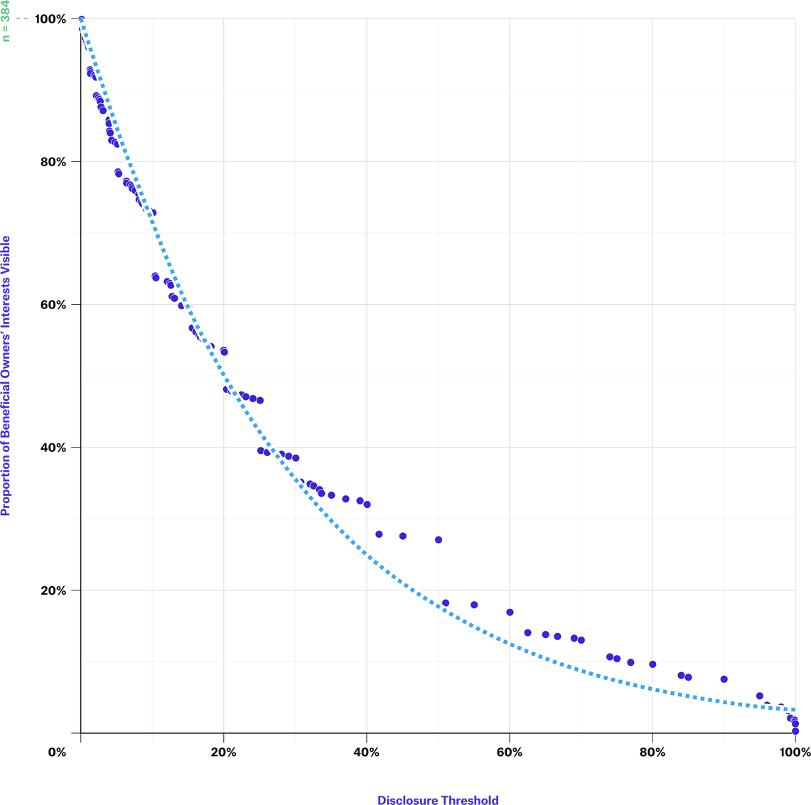
ПОРОГ ДОЛИ УЧАСТИЯ ДЛЯ ОТЧЕТНОСТИ
ПРИМЕР
Нигерия
Прозрачность информации
о бенефициарных владельцах на различных пороговых уровнях в добывающем секторе Нигерии
Процентное соотношение бенефициарных владельцев с прозрачной долей участия
Пороговое значение доли для раскрытия информации
ИСТОЧНИК: ИПДО НИГЕРИИ и OPEN OWNERSHIP
Notes:
Setting low thresholds ensures that a greater number of beneficial owners are disclosed to authorities.
Examination of the data from Nigeria’s extractive industry disclosures in this figure demonstrates the extent to which different thresholds can alter the number of interests disclosed by beneficial owners.
If Nigeria had applied a 20% threshold for its extractive industries disclosure requirements, rather than effectively having no threshold level, then the number of reported interests would have halved. This would very likely have had detrimental effects on the policy aims of helping to prevent or investigate corruption cases linked to the sector.

Slide 14

КЛЮЧЕВОЙ АСПЕКТ
Обязательства
по отчетности
для публичных должностных лиц (ПДЛ)
Notes:
Second aspect – reporting obligations for politically exposed persons or PEPs.

Slide 15
ОБЯЗАТЕЛЬСТВА ПО ОТЧЕТНОСТИ ДЛЯ ПДЛ
Требование 2.5(c)
Внедряющие страны обязаны запрашивать у компаний сведения о публичных должностных лицах, которые прямо или косвенно владеют долями в компании, независимо от размера доли.
Notes:
The 2023 EITI Standard strengthened the requirement for disclosure of PEPs who directly or indirectly hold an interest in a company, by requiring full disclosure of PEPs regardless of their level of ownership.

Slide 16
Обоснование
ОБЯЗАТЕЛЬСТВА ПО ОТЧЕТНОСТИ ДЛЯ ПДЛ
Это общепризнанный факт, что влияние
и власть, которые ПДЛ получают благодаря занимаемому положению, могут вести
к должностным злоупотреблениям, включая коррупцию, взяточничество и отмывание денег.
Эта информация играет ключевую роль в выявлении ситуаций конфликта интересов.
Недостаток прозрачности в отношении ПДЛ и их активов, особенно в добывающем секторе, порождает высокие коррупционные риски, особенно в случаях, когда ПДЛ участвуют в процедурах заключения концессионных соглашений на добычу природных ресурсов.
Notes:
These disclosures are important for identifying conflicts of interest.
Conversely, a lack of transparency on PEPs and their assets – specifically those held in the extractive sector – can pose high corruption risks, especially when PEPs are involved in the award of natural resource concessions.
Initiatives like “Joining the dots” demonstrate the value of using this information.

Slide 17

ОБЯЗАТЕЛЬСТВА ПО ОТЧЕТНОСТИ ДЛЯ ПДЛ
ПРИМЕР
Армения и Гана
Определение понятия ПДЛ и обязательств по отчетности
Определение пороговых значений долей участия для ПДЛ:
  Армения 0%
  Гана 0% для местных ПДЛ, 5% для ПДЛ с высоким уровнем риска и иностранных ПДЛ
Notes:
Countries like Armenia, Ghana or the Kyrgyz Republic require beneficial owners that are PEPs to disclose their ownership or control irrespective of the size of the stake.

Slide 18

КЛЮЧЕВОЙ АСПЕКТ
Владение ГП
и компаниями-поставщиками
и контроль над ними
Notes:
Third aspect – ownership and control of state-owned enterprises and their suppliers.
SOEs in the extractive sector play an important role in the production and sale of natural resources and may, thereby, generate significant revenue for the state.
Not having visibility of how SOEs are owned and controlled would constitute a considerable weakness that could undermine the specific aims of beneficial ownership transparency reforms.
The specific risks of opaque ownership and control of SOEs include:
A lack of visibility of the transfer of assets between private and public sectors;
The misuse of SOE resources;
Not understanding the impact of SOEs on the economy;
And not understanding the impact of any cross-border activity undertaken by SOEs.

Slide 19

ВЛАДЕНИЕ ГП И КОНТРОЛЬ НАД НИМИ
Требование 2.5(e)(v)
ГП обязаны раскрывать:
Название государства (государств), владеющего ГП или контролирующего его
Доля владения
Подробная информация
о том, как осуществляются права владения или
контроля
Если ГП не полностью принадлежит государству, то в соответствии
с требованием 2.5(c) подлежит раскрытию информация о его БВ.
Notes:
Under the 2023 Standard, SOEs are required to disclose:
Name of the state(s) owning or controlling the SOE
Level of ownership
Details about how ownership or control is exerted
In any declaration by an SOE, it is recommended to capture information about the state or state agency involved – this is in addition to the usual information required about natural persons, to be able to comprehensively understand their ownership and control. In this context, only declaring the state ownership of an SOE is insufficient, and more focus should be put on those in control and the benefits that may arise from their positions of stewardship.

Slide 20
ВЛАДЕНИЕ ГП И КОНТРОЛЬ НАД НИМИ
Требование 2.6(e)
При наличии практической возможности государственные предприятия поощряются к раскрытию идентификационных данных и бенефициарных владельцев своих агентов или посредников, поставщиков или подрядчиков в существенных сделках.
Notes:
Where feasible, SOEs are encouraged to disclose the identity and beneficial ownership of their agents or intermediaries, suppliers or contractors for material transactions.

Slide 21
Обоснование
ВЛАДЕНИЕ ГП И КОНТРОЛЬ НАД НИМИ
Обеспечение этичного
и справедливого ведения бизнеса
Оценка рисков, связанных
с посредниками, подрядчиками
и поставщиками
Повышение доверия инвесторов
Notes:
Unlike in the case of an ordinary business, for SOEs, the people whom the state represents have no direct relationship to the entity – neither in regard to the usual benefit of profit, nor in control over operations. However, SOEs deploy public funds. It is therefore taxpayer money that has been invested and is at risk, as well as, potentially, the state’s natural resources, reinforcing the need for transparency to enable accountability and oversight.
SOEs often have complex corporate structures – sometimes spread across multiple jurisdictions – which intertwine with governments in diverse ways via direct or indirect ownership stakes or controlling interests.
To prevent corruption and bribery, it is essential to identify the ultimate owners of companies engaged in transactions with state-owned enterprises (SOEs). This ensures that business dealings are conducted in an ethical and fair manner. The disclosure of beneficial ownership information enables the assessment of risks linked to intermediaries, contractors, and suppliers.
Clear and accessible information about SOEs ownership and control enhances investor confidence.

Slide 22
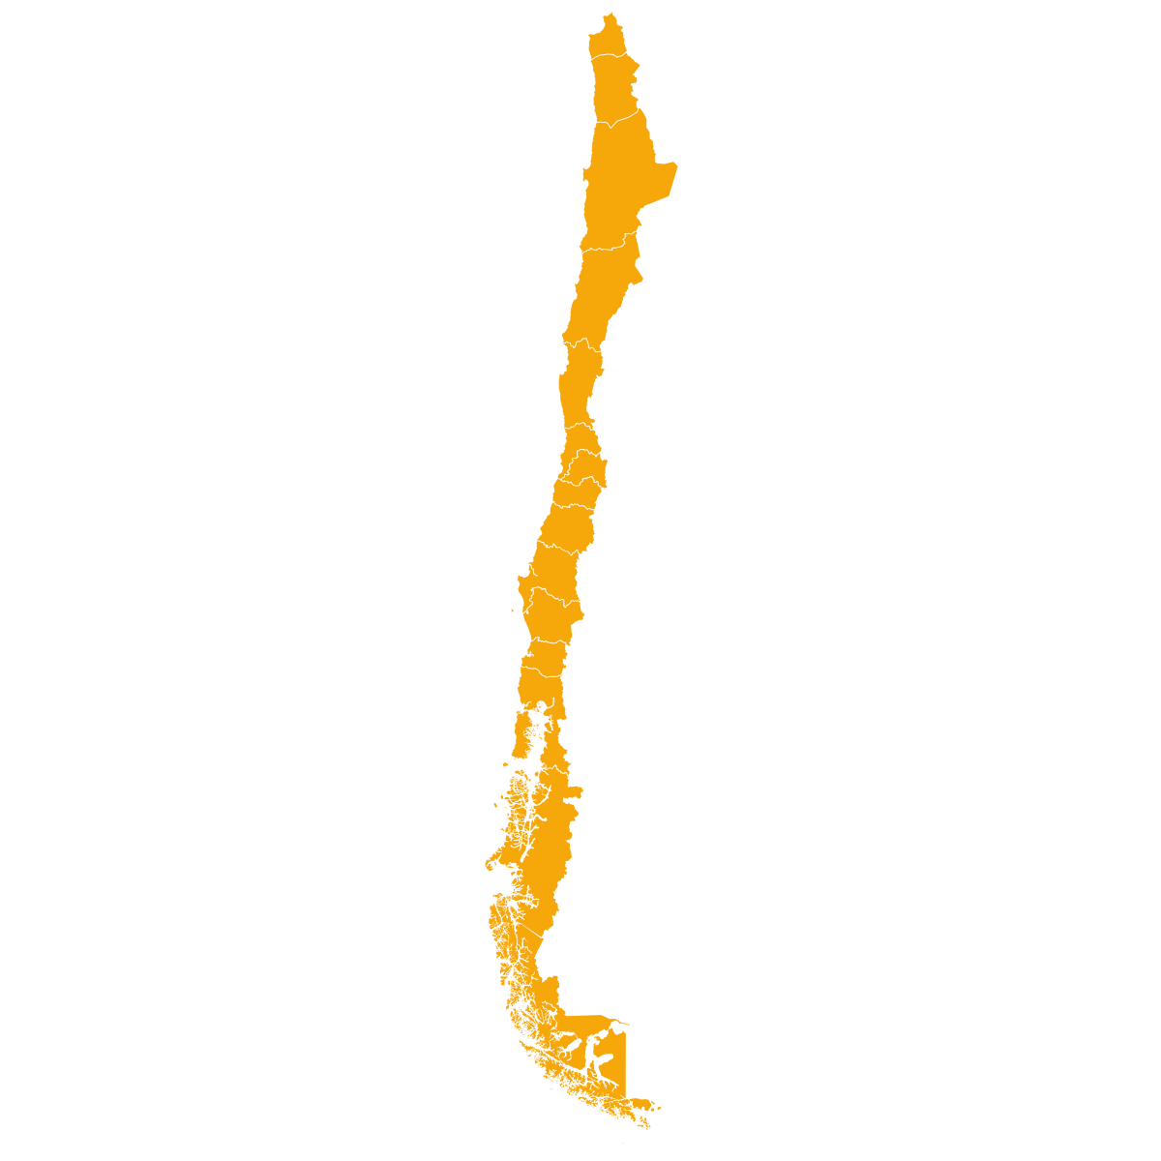
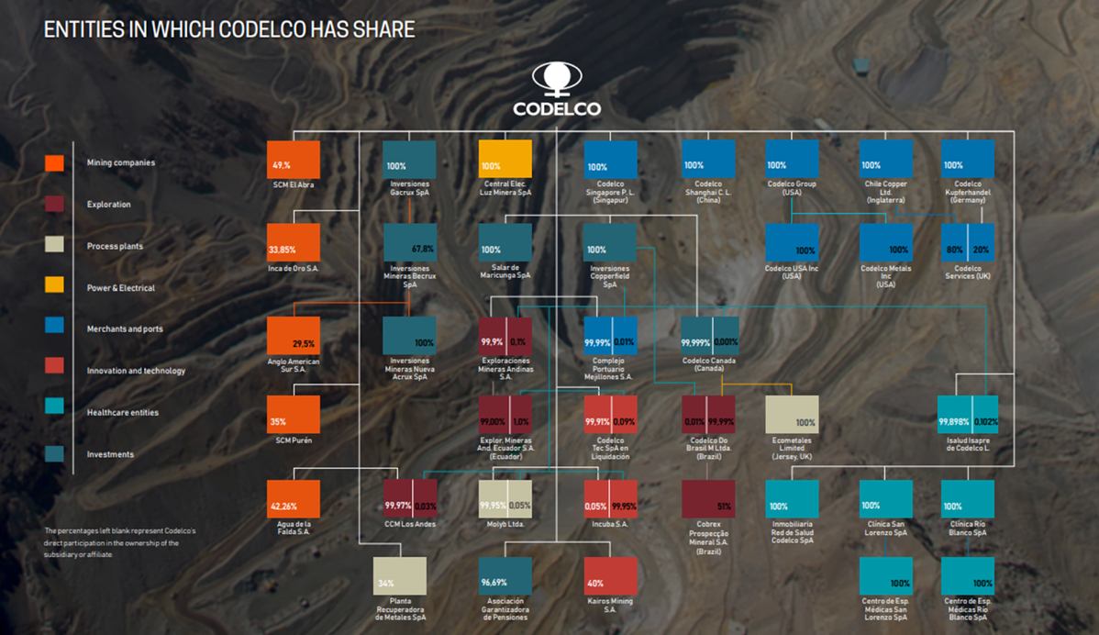
ВЛАДЕНИЕ ГП И КОНТРОЛЬ НАД НИМИ
ПРИМЕР
Codelco, Чили
Подробная информация о правах владения и контроля опубликована на веб-сайте
В Полном отчете за 2022 год раскрыта информация о дочерних и зависимых компаниях, включая % владения
Notes:
Top copper mining company, 100% owned by the Chilean state. Codelco is part of ICMM and therefore supports the EITI.
Codelco publishes information about its subsidiary companies on its website https://www.codelco.com/transparencia/filiales.
In addition, on pages 215 and 216 of the "Integrated Report 2022" data on exploration activities in Brazil are reported.
https://www.codelco.com/prontus_codelco/site/docs/20230405/20230405113753/memoria2022.pdf.
Codelco publishes information on financial results on its website
https://www.codelco.com/transparencia/estados-financieros-y-memorias/estados-financieros-consolidados
Expect 6: Shareholders meeting website:
https://www.codelco.com/transparencia/junta-de-accionistas / The company discloses its corporate governance structure on its 2020 Sustainability Report, page 16-20. Codelco's Corporate Governance Law establishes as an operating principle that it corresponds to the President of the Republic to exercise the powers and functions of the shareholder and of the shareholders' meeting (role of "owner"). https://www.codelco.com/transparencia/junta-de-accionistas
Another example: PT Pertamina (https://www.pertamina.com/en/our-shareholder)
*OE SOE Policy Brief EN.pdf (eiti.org)

Slide 23

КЛЮЧЕВОЙ АСПЕКТ
Юридические владельцы
и корпоративная структура
Notes:
Fourth aspect – legal ownership and ownership structures.

Slide 24
ЮРИДИЧЕСКИЕ ВЛАДЕЛЬЦЫ И КОРПОРАТИВНАЯ СТРУКТУРА
Требование 2.5(g)
Внедряющие ИПДО страны обязаны раскрывать информацию о юридических владельцах юридического лица (лиц), указанных в требовании 2.5(c), включая долю владения.
Распространяется на юрлица, подающие заявку или имеющие долю участия в лицензии или контракте на разведку или добычу нефти, газа или других полезных ископаемых
Notes:
Implementing countries are required to disclose the legal owners of the corporate entity(ies) defined in Req. 2.5(c), including share of ownership.

Slide 25
ЮРИДИЧЕСКИЕ ВЛАДЕЛЬЦЫ И КОРПОРАТИВНАЯ СТРУКТУРА
Требование 2.5(g)
Компании поощряются к раскрытию информации о своей корпоративной структуре, включая полную цепочку юридических лиц, которая ведет к бенефициарному владельцу.
Распространяется на юрлица, подающие заявку или имеющие долю участия в лицензии или контракте на разведку или добычу нефти, газа или других полезных ископаемых
Notes:
Companies are also encouraged to disclose their ownership structure, including the full chain of legal entities leading to the beneficial owner.
Tab 4 c in the BO model declaration form provides a template for disclosing beneficial owners. The model declaration

Slide 26
Обоснование
ЮРИДИЧЕСКИЕ ВЛАДЕЛЬЦЫ И КОРПОРАТИВНАЯ СТРУКТУРА
Недостаточно знать личность конечного бенефициарного владельца, чтобы оценить полную структуру владения компанией.
Знание юридических владельцев и корпоративной структуры может помочь получить полное представление о цепочке владения компанией.
Notes:
Knowing the ultimate beneficial owner is not enough to understand a company’s whole ownership structure.
Understanding legal owners and the ownership structure of company can help in providing a full picture of the company’s ownership chain.
This can help to map the entire scope of companies and relationships between individuals and legal entities that control, influence or own a company, which can inform investigations on conflicts of interest.

Slide 27
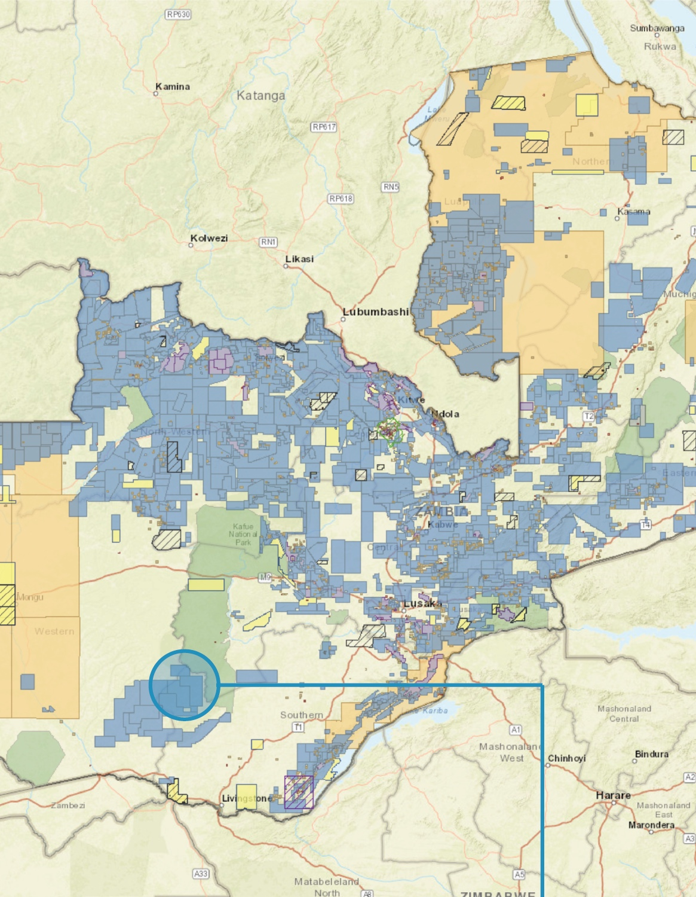
КЛЮЧЕВОЙ АСПЕКТ
Реестр лицензий, заявки на получение лицензий
и бенефициарные владельцы
Notes:
Fifth aspect – linking BO to license applications and registers.

Slide 28
РЕЕСТР ЛИЦЕНЗИЙ, ЗАЯВКИ И БВ
Требование 2.2(c)
В случае если лицензии предоставляются на условиях тендера, правительство обязано раскрывать список участников, включая их бенефициарных владельцев
в соответствии с требованием 2.5 и критерии тендера.
Notes:
Requirement 2.2 c now states that, where licenses are awarded through a bidding process, the government is required to disclose the list of applicants, including their beneficial owners in accordance with Req. 2.5, and the bid criteria.

Slide 29
РЕЕСТР ЛИЦЕНЗИЙ, ЗАЯВКИ И БВ
Требование 2.3(d)
Внедряющие ИПДО страны поощряются к тому, чтобы увязать общедоступные реестры лицензий с другими государственными платформами, где раскрывается или содержится информация в соответствии с требованием 2.5
о юридических и бенефициарных владельцах нефтегазовых и горнодобывающих компаний.
Notes:
In addition, implementing countries are encouraged to link publicly available license registers to legal and beneficial ownership registers or other government platforms that disclose or hold information in accordance with Requirement 2.5.

Slide 30
Обоснование
РЕЕСТР ЛИЦЕНЗИЙ, ЗАЯВКИ И БВ
В Стандарте ИПДО 2023 укрепляются параллели между информацией о лицензиях и бенефициарных владельцах, чтобы гарантировать выдачу лицензий прозрачным
и подотчетным субъектам.
Эти параллели могут помочь регулирующим органам проанализировать, кто стоит за юридическими лицами, которые подают заявки, являются держателями лицензий или переуступают их. Он служит методом проверки благонадежности.
Notes:
The 2023 EITI Standard reinforces the connection between licensing and beneficial ownership information, helping ensure that licenses are granted to transparent and accountable entities.
This linkage can help regulators analyse who is behind the legal entities applying for, holding or transferring licenses.

Slide 31

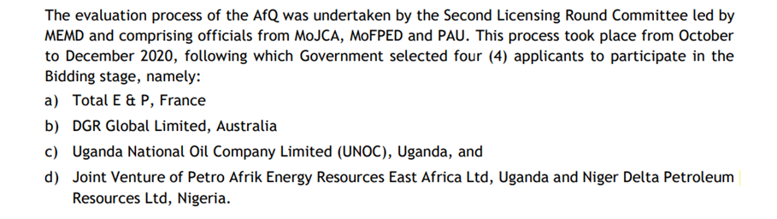
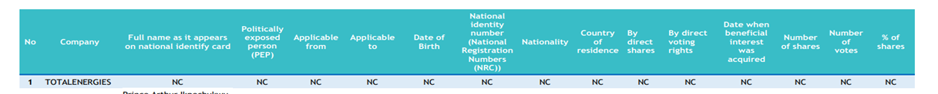
РЕЕСТР ЛИЦЕНЗИЙ, ЗАЯВКИ И БВ
ПРИМЕР
УГАНДА
Раскрытие информации
о юридических владельцах компаний, подающих заявки на участие в раунде выдачи лицензий на разработку
месторождения
Notes:
Although few jurisdictions actively link license and beneficial ownership information, the Opening Extractives programme, implemented by the EITI and Open Ownership, is supporting countries like Colombia, Ghana, Indonesia and Zambia to ensure that beneficial ownership data is actively used for license screening.
In this case Uganda has disclosed through the EITI report a partial list of applicants to the second licensing bidding round. Some of the applicants are material companies already required to provided BO information. However, Uganda did disclose only those a list of prequalified applicants. It would be necessary for Uganda to disclose the full list of applicants (which were 6 and not 4) and the respective BO information.
Countries like Armenia, who discloses BO information on all their mining companies, are also a good example.
Other examples in which BO is required (as stipulated by law) for bidding rounds/licensing rounds but not disclosed to the public: Colombia/Mexico

Slide 32


КЛЮЧЕВОЙ АСПЕКТ
Политика и практика компаний в отношении бенефициарных владельцев
Notes:
Sixth aspect – Company policies and practices on beneficial ownership.

Slide 33
ПОЛИТИКА И ПРАКТИКА КОМПАНИЙ
Требование 1.2(b)
Ожидается, что отчитывающиеся компании и ГП опубликуют свою политику в области противодействия коррупции,
в том числе об использовании ими информации о бенефициарных владельцах.
Ожидается, что компании, представленные в МГЗС, будут применять строгие процедуры должной осмотрительности.
Notes:
The EITI Standard introduces new requirements that shed light on companies’ safeguards against corruption. All reporting companies, including state-owned enterprises, are now expected to publish an anti-corruption policy that sets out how they manage corruption risks, including their use of beneficial ownership data.
Additionally, companies that participate in multi-stakeholder groups are expected to engage in rigorous due diligence processes to strengthen the integrity of the EITI process.
State-owned enterprises are encouraged to disclose the identity of the beneficial owners of their agents or intermediaries, suppliers or contractors, where feasible.
These disclosures help to uncover connections to politically exposed persons (PEPs) and other conflicts of interest.

Slide 34
Обоснование
ПОЛИТИКА И ПРАКТИКА КОМПАНИЙ
Обеспечение равных условий
Формализация антикоррупционной политики и подтверждение использования информации
о БВ в процедурах должной осмотрительности
Соблюдение требований
к поддерживающим ИПДО компаниям
Notes:
In line with what was mentioned at the beginning, this helps to maintain a level playing field, to formalise anti-corruption policies and demonstrate use of BO data for due diligence.
This also ensures that there is a clear alignment with the EITI’s Expectations for EITI supporting companies
Most companies already have such policies, so reporting is straightforward.
EITI requires documentation of policies and practices

Slide 35

ПОЛИТИКА И ПРАКТИКА КОМПАНИЙ
ПРИМЕР
Auxico Resources, Канада
Политика противодействия коррупции и взяточничеству предусматривает положения о должной осмотрительности и описывает индикаторы риска:
Фиктивные компании и организации, принадлежащие государственным должностным лицам или контролируемые ими, их родственниками или партнерами
Нежелание или отказ раскрывать информацию о владельцах
Требование от третьей стороны о неразглашение личности
ИСТОЧНИК: AUXICO RESOURCES CANADA INC., НОРМАТИВНЫЕ ДОКУМЕНТЫ
Notes:
Red flags:
“shell companies, and entities owned or controlled by Government Officials or their relatives or associates”;
“reluctance or refusal to disclose ownership”;
“family ties of a third party with a Government Official”;
“third party requests that identity not be disclosed” (p. 26-27).
Due diligence measures include:
“background checks including qualifications, financial background, government and political ties, number and reputation of clientele, reputation in community, criminal record checks and possible associations with criminal, terrorist or other proscribed persons or groups […]
"If the background check reveals problematic information, Auxico will not, in the absence of extenuating circumstances, enter into an agreement with that third party.”

Slide 36


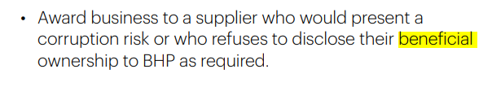
ПОЛИТИКА И ПРАКТИКА КОМПАНИЙ
ПРИМЕР
BHP
Кодекс деловой этики содержит руководящие указания о запросе информации о бенефициарных владельцах в целях управления коррупционными рисками
ИСТОЧНИК: BHP, OUR CODE (КОДЕКС ДЕЛОВОЙ ЭТИКИ)
Notes:
We encourage our suppliers to be transparent on matters important to society, including on their beneficial ownership
Always:
-Understand the identity, role and interests of the person or business who you are dealing with (including the beneficial ownership of companies)
-Always ensure the supplier (including their beneficial owners): is reputable, competent and qualified to perform the work for which they are being hired; will operate safely and ethically; and that compensation sought is reasonable.
Never:
Deal with a party that refuses to disclose its true identity (including details of company beneficial ownership).
Award business to a supplier who would present a corruption risk or who refuses to disclose their beneficial ownership to BHP as required.

Slide 37
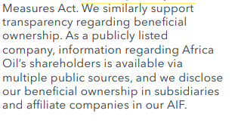
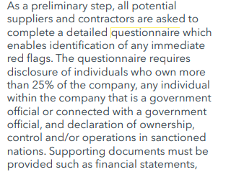
ПОЛИТИКА И ПРАКТИКА КОМПАНИЙ
ПРИМЕР
Africa Oil Corp.
Политика Africa Oil Corp. о применении процедур должной осмотрительности
в отношении поставщиков содержит требование о заполнении поставщиками
и подрядчиками анкеты с информацией
о БВ, чья доля превышает 25%, и ПДЛ
ИСТОЧНИК: AFRICA OIL CORP., ОТЧЕТ ОБ УСТОЙЧИВОМ РАЗВИТИИ ЗА 2022 ГОД
Notes:
As a preliminary step, all potential suppliers and contractors are asked to complete a detailed questionnaire which enables identification of any immediate red flags. The questionnaire requires disclosure of individuals who own more than 25% of the company, any individual within the company that is a government official or connected with a government official, and declaration of ownership, control and/or operations in sanctioned nations. Supporting documents must be provided such as financial statements, incorporation documents and compliance policies and procedures. Should the third party have insufficient compliance documentation, we will refer them to our own policies. Additional scrutiny is given to contractors that would act as an agent on behalf of Africa Oil. Any identified risks at this stage are escalated to the Chief Financial Officer. The next step requires an internal representative to fill in another questionnaire providing additional information regarding Africa Oil’s knowledge of and relationship with the third party, including commercial terms. This aids our Corporate Counsel and Secretary to gauge the level of risk and potentially escalate any concerns to the Chief Financial Officer

Slide 38

КЛЮЧЕВОЙ АСПЕКТ
Достоверность
и полнота данных
о владельцах публичных компаний
Notes:
Seventh aspect – Reliability and comprehensiveness of ownership data for publicly listed companies.

Slide 39
ДАННЫЕ О ВЛАДЕЛЬЦАХ ПУБЛИЧНЫХ КОМПАНИЙ
Требование 2.5(f)(iii)
Зарегистрированные на фондовой бирже компании, включая полностью подконтрольные дочерние предприятия, обязаны раскрывать название фондовой биржи, где они зарегистрированы, и предоставлять ссылку на поданные ими биржевые документы, чтобы упростить доступ общественности к информации об их бенефициарных владельцах.
Notes:
Publicly listed companies, including wholly-owned subsidiaries, are required to disclose the name of the stock exchange and include a link to the stock exchange filings where they are listed to facilitate public access to their beneficial ownership information.

Slide 40
ДАННЫЕ О ВЛАДЕЛЬЦАХ ПУБЛИЧНЫХ КОМПАНИЙ
Требование 2.5(f)(iii)
Многосторонняя группа заинтересованных сторон поощряется к проверке полноты и надежности информации о владельцах, раскрываемой в биржевых документах.
Notes:
EITI multi-stakeholder groups are also encouraged to review the comprehensiveness and reliability of ownership data disclosed in stock exchange filings.

Slide 41
Обоснование
ДАННЫЕ О ВЛАДЕЛЬЦАХ ПУБЛИЧНЫХ КОМПАНИЙ
Важное значение биржевых документов с точки зрения благонадежности финансовых рынков
Укрепление доверия инвесторов и справедливое и эффективное распределение капитала
Всестороннее раскрытие информации помогает предотвратить финансовые потери и обеспечить равные условия
Notes:
This is important because:
First of all, stock exchange filings are essential to the integrity of financial markets
Fosters investor confidence and fair and efficient capital allocation
Comprehensive disclosures help to prevent financial losses and promote a level playing field
Corrupt practices may involve false or misleading information in stock exchange fillings, insider trading manipulation of non-public information for personal gain.
On top of this, reviewing the comprehensiveness and reliability of ownership data disclosed in stock exchange filings can help address gaps in certain jurisdictions where publicly listed companies might take advantage of lax transparency requirements.

Slide 42
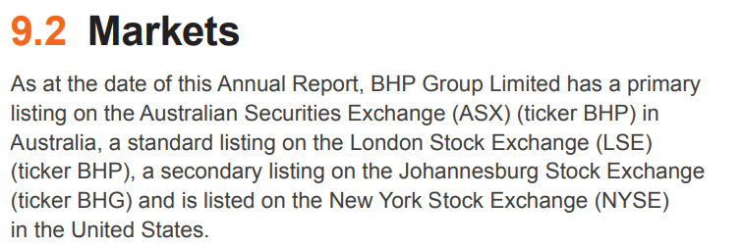
ДАННЫЕ О ВЛАДЕЛЬЦАХ ПУБЛИЧНЫХ КОМПАНИЙ
ПРИМЕР
BHP
Публикует информацию на своем веб-сайте, где каждой из четырех фондовых котировок посвящен специальный раздел
ИСТОЧНИК: ГОДОВОЙ ОТЧЕТ BHP за 2023 год
Notes:
https://www.pwc.com.au/legal/assets/listing-company-asx.pdf

Slide 43
ДАННЫЕ О ВЛАДЕЛЬЦАХ ПУБЛИЧНЫХ КОМПАНИЙ
ИНСТРУМЕНТ
Этапы проверки полноты/надежности данных
При оценке положений о долях владения и контроля в требованиях биржи к раскрытию информации компаниями уделите особое внимание следующим аспектам:
своевременное уведомление о приобретении и отчуждении существенного пакета голосующих ценных бумаг;
уведомления об агрегированных активах и долях, используемых совместно по договору;
уведомления о соглашениях о передаче прав владения и контроля посредством финансовых инструментов, которые действуют аналогично владению акциями или голосующими ценными бумагами;
уведомления с информацией о способах осуществления прав крупных акционеров или держателей голосующих ценных бумаг (т. е. цепочка владения);
уведомления о долях участия, принадлежащих должностным лицам компании.
ИСТОЧНИК: Open Ownership, 2020
Notes:
In assessing the robustness of the definition of ownership and control in an exchange's disclosure requirements, consideration should be given to whether companies must provide:
timely notification on the acquisition and disposal of significant voting rights;
notifications on the basis of aggregated holdings and interests used jointly via an agreement;
notifications of ownership and control arrangements via financial instruments that have a similar effect to owning shares or controlling votes;
notifications that contain information on the means through which major shareholding or voting rights are exercised (e.g. the chain of ownership);
notifications of interests held by company officers.
The future guidance note on Requirement 2.5 will shed more light on how to assess comprehensiveness and reliability.

Slide 44

Резюме
Требование 1.2.
Компаниям и ГП опубликовать политику в области противодействия коррупции, в том числе об использовании ими информации о бенефициарных владельцах (ожидаемое)
Требования 2.2 и 2.3.
Правительствам раскрывать сведения
о бенефициарных владельцах компаний-заявителей (обязательное)
Увязать общедоступные реестры лицензий с другими государственными платформами, в том числе содержащими данные бенефициарных и юридических владельцев (обязательное)

Slide 45
Резюме
Требования 2.5 и 2.6.
Пороговое значение доли владения ≤ 10% (поощряемое)
Включать в отчетность информацию о ПДЛ, которые являются бенефициарными владельцами, независимо от размера доли (обязательное)
Проверка полноты и надежности данных
в биржевых документах (поощряемое)
Государственным предприятиям сообщать
о владельцах и контрольных пакетах (обязательное), а также о бенефициарных владельцах поставщиков (поощряемое)
Раскрывать информацию о юридических владельцах (обязательно) и полной цепочке владения (поощряемое)

Slide 46
Дополнительные ресурсы
Методическое руководство о надзоре за раскрытием сведений о бенефициарных владельцах со стороны МГЗС (будет обновлено в 2024 году)
Типовая форма декларации бенефициарных владельцев
Связь с энергетическим переходом и антикоррупционными мерами: Shining a light on company ownership («Разоблачая владельцев компаний») (Opening Extractives, 2022); Who benefits? («Кому это выгодно?») (Opening Extractives, 2022)
Пороговые значения: Beneficial ownership in law: Definitions and thresholds («Бенефициарное владение в законодательстве: определения и пороговые значения») (Open Ownership, 2019)
ГП: Ownership and control of SOEs («Владение государственными предприятиями и и контроль над ними») (Opening Extractives, 2023)
Лицензии: License to Drill («Лицензия на добычу нефти») (Всемирный банк); инструмент MACRA (Transparency International); Corruption Risks in the Award of Licenses («Коррупционные риски при выдаче лицензий») (NRGI)
Компании: Заявление компаний об обеспечении прозрачности бенефициарного владения (2021); Требования к поддерживающим ИПДО компаниям (2022); Beneficial ownership and listed companies («Бенефициарное владение и зарегистрированные на бирже компании») (Open Ownership, 2020)
Notes:
The guidance note on 2.5 and the model declaration form will be updated in 2024.
On top of these links, there are upcoming publications under Opening Extractives:
A policy brief that will detail the ways in which BO can help tackle corruption across the extractives value chain
A legislative guidance briefing for implementers that will share information and checklists on how to undergo legislative changes related to beneficial ownership

Slide 47
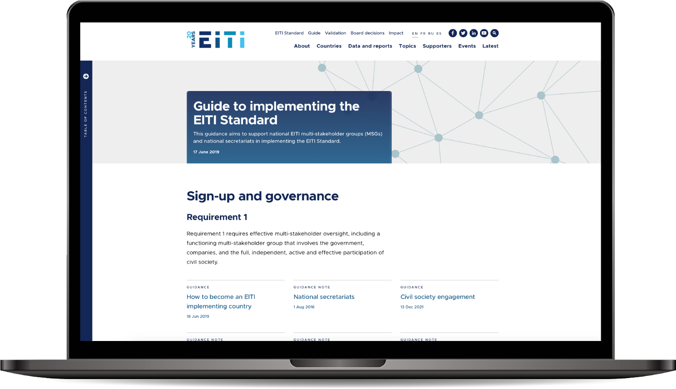

Ознакомьтесь с руководством на странице eiti.org/guide

Slide 48
Вопросы?

Slide 49
Благодарим за внимание!
ЭЛ. ПОЧТА secretariat@eiti.org ТЕЛ. +47 22 20 08 00
АДРЕС EITI International Secretariat, Rådhusgata 26, 0151 Oslo, Norway

