Slide 1
Norme ITIE 2023 : Principaux changements
Divulgation de la propriété effective

Slide 2

Pourquoi la transparence de la propriété effective est-elle importante ?
RÉFLEXION
Notes:
Ask the audience to respond to this questions and summarise their replies.

Slide 3

Pourquoi la transparence de la propriété effective est-elle importante ?
RÉFLEXION
Les sociétés anonymes peuvent faciliter le blanchiment d’argent et la corruption.
Il est essentiel de savoir qui est propriétaire et qui contrôle les entreprises extractives afin de limiter les risques de corruption et les conflits d’intérêts.
Notes:
The abuse of anonymous companies remains the getaway vehicle for the corrupt. They enable wrongdoers to hide behind a chain of companies registered in multiple jurisdictions. Protecting anonymity can deter investment and make it harder to curb corruption. It is estimated that developing countries have lost USD 1 trillion a year since 2011 as a result of corrupt or illegal deals, many of which involve anonymous companies.
Knowing who has the rights to extract oil, gas and minerals is key to addressing risks of corruption or conflict of interest.
Multi-stakeholder groups are required to consider issues related to extractive sector governance – including issues related to corruption – to place more focus on ensuring that EITI implementation strengthens anti-corruption efforts and addresses other nationally relevant governance issues.

Slide 4

Pour les gouvernements et les citoyens
RÉFLEXION
Améliorer le recouvrement des avoirs volés.
Assurer l’intégrité du système d’octroi des licences minières en évitant la corruption pouvant découler de connexions politiques.
Préserver l’intégrité des procédures de passation des marchés publics en révélant les possibles conflits d'intérêts.
Suivre le niveau de participation des entreprises locales à la chaîne d’approvisionnement minier.
Améliorer le climat des investissements.
Notes:
Provides an additional tool for the recovery of stolen assets.
Restores the integrity of the mining licensing system and ensures the absence of political connections that promote corruption.
Increases integrity of public procurement by detecting conflicts of interest.
Enables effective monitor progress towards increased participation of local businesses in the supply of goods and services to the mining sector and participation of citizens in mining activities.
Improves countries’ standing as an attractive investment destination.

Slide 5

Pour les entreprises
RÉFLEXION
Favoriser un climat sain et juste pour les affaires et les investissements.
Améliorer la légitimité sociale de l’activité extractive.
Appuyer la vérification préalable des fournisseurs et des partenaires commerciaux.
Promouvoir et protéger la réputation des entreprises en s’engageant à adopter des pratiques commerciales transparentes.

Slide 6


Norme ITIE 2023
Nouvelles dispositions pour :
Donner aux pays et aux entreprises la possibilité de détecter et de limiter les risques de corruption
Renforcer la divulgation de la propriété effective
Notes:
The EITI Standard has evolved to respond to stakeholder needs and a changing global context.
Now in its fourth edition, the 2023 EITI Standard now includes several new and refined provisions that enable countries to respond to the most pressing challenges that concern natural resource governance today.
Since 2020, the EITI has been strengthening its work on anti-corruption, recognising the unique opportunity for EITI implementation to address corruption and governance risks in the natural resource sector.
For the first time, the 2023 EITI Standard explicitly reflects anti-corruption in the objectives and text of several EITI Requirements.
It includes provisions to help EITI implementing countries identify areas across the extractive sector value chain that are vulnerable to corruption, without imposing burdensome reporting requirements.
As part of strengthening aspects of the standard related to anti-corruption, there are some key changes on beneficial ownership

Slide 7
Transparence de la propriété effective tout au long de la chaîne de valeur
La Norme ITIE couvre
Ressources naturelles
Contrats et licences
Production
Recouvre-ment des recettes
Allocation des recettes
Dépenses sociales et économiques
Utilité publique
Établir un contrôle de l’intégrité de la procédure d’octroi et de transfert des licences/contrats
Améliorer le contrôle gouvernemental des exploitants/projets
Réduire les risques de corruption dans la passation des marchés de la chaîne d’approvisionnement
Aider à exposer les sociétés écrans et les stratagèmes utilisés aux fins d’évasion fiscale/ blanchiment d’argent
Prévenir les conflits d’intérêts dans la gestion des recettes
Exposer les détournements de revenus facilités par les sociétés écrans
Détecter les conflits d’intérêts dans les processus d’approvisionnement
Améliorer la réputation et la crédibilité des investisseurs dans les projets publics
Notes:
Contracts and licenses: Prevents conflict of interest /Ensures compliance with anti-corruption provisions/ Detects anomalies and license transfers/ Reveals track record and past conduct of license applicants
Production: Supports government oversight of operators and project participants / Improves due diligence / Reduces corruption in procurement /
Revenue collection: Exposes shell companies and schemes used for tax evasion / Curbs money laundering by revealing ultimate beneficiaries / Attracts investment by providing necessary data for investors and analysts
Revenue allocation: Prevents conflict of interest in management of resource funds / Reveals attempts to divert revenues through shell companies / Increases oversight of joint venture partnerships with state owned enterprises
Social and economic spending: Detects conflict of interest in government procurement processes / Increases competition and attracts responsible investors in public projects /Enables law enforcement to identify and pursue criminal activity /Improves revenue collection and increases domestic resources available to citizen services

Slide 8
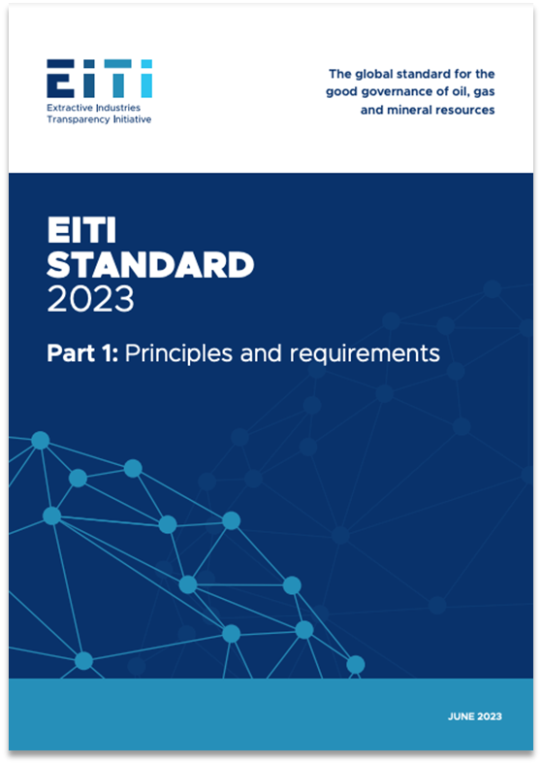
NORME ITIE 2023
Résumé des principaux changements concernant la propriété effective

Slide 9




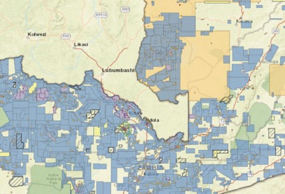


Domaines clés
SEUILS DE DÉCLARATION
PERSONNES POLITIQUEMENT EXPOSÉES
ENTREPRISES D’ÉTAT
PROPRIÉTÉ ET STRUCTURES JURIDIQUES
OCTROI DES LICENCES
POLITIQUES ET PRATIQUES DES ENTREPRISES
EXHAUSTIVITÉ ET FIABILITÉ
Notes:
There are seven key changes in the 2023 Standard that relate to beneficial ownership
Reporting thresholds
PEPs
SOEs
Legal ownership and structures
Licensing
Company policies and practices
And comprehensiveness and reliability of stock exchange filings

Slide 10

DOMAINE CLÉ
Seuil pour la déclaration des informations relatives à la propriété effective
Notes:
First aspect – ownership thresholds.
For the most common forms of ownership and control – namely, direct or indirect possession of ownership shares, voting rights, and right to income – most jurisdictions establish a threshold for disclosure requirements, expressed as a percentage of total ownership or control.
When establishing the definition of beneficial ownership, jurisdictions specify the minimum stake an individual needs to own or control in a company, such as possession of ownership shares or voting rights. The lower the threshold, the easier it is to identify hidden interests.
However, there is no one-size-fits-all level for thresholds since different percentages will be appropriate in line with the different policy aims that governments pursue via BOT. Similarly, certain economies or industry sectors that are associated with higher risks of financial crime should apply more stringent thresholds.
Whilst thresholds can always be exploited by individuals seeking to avoid disclosure requirements by limiting their ownership stakes to just below the level stipulated in law, having low thresholds makes this more difficult. Lower thresholds for reporting the beneficial owners of oil, gas and mining companies enable the public to have a more comprehensive view of who benefits from natural resources.

Slide 11
SEUILS DE DÉCLARATION DE LA PROPRIÉTÉ
Exigence 2.5 (f)(i)
Les pays mettant en œuvre l'ITIE sont encouragés à adopter un seuil de propriété de 10% ou inférieur pour la déclaration des bénéficiaires effectifs.
Notes:
The EITI Standard now encourages countries to adopt an ownership threshold of 10% or lower.
This means that any individual who directly or indirectly holds this or a higher percentage of shares of a company will be disclosed as a beneficial owner. This ensures that most or all ownership interests are disclosed, leaving no room for hidden interests.
This makes the EITI the only Standard clearly recommending a threshold. FATF does not recommend a specific threshold level, but mentions a maximum 25% figure as recommended, in the context of examples to illustrate how thresholds would work.
While early adopters like the UK and Ukraine established a 25% threshold in 2015, and the European Union’s AMLD4 did the same that year, more recent legislation across jurisdictions has set lower thresholds.
Now, more than 20 EITI countries have embraced a threshold of 10% or less, including Argentina (1 share or above), Colombia (5%), Nigeria (5%) and Senegal (2%).
Several countries have also adopted lower thresholds specifically for high-risk sectors such as the extractives, including Armenia (10% for mining sector, versus 20% for other sectors), Ghana (5% for locally registered extractive sector companies, versus 20% for low-risk sectors) and Liberia (5% for mining, oil, gas and agriculture, versus 10% for the forestry sector).
Still, many countries have yet to follow suit.

Slide 12
Justification
SEUILS DE DÉCLARATION DE LA PROPRIÉTÉ
Le secteur extractif présente des risques élevés de corruption.
Le fait de fixer des seuils plus bas de déclaration permet de clarifier les structures de propriété (par exemple, petite participation dans une grande entreprise).
Permet au public de contrôler qui bénéficie des ressources naturelles.
Notes:
When setting threshold levels, governments should start by examining the policy goals behind their drive to create BO registers. These can include tackling corruption, money laundering, terrorism financing, and tax evasion, or supporting economic activity by lowering the chance of fraud and the cost of due diligence. A low threshold is necessary to capture data on the relevant beneficial owners that enable governments to meet the majority of these policy goals.
When setting thresholds, implementers should adopt a risk-based approach (RBA) to most effectively meet their specific policy goals. High thresholds leave a disclosure regime vulnerable to loopholes, whilst low thresholds enable authorities to capture more data on those with relationships of ownership or control over corporate vehicles.
The extractives sector, being a high risk sector in most EITI implementing countries, should therefore have lower thresholds for reporting the beneficial owners of oil, gas and mining companies. This enables the public to have a more comprehensive view of who benefits from natural resources.
Armenia, for instance, moved from a 20% threshold for BO in its 2008 AML law to a 10% level for its 2019 mining sector disclosures. Similarly, Liberia adopted a 5% threshold for mining, oil, gas, and agriculture, versus a higher 10% threshold for the forestry sector. Ghana has adopted a 0% threshold for all locally registered extractive sector companies. Foreign extractive companies operating in Ghana are subject to a 5% disclosure threshold.
Sector-specific thresholds are easier to implement in regulated industries or other situations where authorities know which companies are operating in a given sector, and therefore also which companies are expected to declare at a given threshold.

Slide 13
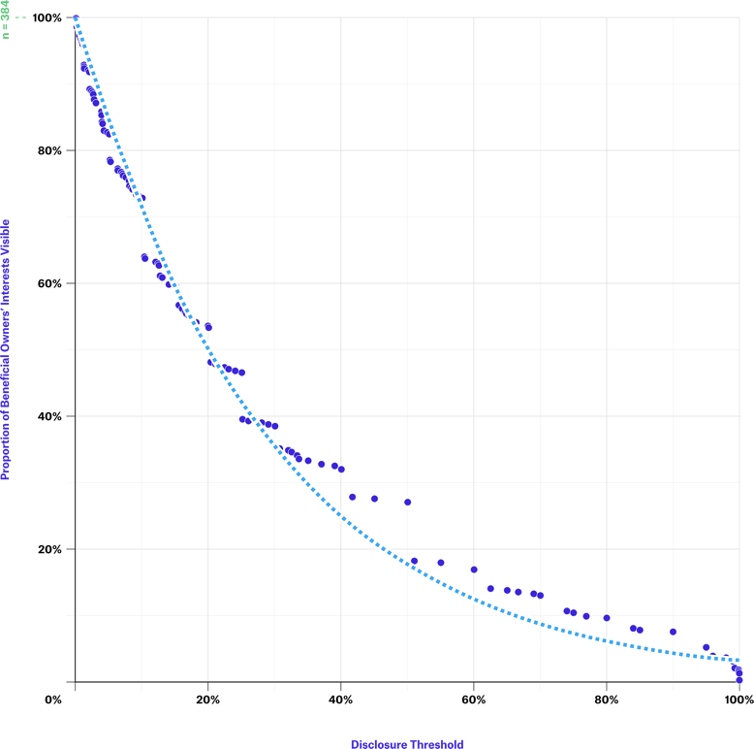
SEUILS DE DÉCLARATION DE LA PROPRIÉTÉ
ÉTUDE DE CAS
Nigeria
Visibilité des bénéficiaires effectifs à différents niveaux de seuil dans le secteur extractif du pays.
Proportion des intérêts des bénéficiaires effectifs visibles
Seuil de divulgation
SOURCE : ITIE NIGERIA & OPEN OWNERSHIP
Notes:
Setting low thresholds ensures that a greater number of beneficial owners are disclosed to authorities.
Examination of the data from Nigeria’s extractive industry disclosures in this figure demonstrates the extent to which different thresholds can alter the number of interests disclosed by beneficial owners.
If Nigeria had applied a 20% threshold for its extractive industries disclosure requirements, rather than effectively having no threshold level, then the number of reported interests would have halved. This would very likely have had detrimental effects on the policy aims of helping to prevent or investigate corruption cases linked to the sector.

Slide 14

DOMAINE CLÉ
Obligation de déclaration pour les personnes politiquement exposées (PPE)
Notes:
Second aspect – reporting obligations for politically exposed persons or PEPs.

Slide 15
OBLIGATIONS DE DÉCLARATION POUR LES PPE
Exigence 2.5 (c)
Il est exigé des pays de mise en œuvre qu'ils demandent aux entreprises de divulguer le nom de toute personne politiquement exposée détenant directement ou indirectement une participation dans une entreprise, quel que soit le niveau de propriété.
Notes:
The 2023 EITI Standard strengthened the requirement for disclosure of PEPs who directly or indirectly hold an interest in a company, by requiring full disclosure of PEPs regardless of their level of ownership.

Slide 16
Justification
OBLIGATIONS DE DÉCLARATION POUR LES PPE
Il est amplement reconnu que les PPE tirent un pouvoir d’influence de leur position, qu’elles peuvent utiliser de manière abusive à des fins de corruption, de malversation ou de blanchiment d’argent.
Ces divulgations sont primordiales pour détecter les conflits d’intérêts.
Le manque de transparence sur les PPE et leurs actifs – en particulier ceux détenus dans le secteur extractif – peut augmenter le risque de corruption, en particulier lorsque ces PPE ont un rôle à jouer dans l’attribution de concessions de ressources naturelles.
Notes:
These disclosures are important for identifying conflicts of interest.
Conversely, a lack of transparency on PEPs and their assets – specifically those held in the extractive sector – can pose high corruption risks, especially when PEPs are involved in the award of natural resource concessions.
Initiatives like “Joining the dots” demonstrate the value of using this information.

Slide 17

OBLIGATIONS DE DÉCLARATION POUR LES PPE
ÉTUDE DE CAS
Arménie et Ghana
Définir la notion de PPE et prévoir l’obligation de déclaration
Établir des seuils de propriété pour les PPE :
  Arménie 0 %
  Ghana 0 % PPE locales, 5 % PPE à haut risque et étrangères
Notes:
Countries like Armenia, Ghana or the Kyrgyz Republic require beneficial owners that are PEPs to disclose their ownership or control irrespective of the size of the stake.

Slide 18

DOMAINE CLÉ
Propriété et contrôle des entreprises d’État et de leurs fournisseurs
Notes:
Third aspect – ownership and control of state-owned enterprises and their suppliers.
SOEs in the extractive sector play an important role in the production and sale of natural resources and may, thereby, generate significant revenue for the state.
Not having visibility of how SOEs are owned and controlled would constitute a considerable weakness that could undermine the specific aims of beneficial ownership transparency reforms.
The specific risks of opaque ownership and control of SOEs include:
A lack of visibility of the transfer of assets between private and public sectors;
The misuse of SOE resources;
Not understanding the impact of SOEs on the economy;
And not understanding the impact of any cross-border activity undertaken by SOEs.

Slide 19

PROPRIÉTÉ ET CONTRÔLE DES ENTREPRISES D’ÉTAT
Exigence 2.5 (e)(v)
Il est exigé des entreprises d’État qu’elles divulguent :
Nom du ou des États détenant ou contrôlant l’entreprise d’État
Niveau de propriété
Détails quant à la façon dont la propriété ou le contrôle est exercé
Si l’entreprise d’État n’appartient pas exclusivement à l’État, les informations sur la propriété effective doivent être divulguées conformément à l’Exigence 2.5 (c).
Notes:
Under the 2023 Standard, SOEs are required to disclose:
Name of the state(s) owning or controlling the SOE
Level of ownership
Details about how ownership or control is exerted
In any declaration by an SOE, it is recommended to capture information about the state or state agency involved – this is in addition to the usual information required about natural persons, to be able to comprehensively understand their ownership and control. In this context, only declaring the state ownership of an SOE is insufficient, and more focus should be put on those in control and the benefits that may arise from their positions of stewardship.

Slide 20
PROPRIÉTÉ ET CONTRÔLE DES ENTREPRISES D’ÉTAT
Exigence 2.6 (e)
Dans la mesure du possible, les entreprises d’État sont encouragées à divulguer l’identité et la propriété effective détenue par leurs agents ou intermédiaires, fournisseurs ou sous-traitants relativement aux transactions significatives.
Notes:
Where feasible, SOEs are encouraged to disclose the identity and beneficial ownership of their agents or intermediaries, suppliers or contractors for material transactions.

Slide 21
Justification
PROPRIÉTÉ ET CONTRÔLE DES ENTREPRISES D’ÉTAT
Veiller à ce que les activités commerciales soient conduites de manière éthique et juste.
Veiller à l’évaluation des risques liés aux intermédiaires, fournisseurs et sous-traitants.
Renforcer la confiance des investisseurs.
Notes:
Unlike in the case of an ordinary business, for SOEs, the people whom the state represents have no direct relationship to the entity – neither in regard to the usual benefit of profit, nor in control over operations. However, SOEs deploy public funds. It is therefore taxpayer money that has been invested and is at risk, as well as, potentially, the state’s natural resources, reinforcing the need for transparency to enable accountability and oversight.
SOEs often have complex corporate structures – sometimes spread across multiple jurisdictions – which intertwine with governments in diverse ways via direct or indirect ownership stakes or controlling interests.
To prevent corruption and bribery, it is essential to identify the ultimate owners of companies engaged in transactions with state-owned enterprises (SOEs). This ensures that business dealings are conducted in an ethical and fair manner. The disclosure of beneficial ownership information enables the assessment of risks linked to intermediaries, contractors, and suppliers.
Clear and accessible information about SOEs ownership and control enhances investor confidence.

Slide 22
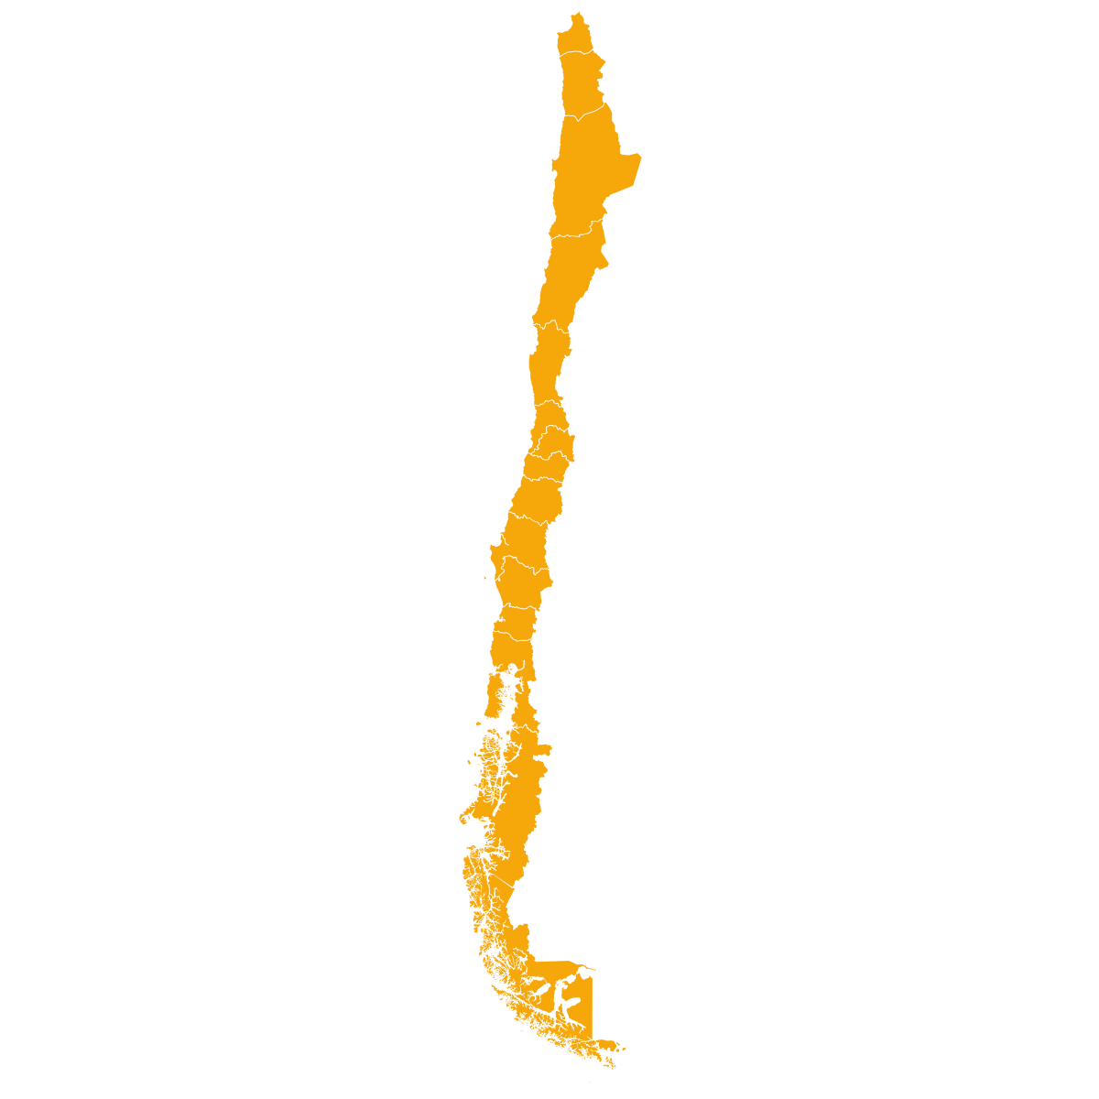
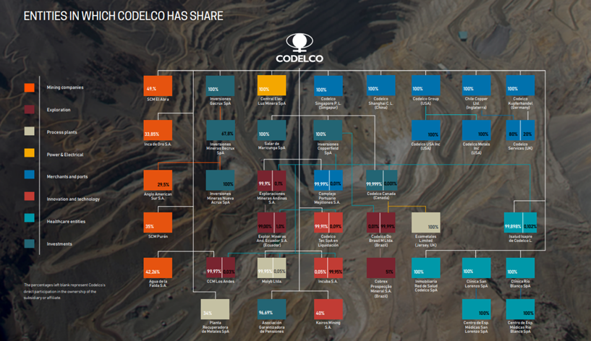
PROPRIÉTÉ ET CONTRÔLE DES ENTREPRISES D’ÉTAT
ÉTUDE DE CAS
Codelco, Chili
Informations détaillées sur la propriété et le contrôle divulguées sur le site Internet
Informations sur les filiales et sociétés affiliées, ainsi que sur le pourcentage de participation publiées dans le Rapport complet 2022
Notes:
Top copper mining company, 100% owned by the Chilean state. Codelco is part of ICMM and therefore supports the EITI.
Codelco publishes information about its subsidiary companies on its website https://www.codelco.com/transparencia/filiales.
In addition, on pages 215 and 216 of the "Integrated Report 2022" data on exploration activities in Brazil are reported.
https://www.codelco.com/prontus_codelco/site/docs/20230405/20230405113753/memoria2022.pdf.
Codelco publishes information on financial results on its website
https://www.codelco.com/transparencia/estados-financieros-y-memorias/estados-financieros-consolidados
Expect 6: Shareholders meeting website:
https://www.codelco.com/transparencia/junta-de-accionistas / The company discloses its corporate governance structure on its 2020 Sustainability Report, page 16-20. Codelco's Corporate Governance Law establishes as an operating principle that it corresponds to the President of the Republic to exercise the powers and functions of the shareholder and of the shareholders' meeting (role of "owner"). https://www.codelco.com/transparencia/junta-de-accionistas
Another example: PT Pertamina (https://www.pertamina.com/en/our-shareholder)
*OE SOE Policy Brief EN.pdf (eiti.org)

Slide 23

DOMAINE CLÉ
Propriété au sens juridique et structures de propriété
Notes:
Fourth aspect – legal ownership and ownership structures.

Slide 24
PROPRIÉTÉ JURIDIQUE ET STRUCTURES DE PROPRIÉTÉ
Exigence 2.5 (g)
Il est exigé des pays de mise en œuvre qu'ils divulguent l’identité des propriétaires légaux des personnes morales comme le prévoit l’Exigence 2.5 (c), ainsi que leur taux de participation.
Applicable aux personnes morales ayant fait une demande de licence ou de contrat pétrolier, gazier ou minier, de production ou d’exploration, ou y détendant une participation.
Notes:
Implementing countries are required to disclose the legal owners of the corporate entity(ies) defined in Req. 2.5(c), including share of ownership.

Slide 25
PROPRIÉTÉ JURIDIQUE ET STRUCTURES DE PROPRIÉTÉ
Exigence 2.5 (g)
Les entreprises sont encouragées à divulguer leur structure de propriété, notamment la chaîne complète de personnes morales menant jusqu’au bénéficiaire effectif.
Applicable aux personnes morales ayant fait une demande de licence ou de contrat pétrolier, gazier ou minier, de production ou d’exploration, ou y détendant une participation.
Notes:
Companies are also encouraged to disclose their ownership structure, including the full chain of legal entities leading to the beneficial owner.
Tab 4 c in the BO model declaration form provides a template for disclosing beneficial owners. The model declaration

Slide 26
Justification
PROPRIÉTÉ JURIDIQUE ET STRUCTURES DE PROPRIÉTÉ
Connaître le bénéficiaire effectif final ne suffit pas pour comprendre la structure de propriété d’une entreprise dans son ensemble.
Connaître les propriétaires légaux et comprendre la structure de la propriété d’une entreprise permet d’avoir une image complète de la chaîne de propriété de cette entreprise.
Notes:
Knowing the ultimate beneficial owner is not enough to understand a company’s whole ownership structure.
Understanding legal owners and the ownership structure of company can help in providing a full picture of the company’s ownership chain.
This can help to map the entire scope of companies and relationships between individuals and legal entities that control, influence or own a company, which can inform investigations on conflicts of interest.

Slide 27
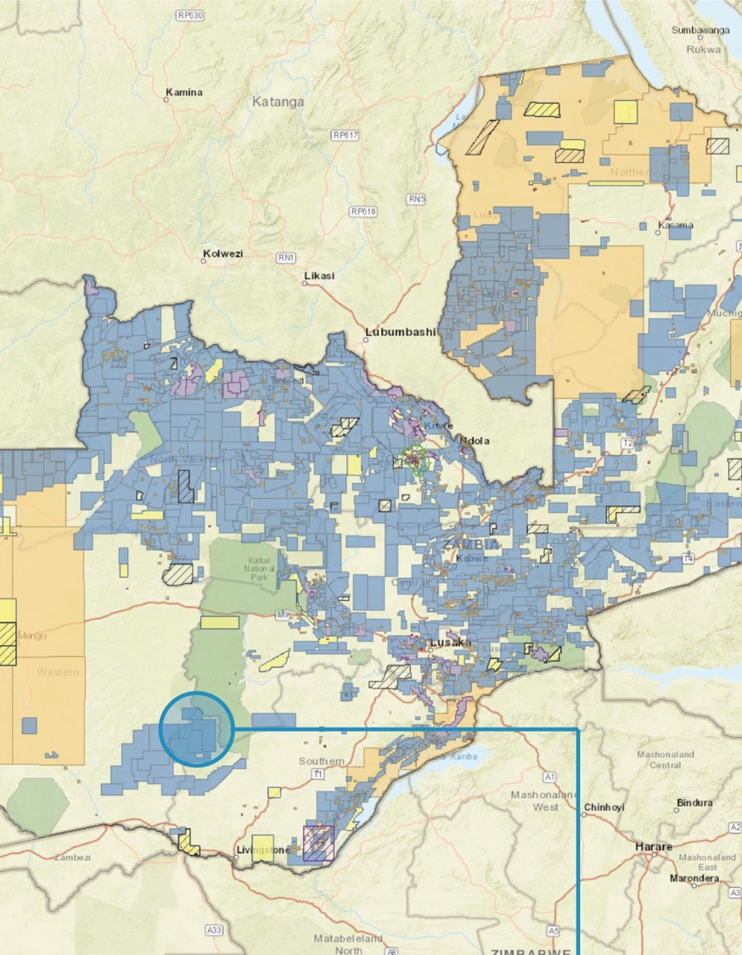
DOMAINE CLÉ
Registre des licences, demandes de licences et bénéficiaires effectifs
Notes:
Fifth aspect – linking BO to license applications and registers.

Slide 28
REGISTRE DES LICENCES, DEMANDES ET BÉNÉFICIAIRES EFFECTIFS
Exigence 2.2 (c)
Lorsqu’une licence est attribuée à l’issue d’un processus d’appel d’offres, il est exigé du gouvernement qu'il divulgue la liste des soumissionnaires, y compris leurs bénéficiaires effectifs de même que les critères de soumission, conformément à l’Exigence 2.5.
Notes:
Requirement 2.2 c now states that, where licenses are awarded through a bidding process, the government is required to disclose the list of applicants, including their beneficial owners in accordance with Req. 2.5, and the bid criteria.

Slide 29
REGISTRE DES LICENCES, DEMANDES ET BÉNÉFICIAIRES EFFECTIFS
Exigence 2.3 (d)
Les pays de mise en œuvre sont encouragés à relier les registres de licences accessibles au public à d’autres plateformes gouvernementales qui divulguent ou détiennent des informations conformément à l’Exigence 2.5 sur les bénéficiaires juridiques et effectifs d’entreprises pétrolières, gazières et minières.
Notes:
In addition, implementing countries are encouraged to link publicly available license registers to legal and beneficial ownership registers or other government platforms that disclose or hold information in accordance with Requirement 2.5.

Slide 30
Justification
REGISTRE DES LICENCES, DEMANDES ET BÉNÉFICIAIRES EFFECTIFS
La Norme ITIE 2023 permet de rapprocher les informations relatives à l’octroi des licences et aux bénéficiaires effectifs, le but étant que les licences soient accordées à des entités transparentes et redevables.
Ce rapprochement peut aider les régulateurs à savoir qui se trouve derrière les personnes morales qui font une demande de licence, en détiennent une ou souhaitent la transférer. C’est une méthode servant à contrôler et à garantir l’intégrité des processus.
Notes:
The 2023 EITI Standard reinforces the connection between licensing and beneficial ownership information, helping ensure that licenses are granted to transparent and accountable entities.
This linkage can help regulators analyse who is behind the legal entities applying for, holding or transferring licenses.

Slide 31

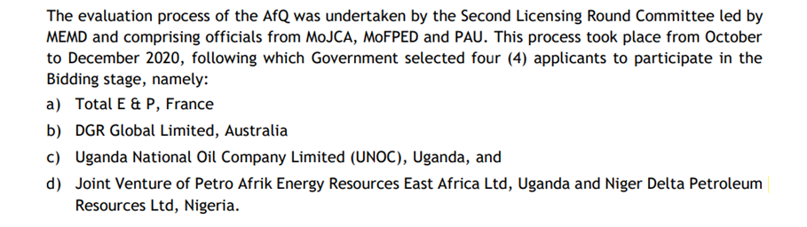
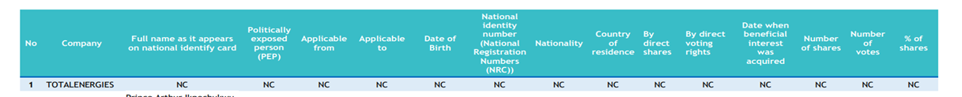
REGISTRE DES LICENCES, DEMANDES ET BÉNÉFICIAIRES EFFECTIFS
ÉTUDE DE CAS
OUGANDA
Divulgation de la propriété juridique des soumissionnaires lors d’une procédure ouverte pour l’octroi de licences pétrolières
Notes:
Although few jurisdictions actively link license and beneficial ownership information, the Opening Extractives programme, implemented by the EITI and Open Ownership, is supporting countries like Colombia, Ghana, Indonesia and Zambia to ensure that beneficial ownership data is actively used for license screening.
In this case Uganda has disclosed through the EITI report a partial list of applicants to the second licensing bidding round. Some of the applicants are material companies already required to provided BO information. However, Uganda did disclose only those a list of prequalified applicants. It would be necessary for Uganda to disclose the full list of applicants (which were 6 and not 4) and the respective BO information.
Countries like Armenia, who discloses BO information on all their mining companies, are also a good example.
Other examples in which BO is required (as stipulated by law) for bidding rounds/licensing rounds but not disclosed to the public: Colombia/Mexico

Slide 32


DOMAINE CLÉ
Politiques et pratiques des entreprises en matière de propriété effective
Notes:
Sixth aspect – Company policies and practices on beneficial ownership.

Slide 33
POLITIQUES ET PRATIQUES DES ENTREPRISES
Exigence 1.2 (b)
Il est attendu des entreprises privées et des entreprises d’État déclarantes qu’elles publient une politique de lutte contre la corruption, incluant l’utilisation qu’elles font des données sur la propriété effective.
Il est attendu des entreprises siégeant au groupe multipartite qu’elles suivent des processus rigoureux de vérification préalable.
Notes:
The EITI Standard introduces new requirements that shed light on companies’ safeguards against corruption. All reporting companies, including state-owned enterprises, are now expected to publish an anti-corruption policy that sets out how they manage corruption risks, including their use of beneficial ownership data.
Additionally, companies that participate in multi-stakeholder groups are expected to engage in rigorous due diligence processes to strengthen the integrity of the EITI process.
State-owned enterprises are encouraged to disclose the identity of the beneficial owners of their agents or intermediaries, suppliers or contractors, where feasible.
These disclosures help to uncover connections to politically exposed persons (PEPs) and other conflicts of interest.

Slide 34
Justification
POLITIQUES ET PRATIQUES DES ENTREPRISES
Maintenir des règles du jeu équitables
Formaliser la politique anti-corruption et démontrer l’utilisation des données sur la propriété effective à des fins de vérification préalable
Préserver la cohérence avec la politique sur les Attentes à l’égard des entreprises soutenant l’ITIE
Notes:
In line with what was mentioned at the beginning, this helps to maintain a level playing field, to formalise anti-corruption policies and demonstrate use of BO data for due diligence.
This also ensures that there is a clear alignment with the EITI’s Expectations for EITI supporting companies
Most companies already have such policies, so reporting is straightforward.
EITI requires documentation of policies and practices

Slide 35

POLITIQUES ET PRATIQUES DES ENTREPRISES
ÉTUDE DE CAS
Auxico Resources Canada
La politique de lutte contre la corruption et les pots-de-vin de cette entreprise contient des dispositions en matière de vérification préalable et définit des signaux d’alarme :
Sociétés écrans et entités détenues ou contrôlées par des fonctionnaires publics, leurs proches ou associés
Réticence ou refus de divulguer les informations sur la propriété
Tierce partie demandant que son identité ne soit pas divulguée
SOURCE : AUXICO RESOURCES CANADA INC, « DOCUMENTS DE GOUVERNANCE »
Notes:
Red flags:
“shell companies, and entities owned or controlled by Government Officials or their relatives or associates”;
“reluctance or refusal to disclose ownership”;
“family ties of a third party with a Government Official”;
“third party requests that identity not be disclosed” (p. 26-27).
Due diligence measures include:
“background checks including qualifications, financial background, government and political ties, number and reputation of clientele, reputation in community, criminal record checks and possible associations with criminal, terrorist or other proscribed persons or groups […]
"If the background check reveals problematic information, Auxico will not, in the absence of extenuating circumstances, enter into an agreement with that third party.”

Slide 36


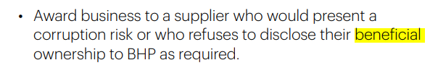
COMPANY POLICY & PRACTICE
ÉTUDE DE CAS
BHP
Le code de conduite de cette entreprise définit des lignes directrices sur l’obligation de fournir des informations concernant les bénéficiaires effectifs afin de mieux contrôler le risque de corruption.
SOURCE: BHP, “OUR CODE”
Notes:
We encourage our suppliers to be transparent on matters important to society, including on their beneficial ownership
Always:
-Understand the identity, role and interests of the person or business who you are dealing with (including the beneficial ownership of companies)
-Always ensure the supplier (including their beneficial owners): is reputable, competent and qualified to perform the work for which they are being hired; will operate safely and ethically; and that compensation sought is reasonable.
Never:
Deal with a party that refuses to disclose its true identity (including details of company beneficial ownership).
Award business to a supplier who would present a corruption risk or who refuses to disclose their beneficial ownership to BHP as required.

Slide 37
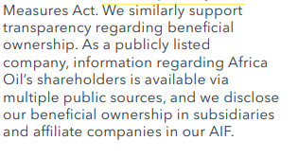
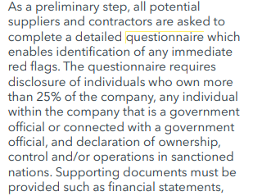
COMPANY POLICY & PRACTICE
ÉTUDE DE CAS
Africa Oil Corp.
Le programme de vérification préalable des fournisseurs d’Africa Oil Corp. exige que les fournisseurs et les sous-traitants remplissent un questionnaire sur les bénéficiaires effectifs dépassant un seuil de participation de 25 % et les PPE.
SOURCE: AFRICA OIL CORP., “2022 SUSTAINABILITY REPORT”
Notes:
As a preliminary step, all potential suppliers and contractors are asked to complete a detailed questionnaire which enables identification of any immediate red flags. The questionnaire requires disclosure of individuals who own more than 25% of the company, any individual within the company that is a government official or connected with a government official, and declaration of ownership, control and/or operations in sanctioned nations. Supporting documents must be provided such as financial statements, incorporation documents and compliance policies and procedures. Should the third party have insufficient compliance documentation, we will refer them to our own policies. Additional scrutiny is given to contractors that would act as an agent on behalf of Africa Oil. Any identified risks at this stage are escalated to the Chief Financial Officer. The next step requires an internal representative to fill in another questionnaire providing additional information regarding Africa Oil’s knowledge of and relationship with the third party, including commercial terms. This aids our Corporate Counsel and Secretary to gauge the level of risk and potentially escalate any concerns to the Chief Financial Officer

Slide 38

DOMAINE CLÉ
Fiabilité et exhaustivité des données concernant la propriété des sociétés cotées en Bourse
Notes:
Seventh aspect – Reliability and comprehensiveness of ownership data for publicly listed companies.

Slide 39
DONNÉES SUR LA PROPRIÉTÉ DES SOCIÉTÉS COTÉES EN BOURSE
Exigence 2.5 (f) (iii)
Il est exigé des entreprises cotées en bourse, y compris des filiales leur appartenant entièrement, qu’elles divulguent le nom de la bourse et d'inclure un lien vers la documentation de la bourse où elles sont cotées afin de faciliter l’accès public aux informations sur la propriété effective.
Notes:
Publicly listed companies, including wholly-owned subsidiaries, are required to disclose the name of the stock exchange and include a link to the stock exchange filings where they are listed to facilitate public access to their beneficial ownership information.

Slide 40
DONNÉES SUR LA PROPRIÉTÉ DES SOCIÉTÉS COTÉES EN BOURSE
Exigence 2.5 (f) (iii)
Le groupe multipartite est encouragé à examiner l’exhaustivité et la fiabilité des informations sur la propriété qui sont divulguées dans les dépôts boursiers.
Notes:
EITI multi-stakeholder groups are also encouraged to review the comprehensiveness and reliability of ownership data disclosed in stock exchange filings.

Slide 41
Justification
DONNÉES SUR LA PROPRIÉTÉ DES SOCIÉTÉS COTÉES EN BOURSE
Les informations communiquées aux autorités boursières sont essentielles pour garantir l’intégrité des marchés financiers.
Ces règles favorisent la confiance des investisseurs et une répartition équitable et efficace des capitaux.
Le caractère complet des informations permet de prévenir les pertes financières et d’encourager des conditions de concurrence équitables.
Notes:
This is important because:
First of all, stock exchange filings are essential to the integrity of financial markets
Fosters investor confidence and fair and efficient capital allocation
Comprehensive disclosures help to prevent financial losses and promote a level playing field
Corrupt practices may involve false or misleading information in stock exchange fillings, insider trading manipulation of non-public information for personal gain.
On top of this, reviewing the comprehensiveness and reliability of ownership data disclosed in stock exchange filings can help address gaps in certain jurisdictions where publicly listed companies might take advantage of lax transparency requirements.

Slide 42
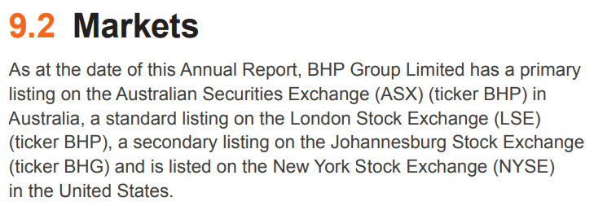
DONNÉES SUR LA PROPRIÉTÉ DES SOCIÉTÉS COTÉES EN BOURSE
ÉTUDE DE CAS
BHP
Cette entreprise diffuse des informations sur son site Internet, lequel contient des sections spécifiques pour chacune de quatre bourses où elle est cotée.
SOURCE : RAPPORT ANNUEL DE BHP 2023
Notes:
https://www.pwc.com.au/legal/assets/listing-company-asx.pdf

Slide 43
DONNÉES SUR LA PROPRIÉTÉ DES SOCIÉTÉS COTÉES EN BOURSE
OUTIL
Étapes pour vérifier l’exhaustivité/la fiabilité
Pour évaluer la solidité de la définition de la propriété et du contrôle des exigences des autorités boursières, il convient d’examiner si les sociétés ont à fournir les informations suivantes :
Une notification en temps utile en cas d’acquisition et de cession de droits de vote importants ;
Une notification si des participations et parts d’intérêts agrégées sont utilisées de manière groupée moyennant un accord ;
Une notification en cas d’accords sur la propriété et le contrôle par le biais d’instruments financiers ayant un effet similaire à la détention d’actions ou de droits de vote suffisants pour exercer un contrôle ;
Une notification contenant des informations sur les moyens par lesquels les principales participations ou les droits de vote sont exercés (par exemple, la chaîne de propriété) ;
La notification des parts détenues par les dirigeants d’une société.
SOURCE : Open Ownership, 2020
Notes:
In assessing the robustness of the definition of ownership and control in an exchange's disclosure requirements, consideration should be given to whether companies must provide:
timely notification on the acquisition and disposal of significant voting rights;
notifications on the basis of aggregated holdings and interests used jointly via an agreement;
notifications of ownership and control arrangements via financial instruments that have a similar effect to owning shares or controlling votes;
notifications that contain information on the means through which major shareholding or voting rights are exercised (e.g. the chain of ownership);
notifications of interests held by company officers.
The future guidance note on Requirement 2.5 will shed more light on how to assess comprehensiveness and reliability.

Slide 44

Synthèse
Exigence 1.2 :
Publication par les entreprises privées et les entreprises d’État d'une politique de lutte contre la corruption, dont l’usage qu’elles font des données sur les bénéficiaires effectifs (attendu).
Exigences 2.2 et 2.3 :
Divulgation par les gouvernements des noms des bénéficiaires effectifs des entreprises soumissionnaires (exigence).
Mise à disposition publique du lien entre les registres de licence accessibles au public et d’autres plateformes gouvernementales, notamment celles contenant des données sur les propriétaires effectifs et légaux (exigence).

Slide 45
Synthèse
Exigences 2.5 et 2.6 :
Seuil de propriété de ≤ 10 % (encouragement).
Signalement des PPE qui sont en même temps des bénéficiaires effectifs, quel que soit leur degré de participation (exigence).
Examen de l’exhaustivité et de la fiabilité des renseignements fournis aux autorités boursières (encouragement).
Obligation des entreprises d’État de déclarer les informations sur la propriété et le contrôle (exigence), et sur les bénéficiaires effectifs de leurs fournisseurs (encouragement).
Divulgation des propriétaires juridiques (obligation) et de la chaîne de propriété complète (encouragement).

Slide 46
Ressources additionnelles :
Note d’orientation relative à la supervision exercée par le groupe multipartite sur la déclaration des bénéficiaires effectifs (mise à jour prévue en 2024)
Modèle de formulaire de déclaration sur la propriété effective
Liens avec la transition énergétique et la lutte contre la corruption : Faire la lumière sur la propriété des entreprises (Opening Extractives, 2022) ; Qui en profite ? (Opening Extractives, 2022)
Question des seuils : Bénéficiaire effectif en droit : définitions et seuils (Open Ownership, 2019)
Entreprises d’État : Propriété et contrôle des entreprises d’État (Opening Extractives, 2023)
Licences : Licence de forage (Banque mondiale) ; outil MACRA (Transparency International) ; Risques de corruption dans l’attribution des licences (NRGI)
Entreprises : Engagement envers la transparence de la propriété effective (2021) ; Attentes à l’égard des entreprises soutenant l’ITIE (2022) ; Propriété effective et sociétés cotées (Open Ownership, 2020)
Notes:
The guidance note on 2.5 and the model declaration form will be updated in 2024.
On top of these links, there are upcoming publications under Opening Extractives:
A policy brief that will detail the ways in which BO can help tackle corruption across the extractives value chain
A legislative guidance briefing for implementers that will share information and checklists on how to undergo legislative changes related to beneficial ownership

Slide 47
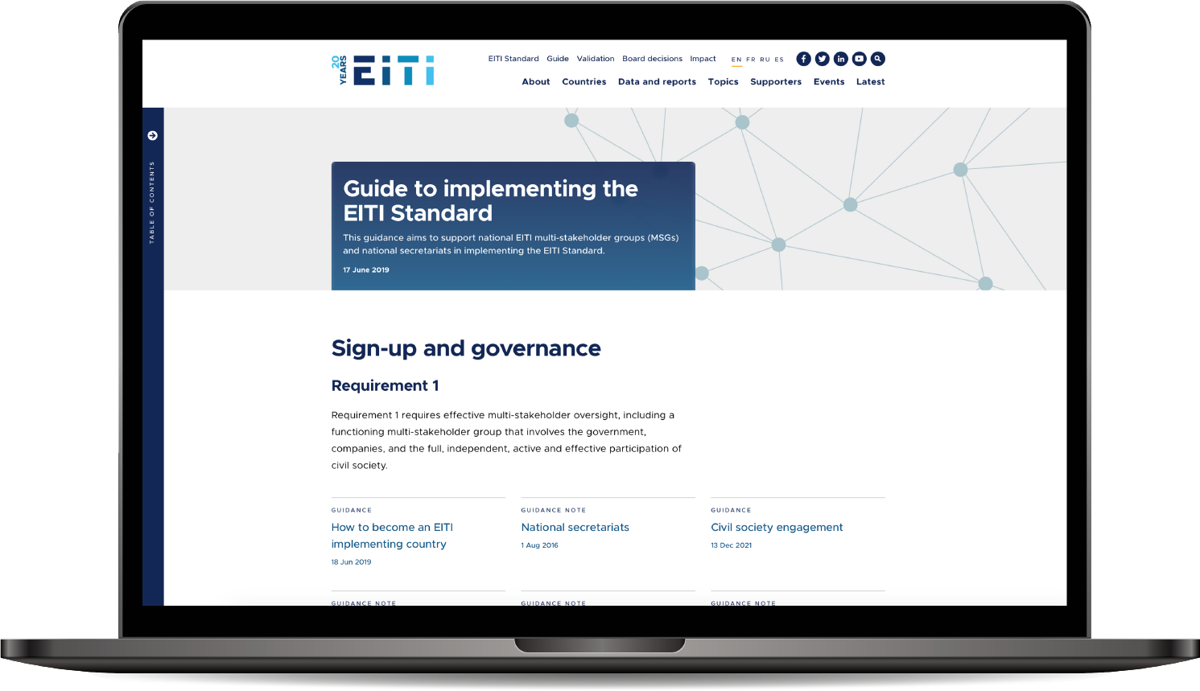

Consultez notre guide eiti.org/guide

Slide 48
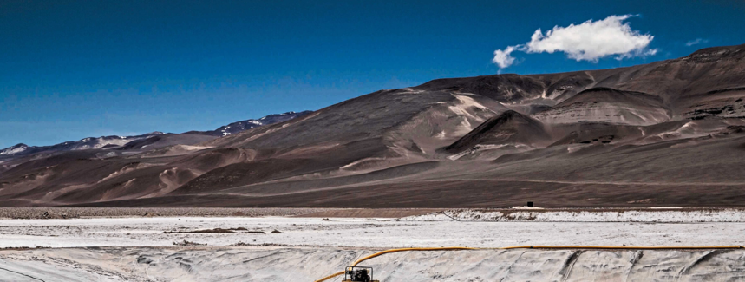
SEUILS DE PROPRIETE EFFECTIVE POUR LE RAPPORTAGE
ETUDE DE CAS
Argentine
La société civile demande une divulgation exhaustive de la propriété effective
SOURCE: PHOTO ESSAY AMERICAN QUARTLEY
Notes:
In Argentina, civil society has highlighted that the lack of accessible information about ownership of the mining sector at the national level makes it hard to build an accurate picture of governance and ensure its public oversight. With support from the Opening Extractives programme, the journalist network Red Ruido and civil society organisation (CSO) Fundeps attempted to investigate the provincial governance of lithium exploitation in two northern provinces of Argentina. As beneficial ownership information was not available in the region, they used accessible information on legal ownership as well as contracts, royalties and many other indicators to investigate.
Lessons leant
Journalists found that four of the world’s largest investment funds and financial companies, which all hold shares in each other’s capital investments, were also the main direct or indirect shareholders of the lithium companies operating in the two provinces. By looking into the companies’ annual accounts and reports, they managed to find names of actual people holding shares and receiving dividends. However, the additional amount of shares collectively held by all these natural persons still only accounted for about 1% of the total shareholding, a very small part of the picture.
The investigation showed the complexity of ownership networks involved in the exploitation of lithium in the country and highlighted how difficult it is to identify the ultimate beneficial owners of these high-value mining projects. The heavy use of investment funds added further complications, as they are exempt from beneficial ownership disclosure requirements in many jurisdictions.
Access to information is important. The lead researchers called for access to better-quality information to ensure public oversight and help detect any potential signs of corruption and fraud in the context of the race towards transition minerals. Beyond the disclosure of beneficial ownership information for investment funds, this case also highlighted the need for improving information on existing regulations and practices relating to complex corporate structures and beneficial ownership. This information is essential to equip civil society to its public oversight function.

Slide 49
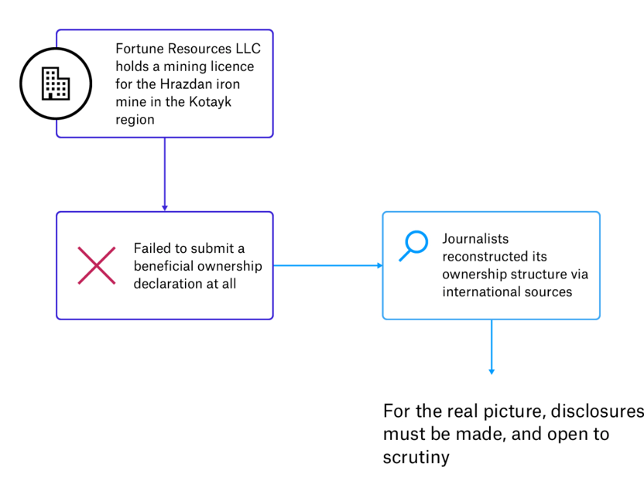
REGISTRE, DEMANDES DE LICENCES ET PROPRIETE REELLE
ETUDE DE CAS
ARMENIE
Des journalistes ont identifié des signaux d'alerte dans la chaîne d'approvisionnement minière grâce au registre du commerce de l'Arménie
En utilisant des sources publiques locales et internationales, les structures de propriété peuvent être reconstituées pour montrer la propriété des entreprises et identifier les signaux d'alerte potentiels. Cela peut inciter les autorités à mener des enquêtes.
Notes:
The Opening Extractives programme implemented by the EITI and Open Ownership gained insights from what journalists found by investigating beneficial ownership information in the the Armenia Electronic Business register.
There are 22 registered entities which have permits to mine, but the actual number of separate companies appears to be far lower and there have been inconsistences in declarations. Armenian law requires mining companies that have a license to extract metallic minerals to make beneficial ownership declarations. However, Armenian journalists discovered that 5 of the 22 companies with mining permits may have submitted incorrect or incomplete declarations or did not submit them at all.
Lessons learnt:
This type of investigation is important for holding companies as well as governments to account for implementing their licensing policies and procedures. In this case, the State Register of Legal Entities of the Ministry of Justice defended the mining companies, saying the companies are aware of their duties and fulfill them, and noted that the State Registrar accepts the information submitted by companies as true unless a complaint is registered. Using publicly available beneficial ownership information can help public authorities and show if companies are failing to comply with obligations and identify red flags of potential conflicts of interest.

Slide 50
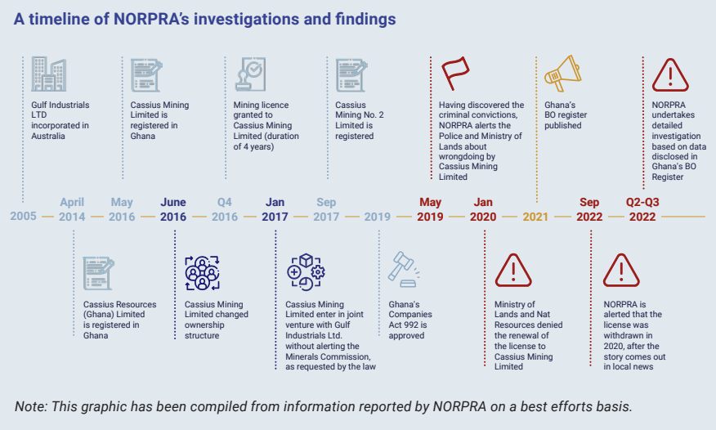
REGISTRE, DEMANDES DE LICENCES ET PROPRIETE REELLE
ETUDE DE CAS
Ghana
Révocation des droits d'exploitation minière sur la base d'une condamnation pénale
Notes:
An example of linking licensing and beneficial ownership information is from the Opening Extractives programme, where journalists in Ghana uncovered criminal beneficial owners based on how legal criteria on beneficial ownership information which includes criminal records of a company’s management and beneficial owners; a company’s history of compliance with tax and other legal requirements; and/ or nationality requirements. Knowing an applicant’s beneficial owners can allow for criminal background checks and related due diligence to be performed. For example, Ghana’s Companies Act prohibits individuals with criminal convictions or a history or fraud from doing business in Ghana.
Lesson learnt:
In 2020, Ghana’s Minister for Mines instructed the Minerals Commission not to renew a license for a company on the grounds of convictions of the directors by courts of competent jurisdiction in Australia.
This decision was made public following investigations by the CSO Northern Patriots in Research and Advocacy (NORPRA), who searched Ghana’s beneficial ownership registry after it was launched in 2020 to find out more information about the largescale mining company, which had been granted a concession to mine gold in an area initially earmarked for small-scale mining activities. NORPRA found that each of the beneficial owners reported to the register had criminal convictions, including on crimes of narcotic drugs, fraud, market manipulation, unprofessional conduct and breach of duty.

Slide 51
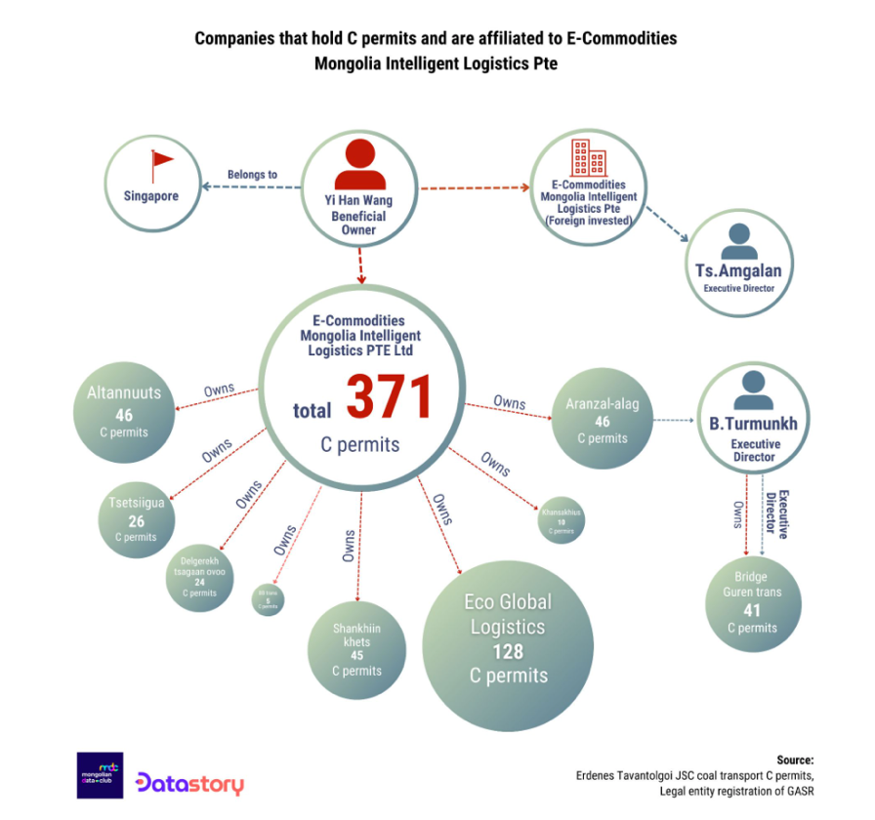
DONNEES DE PROPRIÉTÉ RÉELLE DES ENTREPRISES COTÉES EN BOURSE
ETUDE DE CAS
Mongolie
Enquête sur les propriétaires finaux de sociétés ayant obtenu des permis pour le transport de charbon et gérées par une grande entreprise d'État en Mongolie.
Notes:
In Mongolia, the Opening Extractives programme supported the CSO Mongolia Data Club, in partnership with Open Society Forum, to organise a five-month training programme to bring together and strengthen data analysis capacity of teams of investigative journalists and data scientists.
The training focused on beneficial ownership transparency, government spending and procurement processes, including for SOEs.
Several teams looked into the governance and practices of the biggest coal exporter in Mongolia. One group focused on Mongolia’s government resolution no.362, implemented in 2023. The resolution grants mining companies the right to issue “C permits” to authorise a selection of coal transportation companies to transport coal between Mongolia and China.
Lessons learnt:
1.The outcome of the tendering process announced by the State Procurement Office reported over 7,000 new permits issued. The company in focus issued over 4,000 permits to 188 companies in the first quarter of 2023. Using Mongolia Data Club’s data analysis tools, the group of journalists identified that a significant proportion of these 188 companies were interrelated and estimated that one-third of the 4,017 C permits issued by the company in January and February 2023 were “in the hands of a few people who are related to highranking government officials and the owners of foreign companies.
2. The journalists used their research to hold the government accountable and question fair allocation of C permits. Mongolia Data Club continues to provide training to support local capacity in data journalism and is now supporting the Government of Mongolia with their recently developed anticorruption package to tackle challenges in Mongolia’s SOEs.

Slide 52
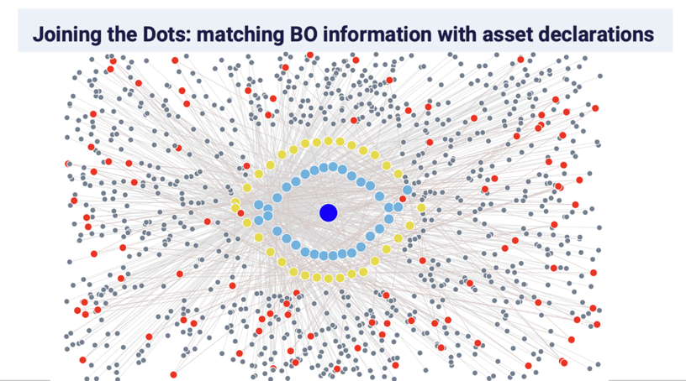
PROPRIÉTÉ RÉELLE ET CONTRÔLE DES ENTREPRISES D'ETAT
ETUDE DE CAS
Nigéria
Relier les points avec les Personnes politiquement Exposées au Nigéria : un outil reliant les informations de propriété réelle avec les personnes politiquement exposées et les données sur l'octroi de licences
Notes:
The Opening Extractives programme supported several civil society initiatives to use beneficial ownership data as part of dedicated projects. One of them was Joining the Dots with Politically Exposed Persons in Nigeria – an initiative led by Directorio Legislativo that compiles, verifies and cross-checks information on PEPs who are beneficial owners of companies holding mining, oil and gas licenses. Its objective is to foster transparency and fight corruption in the extractive sector. When analysing the data, Directorio Legislativo uncovered over 500 potential red flags and also generated some key insights. For example, most PEPs involved in potential conflicts of interest are or were part of the Legislative branch, with over 40% being members of the House of Representatives. While the full dataset included companies from oil and gas as well as mining, three quarters of companies flagged under the third type of risk alert were concentrated in the oil and gas industry.
This builds on learning from the first Joining the Dots project in Colombia, which combined data on financial declarations of public officials; the list of extractive and hydrocarbon companies operating in the country; and public procurement data to identify potential conflicts of interest. The new tool developed in Nigeria allows any user to identify three types of risk alerts for potential conflicts of interest or irregularities:
1. A PEP that is a beneficial owner of a mining, oil or gas company registered in the Nigerian state, looking at companies with active extractive licenses.
2. A PEP relative who is a beneficial owner of a mining, oil or gas company registered in the Nigerian state, looking at companies with active extractive licenses.
3. An irregularity in which a mining, oil or gas company has another company listed as a beneficial owner, instead of a natural person.
Lessons learnt:
Projects like Joining the Dots help point to concrete areas for improvement of data accessibility and usability and raise governments’ attention to potential areas of investment to support progress in this area.

Slide 53
POLITIQUE ET PRATIQUE D'ENTREPRISES
ETUDE DE CAS
Zambie
Les autorités fiscales et la société civile utilisent les informations sur la propriété effective pour obliger les entreprises à répondre de leurs obligations fiscales.
Exemples du Centre pour la politique commerciale et le développement (CTPD) et du Centre d'intelligence financière.
Notes:
The Opening Extractives programme supported a CSO called the Centre for Trade Policy and Development (CTPD) to carry out research on beneficial ownership, statutory compliance and tax compliance. Their focus was on several companies that were cited in the 2021 Auditor General’s report to have filed nil declarations for mineral royalty tax despite holding export permits and exporting various minerals, including copper, manganese and cobalt.
Lessons learnt:
The lack of declarations was found to account for mineral royalty losses to the government. According to the research team, beneficial ownership information for these companies was essential to hold their true owners to account for these losses. Facing challenges in accessing this information, they shared a number of recommendations with the government to improve compliance and ensure effective access to information in Zambia and raise governments’ attention to potential areas of investment to support progress in this area
The Opening Extractives programme also did research on the use of beneficial ownership data by Zambia’s Financial Intelligence Centre (FIC) in investigating corruption.
Lessons learnt:
The FIC identifies true company owners by following the money as part of its process of conducting financial analysis. In many cases, this differs from information disclosed to the register. For example, the FIC often identifies foreign nationals as the true beneficial owners where Zambian nationals have been disclosed; beneficial owners where none have been declared; or additional beneficial owners to those declared to the register. This is in part due to low compliance. Around a third of companies have submitted information, which the Zambian government is currently trying to improve through amending legislation and raising awareness. Nevertheless, “the register is key,” according to the FIC.

Slide 54
Questions ?

Slide 55
Merci
E-MAIL secretariat@eiti.org TÉL. +47 22 20 08 00
ADRESSE EITI International Secretariat, Rådhusgata 26, 0151 Oslo, Norvège

