Slide 1
Open contracting for oil & mining rights Gavin Hayman & Rob Pitman
Open Contracting Partnership

Slide 2
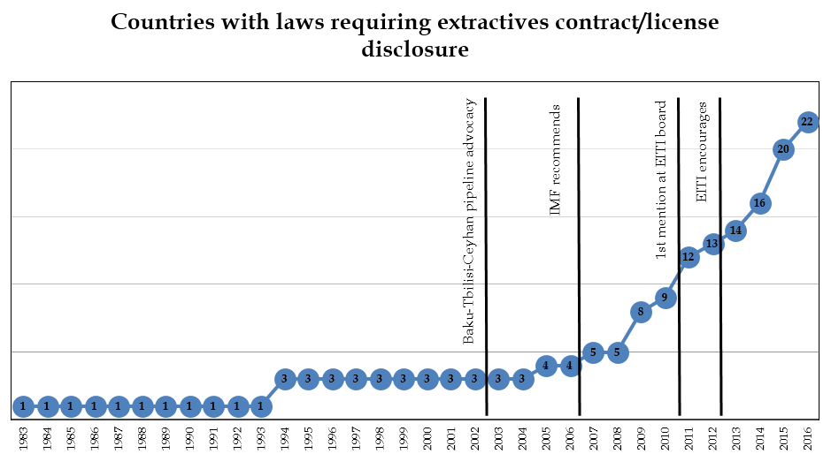
Norms are changing fast

Slide 3
Natural resource value chain
Allocation sets the tone for everything else
The Contracting, not just the contract
Surprisingly little clear, actionable guidance
Shared interest by companies & citizens in transparent,
non-discriminatory regime

Slide 4
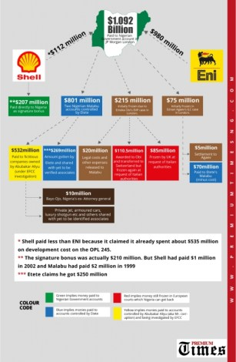
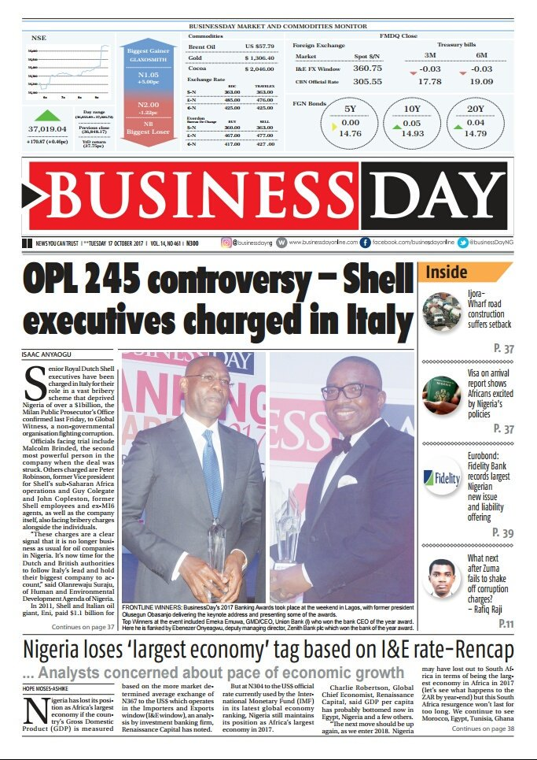
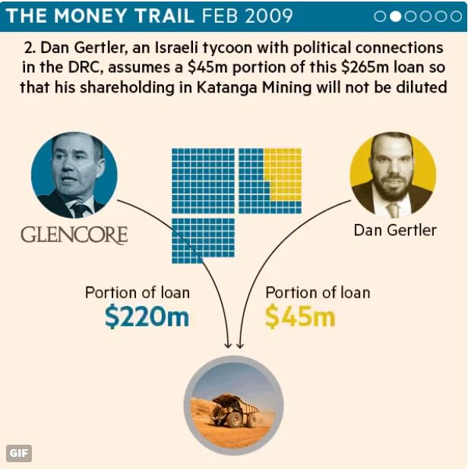
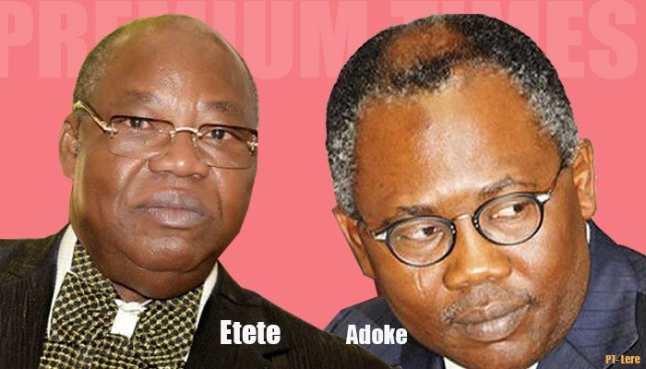
When contracting goes wrong 1
US$1 Billion

Slide 5
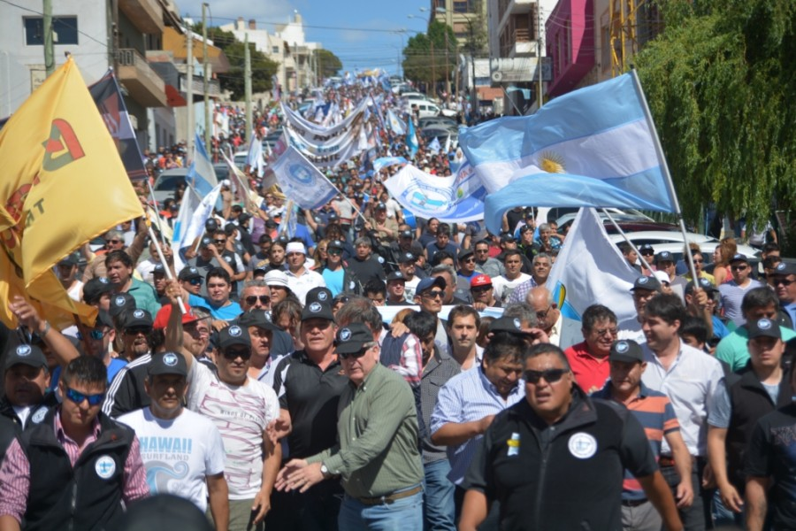
When contracting goes wrong 2
US$20 million per week

Slide 7
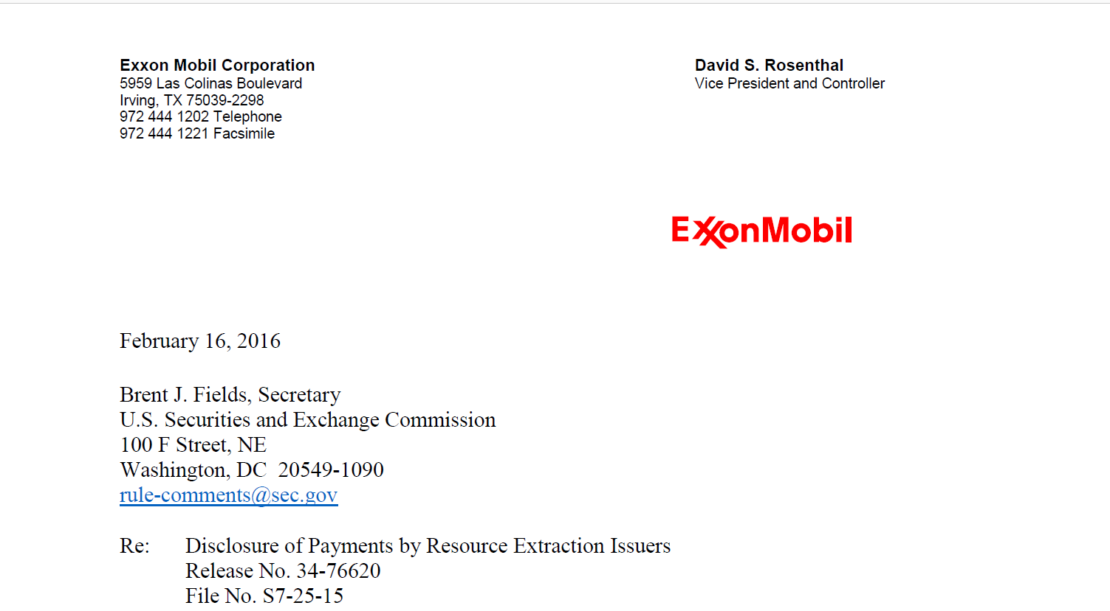
& what open contracting isn’t!
… “so-called “contract transparency” or “open contracting,” under which oil and gas contracts would be negotiated in a kind of public-utility framework whereby groups other than the parties themselves would have seats at the table and pass judgment on contract terms”.

Slide 8
16 good practices, each with examples
Featuring 30+ examples from:
Australia (NSW & NT), Canada (Alberta),
Colombia, DRC, Guinea, Lebanon,
Mexico, Mongolia, New Zealand, Norway,
Peru, Philippines, Sierra Leone and Zambia

Slide 9
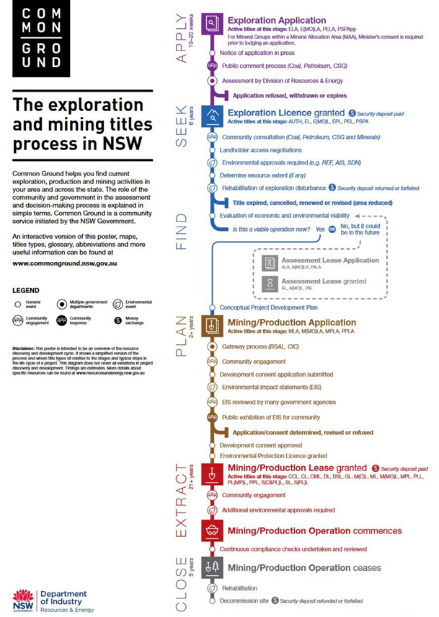
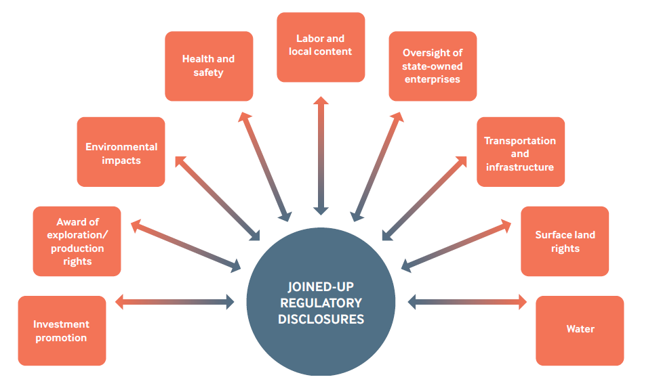
Disclosure does not always lead to transparency
“If it takes too long to find information about a process or project, it becomes easier to just join a protest ”

Slide 10
Meeting varied user needs is critical
“If all of the information is of one particular flavor then the motives of the regulator can be called into question”
Gov.
Civil
Society
Private
Sector

Slide 11
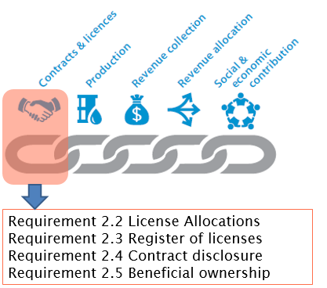
Many better practices already feature in EITI

Slide 12
Information gaps + EITI limitations are still most pronounced at the project-level
1. Implementation information
2. Completing the legal framework

Slide 13
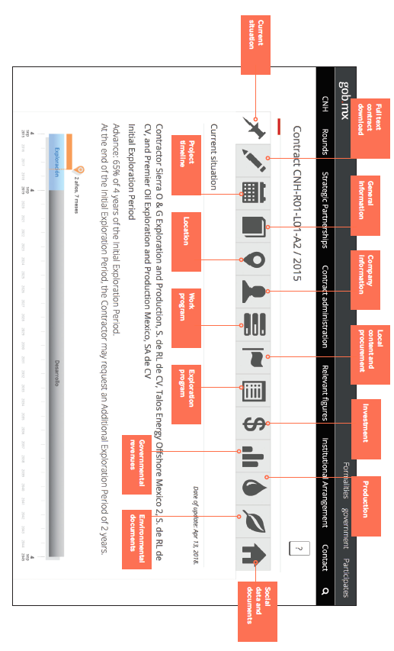
Rondas Mexico: A glimpse into the future?

Slide 14
In closing
More open contracting = better, sustainable deals!
⇒ Lots of emerging good practices to adapt & adopt
Openness has proven +ve impact:
For business & competition: eg. Mexico licencing round
For public trust: eg. 82% for Alberta Energy Regulator
For efficiency: eg. CAN$224m in savings
Time to upgrade the guidance under EITI?

