Slide 1

Formulating Effective Workplans and Measuring Results in a
COVID-19 ERA
Facilitated by: Rena Guenduez
For: Extractives Industry Transparency Initiative
Eastern Europe, Central Asia, and the Caucasus
November 18, 2020

Slide 2
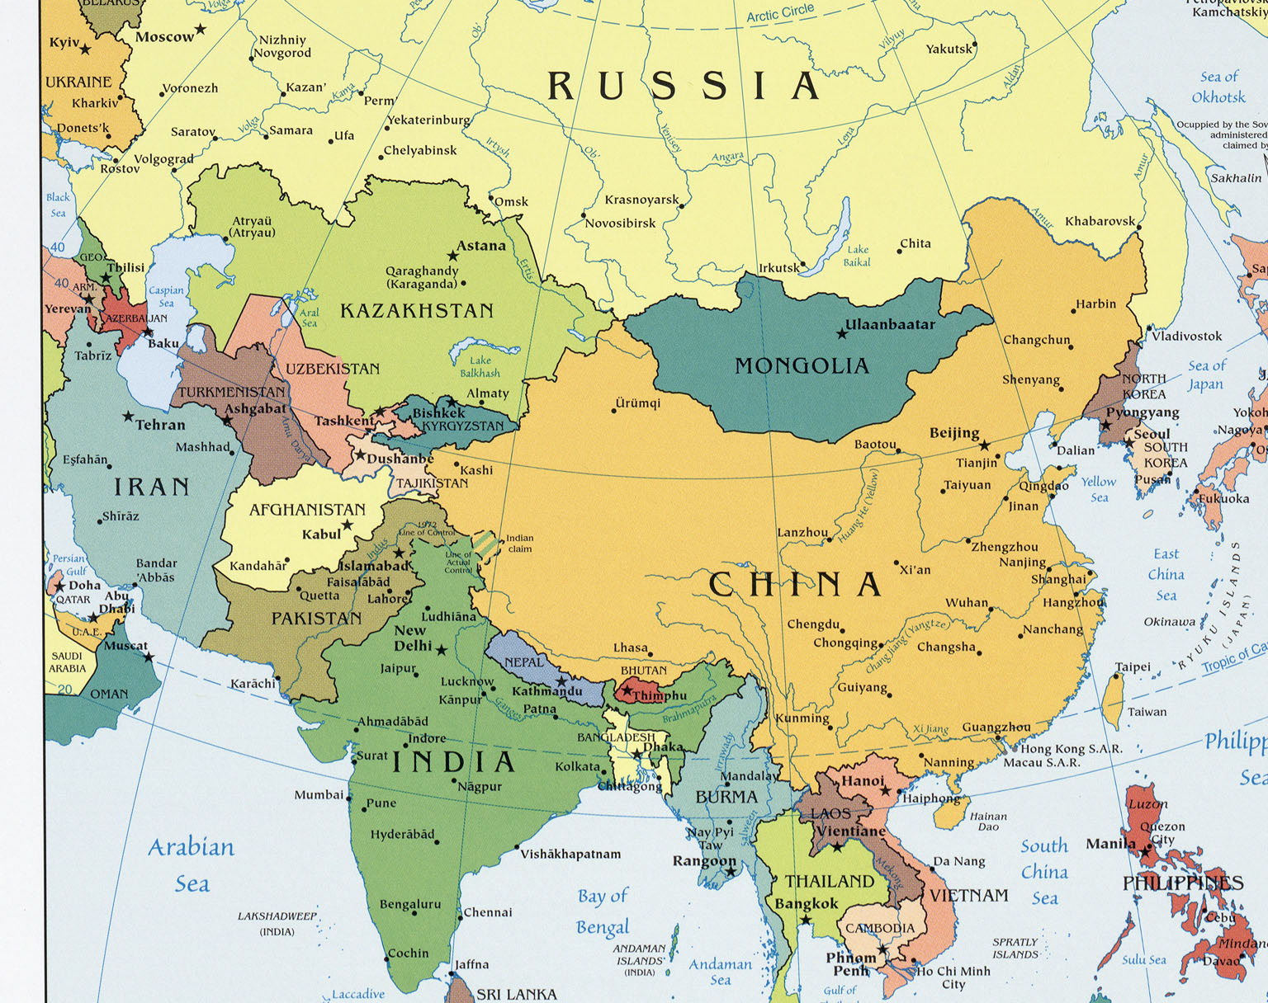
Welcome Everyone

Slide 3

Workshop Agenda
1 | Welcome and Introduction
2 | Icebreaker
3 | Overview of Work-planning and Results Based Management
4 | Quick Questions and Answers
5 | Impact and Effort Matrix
6 | 3 Action Steps to Create a Strategic RBM Integrated Workplan
7 | Sharing Session

Slide 4

Overview
Work-Planning and a Results Based Management Approach
Section 1

Slide 5

EITI Workplan Requirements
The EITI work plan forms the foundation for all EITI activities in implementing countries and ensures that implementation activities are targeted to deliver the results desired by stakeholders.
The work plan sets out why the EITI is being implemented and what issues the EITI process will seek to address.
Requirement 1.5
The multi-stakeholder group is required to maintain a current work plan, fully costed and aligned with the reporting and Validation deadlines established by the EITI Board.

Slide 6

Why? Observations and Challenges
Overall Observations
  Issues related to Clarity on “Strategic Vision” versus “Objectives”,
  Often limited MSG participation – result is NS develops Workplan,
  Constituent outreach and consultation limited
  Activities are not always achieved as planned
  Activities are not always designed effectively or strategically
  Activities are not always measured or monitored
  Annual Workplan Challenges 2020-2021
  COVID-19; face to face connectivity, consultation, communication limited
  Rethinking & redesigning activities for a digital age

Slide 7
Your Workplan and Results Based Management
Strategic Vision
Organizational tool that lays out your short - medium - long term objectives and goals
Assures you have the financial and human resources, capacity & skills to achieve your objectives & goals
Allows you to plan activities in a strategic way that is easy to manage
Helps you monitor and evaluate your activities to ensure EITI Requirements are met

Slide 8

RBM: What can it do for your organization?
Gets you thinking about what activities are important
Provides structure/framework to activities & importantly a purpose
Simplifies management and administration of operations
It provides flexibility in planning
Breaks down tasks into manageable pieces
Feeds into EITI reporting and aligns with Requirements and Standards
Allows you to meet targets and objectives
Permits the measuring of results for reporting purposes
Can be monitored and evaluated with ease

Slide 9
RBM at a Glance

Slide 10

Strategic Vision & Objectives: Ultimate Goal
Set EITI implementation objectives that are linked to the EITI Principles
Requirement 1.5 (a)
Vision is “mental image of the future”
What is your organizations vision?
How can you achieve this vision?
What activities can support your organizations vision?
Objective is the “goal or aim”
What do you want to achieve in the short – medium or long term?
How are you going to achieve this?
What are you going to produce?
Who do you need to consult?
How are you going to measure this achievement?

Slide 11

Consultation in the Age of COVID-19
Purpose: Workplan
Meetings held with COVID-19 Health and Safety Measures
Phone Connectivity
Send out regular emails to connect with Members and Constituents
Virtual On-Line Platforms (Zoom, Skype, Face Time, Messenger, Other)
Purpose: Outreach and Engagement
Regular social media posts, emailing of newsletters
Mobile Web App Platform all under One Umbrella
Create valuable and interesting content for online platforms
Create On-line Classes, Forums, Meetings or Public Debates
Engage in on-line forums or create your own
Surveys and Questionnaires
Key is to Know your audience well
IAP2 Public Participation
Inform
Consult
Involve
Collaborate
Empower

Slide 12
Activities to Support Vision & Objectives
EITI 2019 Standards & Requirements
Validation
Multi-Stakeholder Elections
Systematic Disclosure
&
Capacity Constraints
National to Community Awareness
& Engagement
Raising
Annual Reporting
&
Flexible Reporting
Annual Workplan
&
Progress Report
External Funding
&
Technical Assistance
Annual Activities
Specified Periods
National Priorities

Slide 13
Overview
Impact and Effort
Designing Meaningful Activities
Break– Out Session
Section 2

Slide 14
RBM
Simple Activity Matrix: Impact and Effort
Identify a Relevant Activity:
Level of Impact | Short Term | Medium Term | Long Term | How Many People?
Level of Effort | Human Resources | Skills and Capacity | Finances | Time?

Slide 15
3 Action Steps to Create a Strategic RBM Integrated Workplan
Section 2

Slide 16
Action 1 RBM Logic Model
ULTIMATE GOAL Change of State |  | GOAL Increased number of citizens who are aware of the benefits of transparency and good governance in the Extractives Sector and have the knowledge and skills to lead and stimulate debate around key issues and advocate accordingly
MEDIUM TERM Objective Change of Performance |  | OUTCOMES
 |  | 1 Improved ability to communicate and engage multiple stakeholders in discussions and increase awareness around natural resource allocation and sector transparency |  |  |  |  | 2 | 2 Shared stakeholder interest in increasing the knowledge and skills, especially among women, about the impacts, benefits, and opportunities of a transparent natural resource sector
SHORT TERM OUTCOMES (Change in Capacity) |  | 1.1 Stakeholders have the knowledge and skills to lead and stimulate debate around sector transparency |  | 1.2 Identify, improve, and enhance techniques and procedures for systematic disclosure | 1.2 Identify, improve, and enhance techniques and procedures for systematic disclosure |  | 2.1 | 2.1 Civil Society Organizations have the strength and knowledge to advocate for transparency in the natural resource sector |  | 2.2 | 2.2 Journalists Improved knowledge and skills for investigative journalism
OUTPUTS (Activity to Complete) |  | 1.1.0 Develop Strategic Awareness Campaigns |  | 1.2.0 Make 4th Report accessible and relevant to multi-stakeholders | 1210 Make GYEITI 1st and 2nd Report accessible and relevant to multi-stakeholders |  |  | 2110 Small Grants for Civil Society Organizations |  |  | 2210 Small Grants for Investigative Journalism
 |  | 1.1.1 Develop branded tools and materials for the outreach and public engagement |  | 1.2.1 Create forums and knowledge sharing platforms for key government agencies and officials on barriers to mainstreaming | 1220 Create forums and knowledge sharing platforms for key government agencies and officials on barriers to mainstreaming |  |  | 2120 CSO Platform for knowledge sharing and exchange on regional level |  |  | 2220 Training and professional development with Journalists
 |  | 1.1.2 Implement platforms (virtual and physical) for knowledge sharing and debate |  | 1230 Establish linkages and exchanges for advocacy of legislative reform and systematic disclosure | 1230 GYEITI establishes linkages and exchanges for advocacy of legislative reform and systematic disclosure |  |  | 2130 Network of trained “resource-revenue life cycle” champions from target communities, with emphasis on women |  |  | 2230 Development of a forum that supports ongoing training and knowledge sharing on natural resource transparency

Slide 17
Action 2 Work Breakdown Structure
ULTIMATE OUTCOME Increased number of Citizens are aware of the benefits of transparency and good governance in the Extractives Sector and have the knowledge and skills to lead and stimulate debate around key issues and advocate accordingly
Intermediate Outcomes | 1 Improved ability to communicate and engage multiple stakeholders in discussions and increased awareness around natural resource allocation and sector transparency
Immediate Outcomes | 1.1 GYEITI and Stakeholders have the knowledge and skills to lead and stimulate debate around sector transparency
Description of Planned and Proposed Activities
1100 Output- Develop Strategic Awareness Campaigns (Proposed 4 Campaigns)
1.1.1 | Identify key target audiences and communications messages through EITI consultation
1.1.2 | Define appropriate media strategies for internal and external outreach
1.1.3 | Prepare a strategic plan including monitoring and evaluation plan for each campaign
1.1.4 | Approval from the MSG
1.1.5 | Pilot and Implement Campaign Number 1 to 4
1.1.6 | Using approved key communications message: i.e. EITI and national EITI priorities message: develop campaign
1.1.7 | Prepare draft materials
1.1.8 | Approval of the MSG
1.1.9 | Finalize materials for final review
1.1.10 | Pilot Campaign Number 1 (Air Television, Platform, Webinar, Virtual Town Hall, Radio etc.)
1.1.11 | Monitor Campaign and Evaluate Effectiveness
1.1.12 | Use a mobile app technology for EITI to campaign and engage in national outreach
1.1.13 | Monitor and Evaluate impact
1.1.14 | Report on the impact in progress reports, website and on social media

Slide 18
Action 2 Work Breakdown Structure
ULTIMATE OUTCOME Increased number of Citizens are aware of the benefits of transparency and good governance in the Extractives Sector and have the knowledge and skills to lead and stimulate debate around key issues and advocate accordingly
Intermediate Objectives | 1 Improved ability to communicate and engage multiple stakeholders in discussions and increased awareness around natural resource allocation and sector transparency.
Immediate Objectives | 1.2 Identify, improve, and enhance techniques and procedures for systematic disclosure
Description of Planned and Proposed Activities
1210 Output- Make 4th & 5th Report accessible and relevant to multi-stakeholders
1.2.1 | Use the 4th Report and create it into a plain language report with infographics (story telling version)
1.2.2 | Conduct a focus group with multi-stakeholders for input into the plain language version (identify targets)
1.2.3 | Use infographics and other multi-media forms to convert the information and make it community relevant
1.2.4 | Create a dissemination strategy (through high-schools community/municipal leaders/women’s organization etc.)
1.2.5 | Create a product(s) and move forward on dissemination
1.2.6 | Engage public in better understanding of managing extractives resources
1.2.7 | Monitoring and evaluation
1.2.8 | Report on successes through social media, website and in annual progress reports
1.2.9 | Conduct a focus group with multi-stakeholders for input into the plain language version
1.2.10 | Use infographics and other multi-media forms to convert the information and make it community relevant
1.2.11 | Create a dissemination strategy for 5th Report
1.2.12 & 1.1.20 | Create a series of product(s) and move forward on dissemination
1.2.13 | Monitoring and evaluation

Slide 19

Action 3 Monitoring and Evaluation
What did we achieve with our activities?
What was the output? Or result?
Can we measure this and how?
How do we monitor progress?
How do we ensure that we are not incurring risk?
How do we evaluate this?
How do we report this and why is this important?

Slide 20
Action 3 Monitoring and Evaluation
Expected results | Indicators | Baseline | Target | Data Sources | Data Collection Methods | Frequency | Responsible
Ultimate Outcome/Goal
Increased number of Citizens that are aware of the benefits of transparency and good governance in the Extractives Sector and have the knowledge and skills to lead and stimulate debate around key issues and advocate accordingly | Enhanced perception (%) of citizens feeling that EITI is performing its role in increasing | Feasibility Study | Direct and Indirect Stakeholders | Government reform, laws, and regulations | Survey, Interviews | Annually | EITI Member organization
Intermediate Outcome/Medium Term Objective
1 Improved ability to communicate and engage multiple stakeholders in discussions and increased awareness around natural resource allocation and sector transparency | Increased Awareness and Number of Number of Activities taking place | 2019 Annual Progress Report | Member Country MSG, Constituents Stakeholders | Annual Progress Report | Survey, Interviews, Platform tracking on social media | Quarterly | EITI Member organization
Immediate Outcomes/Short Term Objectives
1.1 Stakeholders have the knowledge and skills to lead and stimulate debate around sector transparency | Increased number of activities related to EITI by constituents | TBD | MSG Constituents CSOS, Industry | TBD | Social Media tracking, conferences and fourms | Quarterly | EITI Member organization

Slide 21

EITI Requirement 7 Outcomes and Impacts
Regular disclosure of extractive industry data is of little practical use without public awareness, understanding of what the figures mean, and public debate about how resource revenues can be used effectively.
The EITI Requirements related to outcomes and impact seek to ensure that stakeholders are engaged in dialogue about natural resource revenue management. EITI disclosures lead to the fulfilment of the EITI Principles by contributing to wider public debate.
It is also vital that lessons learnt during implementation are acted upon, that recommendations from EITI implementations are considered and acted on where appropriate and that EITI implementation is on a stable, sustainable footing.

Slide 22

EITI Validation:
The Validator is expected to document that a publicly accessible EITI workplan has been agreed by the MSG, and assess whether it includes:
Objectives for implementation that are linked to the EITI principles and reflect national priorities for the extractive industries (1.5.a). The Validator should document any efforts to consult key stakeholders on the objectives for implementation (1.5.b).
Measurable and time-bound activities to achieve the agreed objectives (1.5.c).
Activities aimed at addressing any capacity constraints identified (1.5.c.i).
Activities related to the scope of EITI implementation, including plans for strengthening systematic disclosures (1.5.c.ii).
Activities aimed at addressing any legal or regulatory obstacles identified (1.5.c.iii).
Plans for implementing the recommendations from Validation and EITI implementation (1.5.c.iv).
Costings and funding sources, including domestic and external sources of funding and technical assistance (1.5.d).
A timetable for implementation (1.5.g). If the timetable is not being met, the Validator – based on evidence from key stakeholders and others – should give an opinion on whether the delays in meeting the timetable are reasonable. The Validator is invited to comment on the overall progress in implementing the workplan.
The Validator is expected to document whether the workplan has been made widely available to the public (1.5.e) and has been reviewed and updated annually. The Validator is expected to note whether or not the MSG has considered extending the detail and scope of EITI reporting to address issues such as revenue management and expenditure, transportation payments, discretionary social expenditures, ad-hoc sub-national transfers, beneficial ownership and contracts when reviewing the workplan (1.5.f).

Slide 23

Sharing Session

Slide 24

Questions and Answers

